Slide 1


Integrated Environmental Assessment Training Manual for the Arab Region
Module 2
National IEA process
design and organization

Slide 2
Sessions at a Glance
Session 1: Introduction and objectives
Session 2: IEA process features
Session 3: Overview of the IEA process

Slide 3
Purpose of Module 2
Understand the role, design and organization of the IEA process;
Identify the main steps and activities to achieve IEA’s goals.

Slide 4
Objectives of Module 2
To understand the main stages of the IEA process.
To understand the institutional arrangements.
Learn to lead an IEA process in an interactive and participatory way.
To identify the main activities and procedures for preparing IEA reports and promoting their findings.
To be aware of and able to manage the challenges of running the process while involving the public.

Slide 5
Key IEA Process Attributes
Participatory
Multi-disciplinary & Multi-sectorial
Integrated
Multi-product
Institutionalized

Slide 6
IEA process objectives
  To bring together organizations and people with an interest in IEA that may not have a history of collaboration.
  To involve the policy-makers in order to secure their support for the process and its key findings.
  3. To facilitate the process of interaction based on a common methodology, fostering the dialogue between science and policy.

Slide 7
Some IEA Activities
Establishment an institutional framework for collaboration and organization of the IEA
Establish and maintain an information base.
Discussion forum.
Capacity building.
Define and implement a communication strategy.

Slide 8
Basic Conditions for IEA Process
Political Will and commitments.
Adequate management and technical / scientific capacity to conduct the process.
Experienced officials on environmental issues to lead and enhance the analysis.

Slide 9
Group Discussion: IEA in Your Country
Identify the main organizations that use an integrated approach to lead participatory processes focused on environment-development interactions in your country. Explain briefly the main activities that were/are involved.
What key initiatives are going on in your country that could be strengthened by IEA process?
What opportunities do you see in your country to help drive the IEA process?

Slide 10
GEO: An Integrated Approach
Answers 5 Key Questions
Most assessments stop at this question

Slide 11


Examples of Legal Mandate
Syria case Article 10 provision 3 and article 17 provision 8 of the environmental protection law No.50 declared in 2002. Source: Environment protection Law. Ministry of Municipalities and Environment
The Egyptian mandate case
Article 5 of chapter 2 of Law number 4 of 1994
http://www.eeaa.gov.eg/english/law4.doc
http://www.eeaa.gov.eg/english/law4_arb.doc

Slide 12
The 7 Typical Stages of the IEA Process

Slide 13
The role of participation in the IEA Process
Who are the Stakeholders?
  Their interests are affected by environmental problems or their decisions have environmental effects;
  Have information, resources or expertise required for policy formulation and strategy implementation;
  Control key mechanisms for policy formulation and strategy implementation.

Slide 14
Examples of potential Stakeholders?
Leaders;
Officials of national and regional public offices
Political party representatives;
Scientific community;
Representatives of industry or entrepreneurial associations;
Private sector representatives;
Professional schools or associations;
Academia (universities and research centres);
Non-government organizations;
Mass media;
Youth groups, women groups;
Indigenous communities and groups;
Civil society organizations;
Community and religious groups; and
Opinion leaders.

Slide 15
Principles for engaging stakeholders
Inclusivity
Include a full range of stakeholders representing different interests, including marginal and vulnerable groups.
Pertinence
  Include stakeholders with significant interest in the process.
Gender perspective
  Inclusion of women and men allows formulating and implementing better integrated policies and strategies.

Slide 16
Identifying stakeholders
(role and interest)

Slide 17
Keeping stakeholders engaged in the process
Listen and take into account their points of view
Keep them informed of the activities and results of the process
State clear rules for participation and define expectations
Incorporate key stakeholders in the monitoring process
Develop a range of activities to keep close relationships with the stakeholders

Slide 18
Exercise: Identifying Stakeholders
As individuals, identify the main stakeholders in your country that should be included in an integrated environmental assessment process.
a. _____________
b. _____________
c. _____________
For each stakeholder, list the main organizations or people that should be included.

Slide 19
Stages of The GEO-based IEA Process

Slide 20
STAGES
ACTIVITIES
OUTPUTS
Stage 1 Start-up (4-6 weeks)
Secure legal mandate for environmental assessment and reporting. Identify a local technical team within the lead agency. Develop a basic outline for conceptual framework and process, capacity, time and resources required. Hold start-up meetings to discuss, adjust and finalize the process and institutional arrangements. Secure commitment for resources and in-kind contributions.
MOUs reviewed Conceptual framework
Stage 2 Institutional set-up (1-3 months)
Define roles and responsibilities of the political and technical partners. Establish mechanisms of coordination among partners and collaborating institutions. Define an institutional framework. Discuss the elements for the impact strategy. Prepare a stakeholder map.
MOUs signed Institutional Framework Stakeholders map
Stage 3 Scoping and design (2-4 weeks)
Clarify methodological issues. Establish geographic boundary and detailed timeline for producing the report. Identify key environmental issues. Identify indicators, data requirements and sources of information. Draft an outline of the report. Identify the target audience. Develop the impact strategy. Discuss the elements for a communications and outreach strategy.
Design document (including annotated structure or outline). Impact strategy
12/19/2012

Slide 21
Stage 4 Planning (4-6 weeks)
Define activities in the process, assign responsibilities and identify expected outputs. Allocate financial and human resources. Review and adjust the impact strategy and define indicators of impact. Develop a communication and outreach strategy. Establish a monitoring and evaluation system.
Implementation plan. Adjust impact strategy. Communication and outreach strategy.
Stage 5 Implementation (10-12 months)
Validate priority environment/development issues and their connection according to the IEA framework. Collect process and analyze data and information. Present and discuss preliminary results with relevant partner organizations. Write draft report, organize peer review and finalize report based on feedback. Translation and publication (hardcopy, CD, website, etc).
Report and complementary products in different media.
Stage 6 Communication of results & outreach (1-2 months)
Stage 6 Communication of results & outreach (1-2 months)
Promote different IEA products and messages. Organize interviews with the media. Organize presentations for stakeholders.
Report and complementary products in the public domain.
Stage 7 Monitoring, evaluation & learning (1-2 months)
Evaluate the process. Identify lessons learned. Evaluate the impact of the process in terms of contribution to policy planning capacity building and public awareness.
IEA impacts and recommendations for the future.
Stages of the National IEA Process

Slide 22
Stage 1: Start-up
STAGES
ACTIVITIES
OUTPUTS
Stage 1 Start-up (4-6 weeks)
Secure legal mandate for environmental assessment and reporting. Identify a local technical team within the lead agency. Develop a basic outline for conceptual framework and process, capacity, time and resources required. Hold start-up meetings to discuss, adjust and finalize the process and institutional arrangements. Secure commitment for resources and in-kind contributions.
MOUs reviewed Conceptual framework

Slide 23
Key Outputs from Start-Up
Memorandum of Understanding
Conceptual framework
Prepared by the national environmental authority and the core team
  includes:
    general organization
    methodology
    the IEA process
    guidance for implementation
    an assessment of resources required
    further fund-raising or identification of in-kind contributions

Slide 24
Stage 2: Institutional Set-up
and identification of stakeholders
Stage 2 Institutional set-up (1-3 months)
Define roles and responsibilities of the political and technical partners. Establish mechanisms of coordination among partners and collaborating institutions. Define an institutional framework. Discuss the elements for the impact strategy. Prepare a stakeholder map.
MOUs signed Institutional framework Stakeholders map

Slide 25
Key partners
National Environmental Authority
Technical team
National collaborating institutions (public and private)
UNEP Collaborating Center
UNEP Regional DEWA

Slide 26
Typical organizational framework, Arab Region
UNEP DEWA Regional
CAMRE
Collaborating Centers
AGU-ACSAD
CEDARE
Lead Institution
Technical team
Task force committee
National partners
Ministries of environment
Other
Stakeholders
NGOs/UN agencies/..

Slide 27
Lead Institution
Manages and coordinates the process
Must have a legal mandate to do IEA
National agency such as Ministry of Environment or Environment National Council
Private institution (e.g., NGO, university) with support from government

Slide 28
Criteria for Selecting the Lead Institution
  Capacity to engage key stakeholders
  Sufficient capacity to manage the process
  Recognized ability to carry out high quality assessment and reporting on time and on budget
  Acceptable to a wide range of stakeholders

Slide 29
Criteria for selection of a Local Technical Team
  Experience in IEA
  High public profile and recognized leadership capacity
  Good relationship with the NEA
  Capacity to dialogue with different stakeholders
  Experience in organizing and facilitating workshops
  Sufficient human resources to dedicate time to a demanding assessment

Slide 30
Types of Technical Teams
Small technical team (3-5 people)
  One researcher responsible for whole report
  Team of researchers in charge of many aspects of the report, from data collection, to analysis, writing and organizing consultations
Extended technical team
  Small technical team can add experts that have access to data and information in specific areas

Slide 31
Collaborating Institutions and other Stakeholders
Collaborating institutions have a direct role in the IEA.
Secondary stakeholders may include:
  social and business leaders
  political party representatives
  scientific community
  representatives of private sector and business associations
  professional schools, associations and academia
  NGOs
  media
  Women’s and youth groups
  indigenous communities
  civil society
  religious groups
  … many others

Slide 32
Activating Relationship with the Collaborating Institutions
  Identify a contact person for the duration of the process
  Establish a clear definition of their role and responsibilities
  Keep the contact person regularly informed about the IEA progress

Slide 33
GEO Collaborating Centres
  Clarify methodological issues in the process.
  Provide technical support to the local team for preparing workshops.
  Help facilitate capacity building and other workshops.
  Review drafts.

Slide 34
Developing an Impact Strategy
What is an impact strategy?
Steps that enable your work to be effective
Why an Impact Strategy?
Increase impact a national IEA process has on policies.

Slide 35
Steps in Developing an Impact Strategy
  Anchor the assessment with a change statement
  Relationship management
  Knowledge management
  Management of opportunity
  Monitor, evaluation and improvement

Slide 36
Steps in Developing an Impact Strategy
Step 1
Changes you want
to influence with your work
External political environment
Other influences on decisions and decision makers
Step 5:
Monitoring, evaluation, improvement
Step 2
Who?
Identify Relationships:
Decision makers; influencers;
media; people who work for NGOs, etc.
Step 4
How?
What are the opportunities?
Publishing; conferences
and workshops;
news articles; etc.
Step 3
What?
Knowledge to be
gathered through the
assessment, and how it is to be gathered
Checkpoint:
Timing: what is the current “issue cycle”?

Slide 37
Stage 3: Scoping and design
Stage 3 Scoping and design (2-4 weeks)
Clarify methodological issues. Establish geographic boundary and detailed timeline for producing the report. Identify key environmental issues. Identify indicators, data requirements and sources of information. Draft an outline of the report. Identify the target audience. Develop the impact strategy. Discuss the elements for a communications and outreach strategy.
Design document (including annotated structure or outline). Impact strategy

Slide 38
Exercise: Challenges and strategies for a national IEA
  Individually, consider:
  Why you think it is important for your country to be involved in a national level IEA?
  What you would hope to see as a result of that involvement?
  What constraints you might face?

Slide 39
Planning outcomes
  Participants understand the IEA methodology
  Timetable and well- defined results at each stage
  To identify the requirements
  Coordination mechanisms
  Review and adjust the impact strategy and define measures of impact
  Develop a communication and outreach strategy
  Establish a monitoring and evaluation system.

Slide 40
Stage 4: Planning
Stage 4 Planning (4-6 weeks)
Define activities in the process, Assign responsibilities and identify expected outputs. Allocate financial and human resources. Review and adjust the impact strategy and define indicators of impact. Develop a communication and outreach strategy. Establish a monitoring and evaluation system.
Implementation plan. Adjust impact strategy. Communication and outreach strategy.
Stages of the National IEA Process

Slide 41
Example: IEA Process Timetable

Slide 42
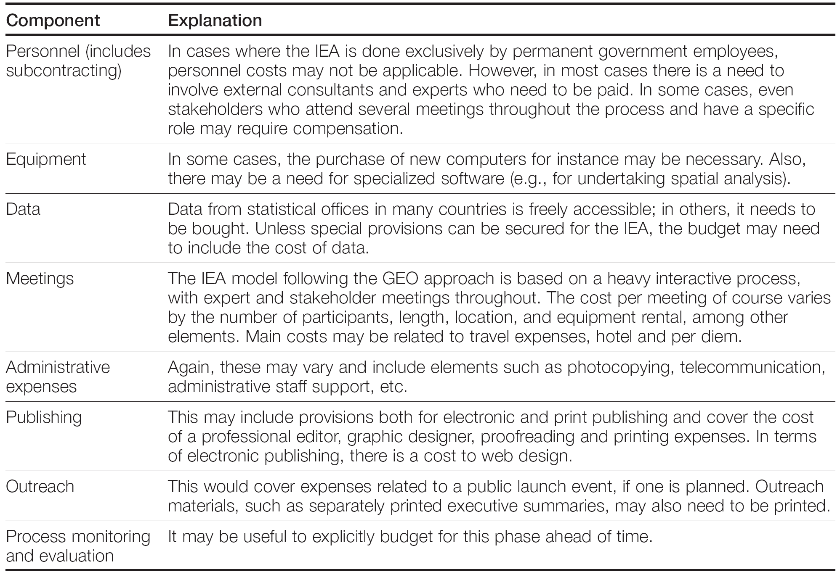
Example: Budget Structure

Slide 43
Exercise: Applying the Scoping Steps
What are the characteristics of the planning process for IEA in your countries.
In your opinion what are the main conditions for an effective IEA in your countries?
Share results in plenary.

Slide 44
Stage 5: Implementation
Stage 5 Implementation (10-12 months)
Validate priority environment/ development issues and their connection according to the IEA framework. Collect process and analyze data and information. Present and discuss preliminary results with relevant partner organizations. Write draft report, organize peer review and finalize report based on feedback. Translation and publication (hardcopy, CD, website, etc).
Report and complementary products in different media.

Slide 45
There are three main components of the implementation stage:
  1. Identification of environmental problems, indicators and sources of data
  2. Data collection, analysis and writing
  3. Translation and publication

Slide 46
IEA Structure
  Overview of economic, social, political and institutional setting.
  Human pressures on the environment
  Assessing state and trends.
  Analyzing the impact of the SoE
  Assessing the responses of government and society.
  Identifying Policy options and scenarios
  Conclusions and recommendations.

Slide 47
Stage 6: Communication & Outreach
Stage 6 Communication of results & outreach (1-2 months)
Stage 6 Communication of results & outreach (1-2 months)
Promote different IEA products and messages. Organize interviews with the media. Organize presentations for stakeholders.
Report and complementary products in the public domain.

Slide 48
  Make your messages understandable to your audiences.
  Make information relevant to your audiences.
  Shape the delivery system for the audience.

Slide 49
Communication Options
Classic methods, largely oriented to print
  reports, synopsis report, bulletins, articles, newsletters
Radio and TV
  interviews, pre-recorded messages
Internet-based reporting
  put report on line in various formats, interactive reports, active systems based on electronic bulletins by e-mail

Slide 50
Stage 7: Monitoring, Evaluation and Learning
Stage 7 Monitoring, evaluation & learning (1-2 months)
Evaluate the process. Identify lessons learned. Evaluate the impact of the process in terms of contribution to policy planning capacity building and public awareness.
IEA impacts and recommendations for the future.
Stages of the National IEA Process

Slide 51
  Evaluation of Process
    were expected results accomplished in each stage?
  Evaluation of Impact
    was the analysis relevant, legitimate and credible?
    what were the impacts of IEA outputs on policymakers, policy and environmental trends?
  Recommend and make improvements for the next IEA process.

Slide 52
Discussion: Evaluation and Learning
In groups of 5-7, discuss the following questions:
Why is it important to evaluate National IEA processes?
Which measures will be good to keep track of the process?
Which mechanisms could be implemented to promote continuity and continuous improvement of the IEA reporting processes?
Report group discussion results in plenary.

