Slide 1


Integrated Environmental Assessment Training Manual for the Arab Region
Module 3
Developing an impact
strategy for your IEA

Slide 2
Session at a Glance
Session 1: Introduction
Session 2: The Impact Process
Session 3: Building an Impact Strategy

Slide 3
OVERVIEW
This module will focus on methods and strategies to position and deliver a national EIA.
The impact process takes time, and involves a real emphasis on being clear and strategic in identifying the changes you want to see as a result of your assessment.
The process focuses on:
- Building relationships with key people;
- Finding out what they know already and what they need to know;
- Creating opportunities to get your messages across;
- Generating a dialogue, and
- Gain the attention and support of those who may have been non- responsive to your assessment.

Slide 4
Outputs Of The Training Module
A skeleton of impact strategy for the participants next SoE/IEA report.
That you see yourself as someone capable of having a real impact on decision-making.

Slide 5
Learning Objectives
Be able to articulate the reasons for conducting an Integrated Environmental Assessment.
Understand the political context for implementing the results of an IEA. How are changes made in policy and practice in your country.
Move beyond awareness of the importance of impact and communications to develop strategies to achieve impact.
Increase recognition of who you want to reach and how that will affect how you undertake your work.
Recognize that a meaningful impact is a dynamic result, requiring an ongoing strategy which is much more than a single product at the end of an assessment.

Slide 6
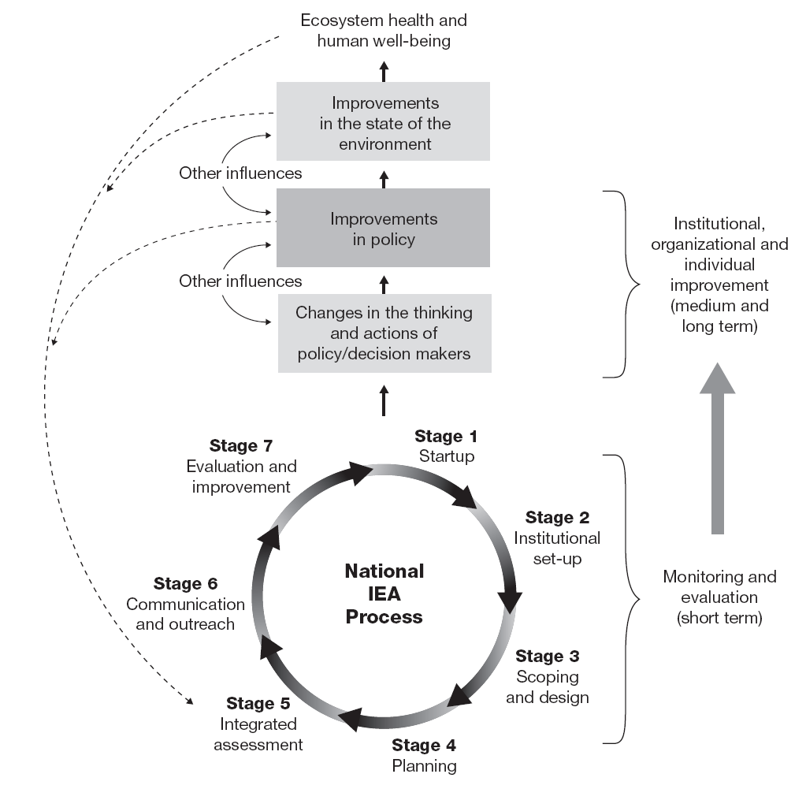
Conceptual Understanding of the National IEA Process

Slide 7

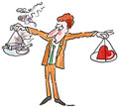
Types of Decision-Making
The ideal rational type
Confused type
Muddling Through

Slide 8
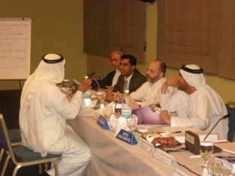

The impact of Science on Policy
and vice versa
Assessment scientists and practitioners need to use credible scientific knowledge to impact decision-makers.
They should also be impacted, and explore the areas and answers that political actors are seeking.
If decision-makers impact you with the sought answers, then you are in a better position to impact them likewise.

Slide 9

Definition of Impact
In simple terms, it is the ability of the assessment to lead governments and actors into adopting different policies and behaviors from what they originally intended. Yet, this lacks much action.

Slide 10
Broader Meaning
Changes to an issue domain.
Defined as the areas in which relevant actors seek to address an issue of common interest, characterized by different beliefs and policy preferences.

Slide 11
There is also a need to acknowledge
the non-assessment related factors
like, social and technological
solutions, that could bring about change
In the issue areas

Slide 12
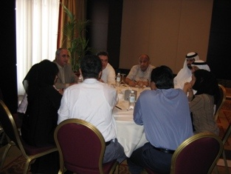
Helping Points
Assessment is a social process, where scientists, policymakers, and other relevant actors collect data, conduct analyses, explain, discuss, learn, and interact with each other, regarding the assessment issues
The process and not the product

Slide 13
Potential users must view the assessment as:
  Addressing actual issues
  Legitimate
  Credible

Slide 14
Session at a Glance
Session 1: Introduction
Session 2: The Impact Process
Session 3: Building an Impact Strategy
Session 4: Implementing an Impact Strategy

Slide 15
The Impact Process
What is an impact strategy?
When do you prepare an impact strategy?
Why would you need an impact strategy?

Slide 16
What is an Impact Strategy?
An impact strategy consists of the steps you take to ensure that the work you do will lead to real progress on key issues or concerns.
It is proactive in nature, and adaptive in a public policy environment where priorities of governments and citizens can shift and change.
Source: IISD (2004)

Slide 17
When is it Prepared and Who Prepares it?
The impact strategy is initiated in the “institutional set-up” stage of the GEO process. It is formalized in the “scoping and design” stage, implemented in stages 4, 5 and 6, and regularly monitored, assessed and improved.
The manager of the GEO/EIA process is responsible for:
  Developing the strategy
  Implementing the strategy
  Monitoring performance on the strategy to ensure results are being achieved, and modifying or adjusting the strategy as needed.
Notes:
17
An impact strategy should be prepared once you have initiated the process for an integrated environmental assessment. It is part of the “institutional setup” for a GEO-type process (see Module 2). The manager, or management team, for the GEO process should be responsible for:
developing the impact strategy, or ensuring that an impact strategy is developed;
implementing the strategy; and
monitoring performance on the strategy to ensure that it is achieving the results you are seeking, and modifying or adjusting it, if necessary.

Slide 18
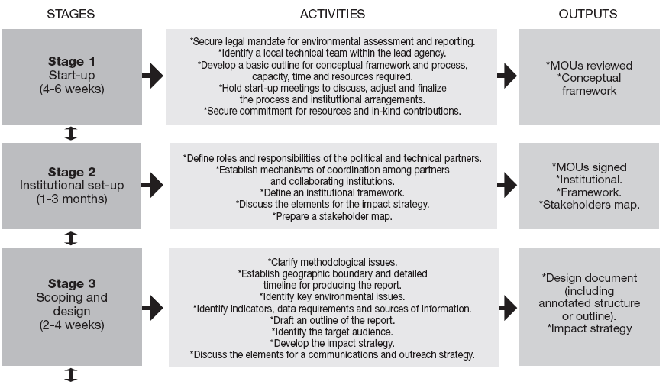
Stages Of The GEO-based IEA Process

Slide 19
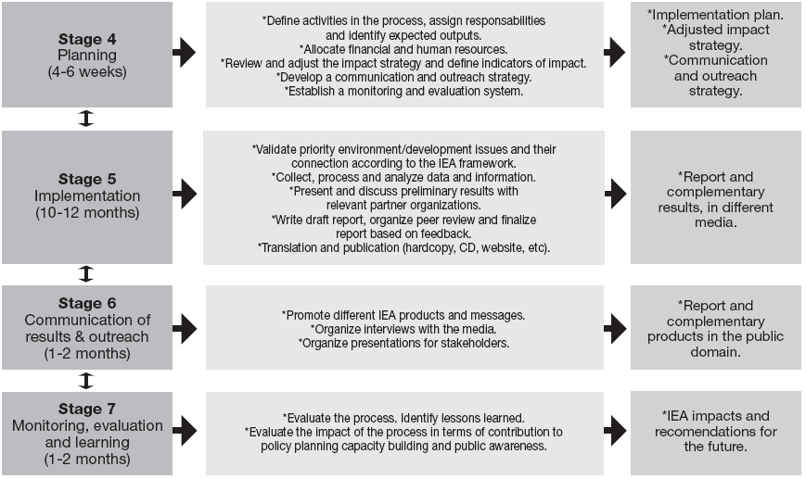
Stages Of The GEO-based IEA Process

Slide 20
Considerations for an Impact Strategy
Why has the assessment been mandated?
  What is the political and bureaucratic context in which it is taking place?
  How can you build bridges with those who might not be in favour of the process? It is important to learn who supports the findings and recommendations of the assessment.
If SoE reports were prepared in the past, what happened to them?
  What priorities for action were recommended?
  How were they acted upon?
Who is involved in the assessment process?
  Do participants add or detract legitimacy from the process?

Slide 21
Considerations for an Impact Strategy
What is taking place in the current bureaucratic context that might:
  Prevent senior bureaucrats from supporting your findings
  Enable them to apply your findings in support of a certain agenda
  What is taking place more generally in your country that might lead to a window of opportunity?

Slide 22
Considerations for an Impact Strategy
There are many ways to get a sense of the political and public environment in which your assessment is taking place:
Investigate with current/former bureaucrats their recollections about the process involved in securing the mandate to do the assessment.
Review the relevant statutes and regulations that govern the assessment process.
Monitor political and social coverage in the national media, what does it think worth reporting.
Attend meetings of NGOs and community based organizations to assess their priorities.

Slide 23
Exercise: Setting the Stage for an Impact Strategy
In groups of 3–4, discuss the context of a previous national assessment in your country.
A.
What was the context for previous assessments with which you are familiar?
Are you operating under a legal or policy mandate?
Are your assessments part of a larger program for government accountability?

Slide 24
Exercise: Setting the Stage for an Impact Strategy
B.
Why were your assessments mandated, directed or commissioned?
Were your assessments a high priority for your superiors?
What other things concern them?

Slide 25
Exercise: Setting the Stage for an Impact Strategy
C. How did/will higher-level decision-makers use your findings?

Slide 26
Understanding Issue Attention Cycles
Understanding what the issue attention cycles are will help in choosing actors to engage with and when to engage them.
    What is on the public, political and bureaucratic radar screen?
    Where will new information and recommendations for action be most useful?

Slide 27
Understanding Issue Attention Cycles
In West Asia Region as well as other regions the social attention to global environmental risks has tended to lag years and even decades behind scientific and technical developments.
A cycle can rise relatively rapidly, remain high for a short period of time, and then drop off again.
In other cases, there may be two cycles for a specific issue.

Slide 28
Three Phases of Issue Development
Phase 1:
Gradual build-up of scientific and analytic capacity through research, monitoring and assessment activities.
Over a long period; characterized by relatively low public attention, society's capacity to address new issues gradually accumulates.
It is unlikely that new institutions will become involved to a major extent with the issue.

Slide 29
Three Phases of Issue Development
Phase 2:
Rapid rise in public attention, a renegotiation of leadership, and an emergent need for new institutions.
The need for coalitions of actors to push the issue forward becomes recognized.
Coalition building is encouraged over increased participation by individual or isolated groups of actors.

Slide 30
Three Phases of Issue Development
Phase 3:
Linkages between the knowledge-intensive and action-intensive management functions increase in frequency and run in both directions: knowledge influences action and vice versa.
There is also a general decline in public attention to the issue.

Slide 31
Phases of Issue Development According to Level of Attention

Slide 32
Discussion: Issue Radar
Discuss in plenary…
What issues are of most concern to citizens in your country right now?
How is your political leadership responding?
How might you align findings from your assessment with these concerns?

Slide 33
The climate change issue in West Asia Region
Attention to climate change issues in West Asia Region and particularly in GCC states was illustrated by the decisions taken during the 3rd OPEC Summit held in Riyadh. The “issue linkage” appears to have been a critical factor in getting climate change onto the agenda of the public and the policy-makers. A large fund ($750 million) was committed during the summit by Saudi Arabia, Kuwait, Qatar and United Arab Emirates to support research and development of cleaner technologies toward reversing the current trends in global warming.

Slide 34
Session at a Glance
Session 1: Introduction
Session 2: The Impact Process
Session 3: Building an Impact Strategy

Slide 35
An Impact Strategy Builds on Communications Activities
 | Impact Strategy | Traditional Communications Activities
Purpose | Goal is to effect change and to identify your potential role as a change agent. | Goal is to ensure people understand the findings and recommendations.
Audience | Small group of key actors and those who have access to those actors. | Broader audiences.
Timing | Developed at the beginning of the assessment process, monitored and adjusted throughout the process. | Part of the impact strategy; usually implemented towards the end of the strategy when findings and recommendations are known.

Slide 36
Steps in Building an Impact Strategy
Creating the change statement. What you would like the impact of your assessment to be?
Relationship management. Identify the key actors that you are seeking to influence, and build connections to them.
Knowledge management. Gather and analyse the knowledge for the assessment.
Opportunity management. Move the knowledge into the hands of those you want to influence.
Monitoring and improvement. Determine whether your impact strategy is working, and adjust it as necessary.

Slide 37
Considerations for building an Impact Strategy
Who is involved in the process, are they adding:
Legitimacy, which ensures that the assessment is carried out in a fair and politically acceptable way, taking the views and values of the respective audiences into account;
Saliency, which means that the assessment addresses the information needs of its users, and
Credibility, which means that the technical and scientific reliability of the information.

Slide 38
Model for an Impact Strategy
Source: IISD (2004)

Slide 39
1. Creating the Change Statement.
An impact strategy is anchored by the “change statement". What would you like to see changed or done differently as a direct result of your assessment?
An impact statement may be broad, may identify key policy mechanisms, or may focus on one priority area.

Slide 40
Examples of Change Statements
A change statement may be broad, such as getting policy-makers to use the IEA.
For example…
Key departmental decision-makers will use the information gathered during the assessment to develop policy priorities, departmental strategic plans and budgets.
Or:
State, as well as national, level planners will review the findings of the assessment, and prepare internal policy briefs on how they will address the recommendations of the assessment.

Slide 41
Examples of Change Statements
The change statement could also identify key policy mechanisms.
  Example…
  The Poverty Reduction Strategy Paper planning and implementation process is adjusted to increase attention to environmental degradation, protection and rehabilitation, based on the findings of the assessment.

Slide 42
Examples of Change Statements
The change statement could focus on one key priority you want your findings to address.
  Example:
  The government institutes a national watershed management plan that takes into consideration the responsibilities and capacities of villagers to protect and rehabilitate their water sources.

Slide 43
Step 2 : Relationship Management
Identify the people you want to reach and obtain a better understanding of their perspective.
  How do these people acquire information?
  Who do they trust?
  Who are the people they listen to, and how can you reach them?
Central to determining who to reach is the core concept of relationship management: maintaining the connections and influence over time.

Slide 44

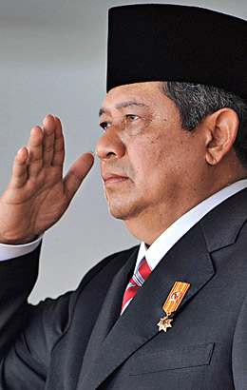
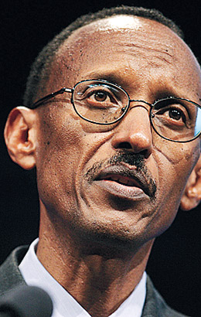
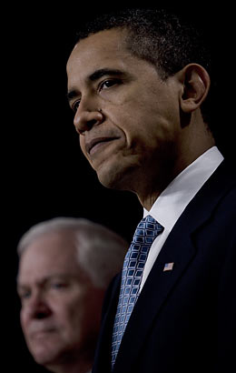


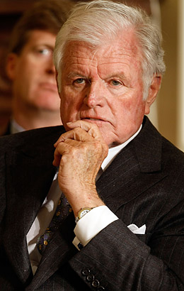
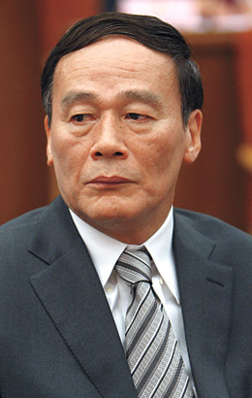
Leaders and Revolutionaries

Slide 45




Artists and entertainers

Slide 46

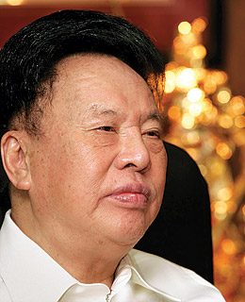




Donors

Slide 47
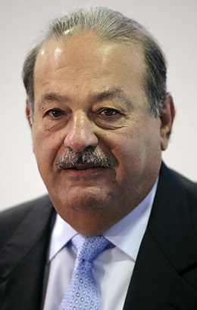
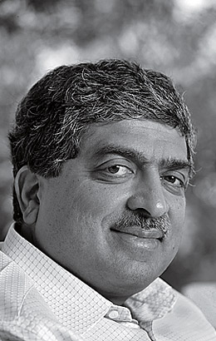
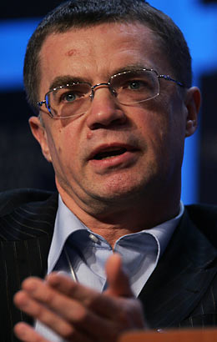



Developers and top businessmen

Slide 48
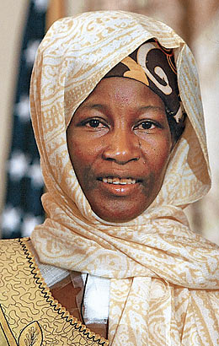
Heroes and Pioneers

Slide 49
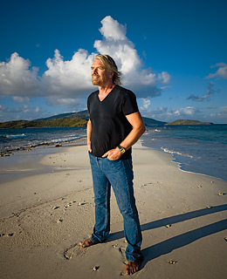

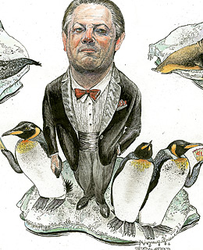

Scientists and Intellectuals

Slide 50

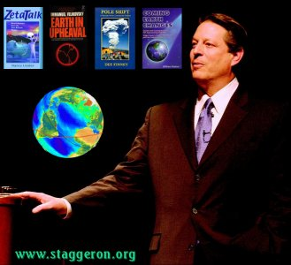

Slide 51

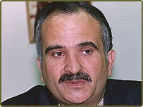
Faces from West Asia

Slide 52
Step 3 : Knowledge Management
Analyse what they need to know, and what you need to know that will help them take or influence the decision.
  Consider how to build trust in your final product.
  Increase the relevance and salience of your findings by including participation of decision-makers in the process.
  Ensure greater legitimacy through participation of scientists in the knowledge development process.

Slide 53
Step 4: Opportunity Management
Move knowledge into the hands of those you want to influence.
Take advantage of key windows to move the assessment findings into the hands of others, and creating opportunity directly.
The development of “key messages” is essential in this step.
  Key messages are short, simple, plain language statements that capture the essence of the work.

Slide 54
Step 5: Monitoring, Evaluation and Improvement
Measure incremental changes in attitudes, actions and behaviors that are a direct outcome of your work.
Monitoring, evaluation and improvement should be in place to identify and map incremental changes that will lead to decisions or changes you are seeking.
Track interactions with your contacts and the media.

Slide 55
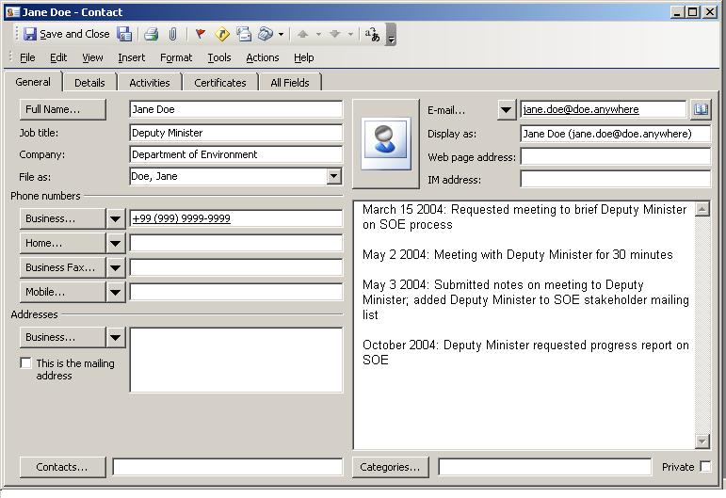
Example of a Database

Slide 56
A Possible Continuum of Behavior Changes in Target Actors
Receiving information
  Information sent to target actors
  Meetings are set up with target actors
Seeking and processing information
  Target actors seek information from others to verify information in the IEA
  Media reports messages that are consistent with IEA
Acting
  Target actors issue new policy briefs, white papers, frameworks, regulations, other responses.
Demanding
  Target actors ask for more work from IEA process leaders (e.g., follow-up investigations, more in-depth assessments).

Slide 57
Exercise: The Impact of IEA and GEO
In groups of 3–5, consider:
  What kinds of changes do you feel are reasonable and meaningful from such an assessment?
  How would you know whether or not such changes were made and were sustainable?
In plenary, one spokesperson report for the group, summarizing changes to be expected.

Slide 58
Case Studies of Assessments that had Impact
Social Learning Group (2001) found that self-conscious process evaluation was rare in the management of global environmental risks.
Consequently, there are few examples of formal “impact strategies” to draw from
Nonetheless, we can learn from assessments that have had some impact success.
These can provide the participants from the Region pointers for the development of an impact strategy

Slide 59
Case Studies of Assessments that had Impact
Millennium Ecosystem Assessment (MA).
Kingdom of Bahrain Strategy to enhance Public Awareness and Decision-making.
Yemen National State of Environment Report (2001).

Slide 60
Kingdom of Bahrain Strategy to enhance Public Awareness
Step 1: Impact statement: what did the strategy want to see changed as a result of the assessment?
Bahrain's awareness strategy stated that, a key step towards meeting the challenges posed by a changing climate is to initiate a national dialogue to raise awareness among key policymakers, civil society organizations and NGOs about its causes and potential consequences.
A shared understanding among these individuals and institutions is essential, not only for mobilizing public support, but also for undertaking the range of participatory activities that will undoubtedly be needed.

Slide 61
Kingdom of Bahrain Strategy to enhance Public Awareness
  The Key objectives:
  1- Identify and increase levels of environmental awareness among key segments of Bahraini society.
  2- Protect the environment, rationalize natural resource use, and reduce resource depletion rates.
  3- Inculcate in the younger generation a set of values and ethical standards that will lead to proactive attitudes and behavior toward climate change and environmental protection.

Slide 62
Kingdom of Bahrain Strategy to enhance Public Awareness
  4- Facilitate public participation and support for resource conservation.
  5- Enhance institutional capacities of various government departments, civil society, industrial and economic organization relevant to climate change, environmental management, and resource conservation.
  6- Establish networks for influencing social, economic and environment policies to be more conducive to sustainable development
  7- Target influential private and civil society groups for raising awareness campaigns regarding specific adaptation, mitigation and vulnerability reduction policies and measures that could be effectively implemented.

Slide 63
Kingdom of Bahrain Strategy to enhance Public Awareness
Step 2: Relationship Management
Communication strategy identifies several categories of civil society groups:
1-These include children, youth and teachers.
2-Governmental policy and decision makers.
3- Non-governmental and civil society organizations.
4-The media.
5-Scientific and academic community.
6- Religious leaders.
7- The private sector.

Slide 64
Kingdom of Bahrain Strategy to enhance Public Awareness
Step 3: Knowledge Management
The public awareness strategy was planned as a parallel component of the climate change activities, but its implementation workshop was conducted as the last activity. Because it was based on the data and information gathered and analyzed to achieve the objectives of the climate project .
However, core knowledge management functions and the relevancy, saliency and credibility of the findings of the assessment were ensured during the series of the workshops conducted to various stakeholders.

Slide 65
Kingdom of Bahrain Strategy to enhance Public Awareness
Step 4: Opportunity Management: how to reach key actors and broader audiences:
The strategy identified distinct areas of action to deliver the knowledge into the hands of those the awareness strategy wanted to influence, these include:
  The need for planning activities to inform and engage stakeholders throughout the interactive process. These were realized through the series of the workshops.
  The preparation of key messages
  Encourage community-based initiative through knowledge sharing and grass-roots communication.
  Encourage and enhance the NGO formulated plans to strengthen the adaptive capacity of the local communities to various environmental stresses including climate change.

Slide 66
Kingdom of Bahrain Strategy to enhance Public Awareness
Step 4:
The need to strengthen the national capacity to sustain actions and decision that emerge from the awareness building strategy.
Education, on-the-job training, formal and informal skill development are core requirements to fill the gaps in knowledge that will help stakeholders and communities to be actively and effectively involved in climate change issues.
The communications strategy identified a broader range of opportunities to deliver the various components of the awareness strategy which includes:
Workshops and meetings with NGOs.
The Media.
Formal presentations to departmental and parliamentary committees.
Training and teaching programmes.
Exclusive events with private sector.

Slide 67
Kingdom of Bahrain Strategy to enhance Public Awareness
Step 5: Monitoring, evaluation and improvement
These were essential components of the climate change including the awareness activity, planned to measure and evaluate the question of success. Monitoring and evaluation were essential:
To measure incremental changes in attitudes and behavior and to adjust the awareness strategy accordingly.
Identify and map incremental changes that will lead to decisions and changes you are seeking through the implementation of the strategy.
Redesign the communications strategy in light of the impact assessment to achieve desired impacts.
Some of the above ideas were never implemented-but they are a good set of objectives for continuous improvement.

Slide 68
Case Studies of Assessments that had Impact
Refer to Module 3 for two other case examples:
Millennium Ecosystem Assessment.
Yemen National State of Environment Report (2001).

Slide 69
Exercise: Building an Impact Strategy
Source: IISD (2004)

Slide 70
Step 1: Draft an Impact Statement
What would you like to see changed or done differently as a direct result of your assessment?
An impact statement may be broad, may identify key policy mechanisms, or may focus on one priority area.

Slide 71
Step 2: Identify WHO You are Trying to Impact
Identify the people you want to reach and obtain a better understanding of their perspective.
  How do these people acquire information?
  Who do they trust?
  Who are the people they listen to, and how can you reach them?
The core concept of relationship management is maintaining the connections and influence over time.

Slide 72
Step 3: Determine WHAT Knowledge Needs to be Collected and How that Knowledge is Collected
Analyse what they need to know, and what you need to know that will help them take or influence the decision.
  Consider how to build trust in your final product.
  Increase the relevance and salience of your findings by including participation of decision-makers in the process.
  Ensure greater legitimacy through participation of scientists in the knowledge development process.

Slide 73
Exercise 4: Plan HOW to Bring the Report to the Attention of Target Audiences
Move knowledge into the hands of those you want to influence.
Take advantage of key windows to move the assessment findings into the hands of others, and creating opportunity directly.
The development of “key messages” is essential in this step.
  Key messages are short, simple, plain language statements that capture the essence of the work.

Slide 74
Pulling the Strategy Together
Presentation of group strategies
Group Review:
  What was similar and dissimilar among the strategies?
  What were the strengths of the strategies?
  What areas need further refining?

Slide 75
Step 5: Monitoring, Evaluation and Improvement
Measure incremental changes in attitudes, actions and behaviors.
Identify and map incremental changes that will lead to decisions or changes you are seeking.
Track interactions with your contacts and the media.

Slide 76
Thank you

