Slide 1


Integrated Environmental Assessment Training Manual for the Arab Region
Module 6
Scenario development and analysis
Module 6: Scenario development and analysis

Slide 2
Overview
Session 1: What is a Scenario?
Session 2: Examples
Session 3: Purpose, Process and Substance
Session 4: Policy Analysis
Session 5: Developing Scenarios
Session 6: Exercise on Scenario Development

Slide 3
Learning Objectives
Be familiar with the types of scenarios
Have developed an understanding of the structure, complexity and dynamics of scenario processes
Be familiar with the steps required for the development of scenarios
Understand how scenarios can be used for the discussion and development of policy options
Notes:
3

Slide 4
Why Future Scenarios?
IEA vs. Traditional SOE (Refer to Module 5)
Scenario Analysis (Outlook)
5. What actions could be taken for a more
sustainable future?
4. Where are we heading?
3. What is being done and how is it effective?
Integrated Policy Analysis & Assessment
2. What are the consequences for the environment
and humanity?
1. What is happening to the environment and Why?
Traditional SOE
Notes:
To introduce an analytical framework for the integrated analysis of environmental trends and policies.
Driving forces
Pressure
State
Impact
Response

Slide 5
DPSIR Approach
STEP 3. What is being done and how is it effective?
Societal Actions
Driving Forces
To restore and enhance the environment
To help society adapt to impacts
Broad Societal Processes
Pressures
Impacts
From societal activities
Human Wellbeing
Ecosystem Services
State
Water, Land, air, biodiversity, or climate
STEP 2. What are the consequences for the environment and humanity?
Natural disturbances
STEP 1. What is happening to the environment and why?
Notes:
Presenter to use this slide and walk through the progression of the analytical process. The notes below provide a basis for the presenter to develop talking points for this diagram
A variant of the Driving Forces, Pressure, State, Impact, Response framework is adopted as the analytic framework for IEA in this resource book. DPSIR used in this context suggests analysing and categorizing problems and interlinkages, as shown in Figure XX. Arrows in the diagram indicate general cause and effect relations among components of the framework. While in some cases cause-effect relationships are straightforward and easy to prove, most often in environmental policy work the connections are complex and effects are typically attributable to multiple causes related to different actors and operating on multiple spatial and temporal scales.
As illustrated on Figure XX, analyzing the STATE of the environment is a focal point for IEA. This involves identifying priority environmental state issues and identifying and analyzing their trends. In the context of global GEO reports, typical state variables fall under the categories such as air, land, water and biodiversity. To effectively answer the question of What is Happening to the Environment and Why, an analysis of state variables must be accompanied by an understanding and appreciation for the direct pressures and indirect societal driving forces which affect state variables individually and collectively. An analysis of the societal actions which influence these environmental states and their associated pressures and driving forces, including the mix of public policies, is a fundamental part of IEA as depicted on Figure XX.
The exposure to changes in various environmental states, combined with the ability of people to adapt to these changes determines the degree to which humans are vulnerable to environmental change.
The impact of changes in the environment can be assessed in this light. More specifically, changes in the environment impact on the various services that ecosystems provide to humans, and changes in these ecosystem services in turn, have an impact on human wellbeing. Building the resilience of society to these impacts requires attention to both reducing the exposure (e.g., less negative change in the state of the environment and in the various services provided by ecosystems), and building the adaptive capacity of society to adapt to the changes the inevitably occur.
Public policies can be designed to reduce exposure and enhance adaptive capacity; therefore an analysis of the mix of policies that both help and hinder improvements in these two factors is an important part of IEA.

Slide 6
DPSIR Framework for Water Resources
Policies, legislation, investments, technology, awareness, tariffs, treatment and recycling, etc.
Demographic Economic development Technology Agricultural Policies
Drivers
Partial control
Responses
Responses
Effectiveness
Pressures
Impact
Increasing scarcity, Increasing Demands , sectoral utilization & competition, waste discharge
Health, ecological, economical & social losses
State
Resources’ state variables (quality and quantity, per capita share)

Slide 7
Why Do We Want to Think about the Future?
To illuminate potential problems, and bring future problems into focus
To explore alternatives in the face of uncertainty
To share understanding and concerns
To uncover assumptions and rigorously test them
To help identify choices and make decisions

Slide 8

What Makes it Difficult to Think about the Future?
Ignorance
Our understanding is limited
Surprise
The unexpected and the novel
Volition
Human choice matters
?
“Human beings are rarely passive witnesses of threatening situations.
Their responses to threats may be unwise, but they inevitably alter the course of events and make mockery of any attempt to predict the future from extrapolation of existing trends.”
René Dubos
Notes:
But, of course, the future is highly uncertain. There are three types of uncertainty:
Ignorance – our understanding of current conditions and the forces causing change is far from complete.
Surprise - the possibility for unexpected events and novel behavior of physical and social systems introduces additional uncertainty.
Volition - the future is subject to human choices that have not yet been made, indeed, choices that can be influenced by the very process of studying the future.
In looking into the future, Berkhout and Hertin (p.39) [5] argue that it “needs to be thought of as being emergent and only partially knowable.” Our uncertainty in knowing the future in general and, more specifically, the impacts of response options stems from three distinct types of indeterminacy: ignorance, surprise and volition. Ignorance refers to limits of scientific knowledge on current conditions and dynamics and is thus closely related to what have been defined as model, calibration, prediction, and projection uncertainty. It implies that even if socio-ecological systems were deterministic in principle, we could only really know their future behaviour within certain bounds. This is of particular concern for systems exhibiting chaotic behaviour, where even slight changes in initial conditions can lead to dramatically different outcomes. Uncertainty due to Ignorance is further compounded by Surprise, the uncertainty due to the inherent indeterminism of complex systems, which can exhibit emergent phenomena and structural shifts.
Finally, Volition refers to the uncertainty that is introduced when human actors are internal to the system under study. Berkhout highlights the fact that because of conscious choice, the assumption of continuity made in the natural sciences is not applicable to social systems, implying that novelty and discontinuity are normal features of these systems. This compounds the types of uncertainty noted above, but is also a key aspect of what was referred to as contextual uncertainty. Moreover, the very process of ruminating on the future can influence these choices. Through this reflexivity, people work either to create the future they desire or to avoid that which they find objectionable.
Link to Marjolein’s discussion of uncertainty.

Slide 9
What Does it Mean to Think about the Future in a Structured Fashion?
Be explicit about your purpose
  see earlier slide on why think about the future
Be explicit about your object of study (system)
  boundaries (time, space, . . .)
  components
  relationships between components
Strive for coherence and consistency
  of both the journey and the destination
Notes:
Link to factors, actors, and sectors concept.
Consistent means no obvious errors of logic.
Coherent means fits together as an organic whole.

Slide 10
What Does it Mean to Think about the Future in a Structured Fashion?
Relevance of exercise to goals
Clarity of communication
  what the images of the future are
  how these were developed
  how insights/lessons derived
Defensibility of insights
  e.g., robustness of actions, relative “desirability” of outcomes

Slide 11
Some Thoughts on Thinking about the Future
“The only relevant discussions about the future are those where we succeed in shifting the question from whether something will happen to what would we do if it did happen.”
Arie de Geus
“…is any purpose served by attempting long-term perspectives for a region? Yes!!! I say this not because the forecasts will necessarily be right, but because they may stimulate helpful actions – actions that may, in fact, even render the forecasts wrong.”
Ramgopal Agarwala
Notes:
Link back to volition and reflexivity.

Slide 12
What is a Scenario?
A scenario is not a prediction of what the future will be. Rather it is a description about how the future might unfold.
Scenarios explore the possible, not just the probable, and challenge their users to think beyond conventional wisdom.

Slide 13
Scenarios are histories of the future, telling coherent, multi-dimensional stories about how events unfold.
They include qualitative description, to capture:
    Cultural influences, values, behaviors
    Shocks, discontinuities
    Texture, richness, imagination, insight
They are supported by quantitative analysis, to provide:
    Definiteness, explicitness, detail
    Consistency
    Technical rigor, scientific accuracy
They are not predictive. They describe futures that could be, rather than futures that will be, because…

Slide 14
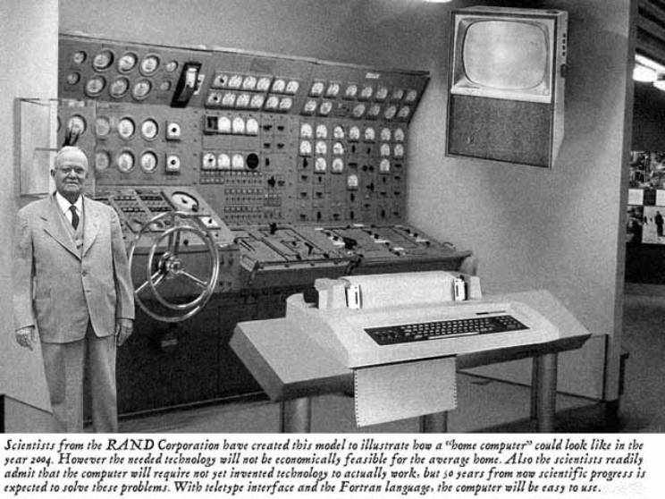
Predictions about the Future Rarely Come True!

Slide 15
A Qualification to the Statement that Scenarios are not Predictions
The claim that scenario analysis* is a non-predictive approach to the future does not imply the lack of inclusion of conditional predictions in the analysis. It does however require that the general purpose of the analysis is not to predict the most likely future state of the system but to assess the feasibility and desirability of different outcomes. Though the analysis is based on individual predictive calculations (e.g. the likely effect of a change in population growth rates or in technological change), the overall goal is to indicate something about the range of possible outcomes and their consequences.
Robinson, 2003
(*backcasting in original)

Slide 16
Scenarios for Information
Scenarios can be used to
  Illuminate potential problems, and bring future problems into focus
  Explore alternative responses in the face of uncertainty, and test them against different possible future paths.
  Clarify and communicate complex information and technical analysis
  Evaluate policies and help us make decisions despite the uncertain future.

Slide 17
Scenarios for Participation
Scenarios can be used to:
  Expand the range of perspectives considered;
  share understanding and concerns;
  explore and explain competing approaches to problems;
  uncover assumptions and rigorously test them;
  expose inconsistencies in thought and assumptions;
  provoke debate; and
  identify options and make decisions.

Slide 18
Examples of Scenarios
Short–term Country Scenarios: Mont Fleur, GCC and the world
Medium–term Regional and Global Scenarios: The UNEP GEO-3 Scenarios
Long–term Global Scenarios: Intergovernmental Panel on Climate Change (IPCC)

Slide 19
Short–term Country Scenarios: Mont Fleur
A scenario exercise carried out in South Africa in 1991–1992, during a time of deep conflict and profound uncertainty.
22 prominent South Africans from across the political spectrum came together to discuss possible future stories about South Africa.
It was innovative in that it brought diverse people together to think creatively about the future.
Notes:
The Mont Fleur scenario exercise was carried out in South Africa in 1991-92. The purpose of the exercise was to stimulate debate about how to shape policy over the next 10 years in the country. It brought together a diverse group of 22 prominent South Africans from across the political spectrum (including politicians, activists, academics and business people) to develop and disseminate a set of stories about what might happen in their country during this period. Its innovativeness and importance stemmed from the fact that, in the midst of a deep conflict and profound uncertainty, it brought people together from diverse organizations to think creatively about the future. The scenarios were widely publicized, being first published in 1992 in the South African newspapers, “The Weekly Mail and The Guardian Weekly.” The scenarios were reprinted in “Deeper News”,, published by the Global Business Network (http://www.gbn.org) with an introduction by Adam Kahane, who facilitated the scenario process.

Slide 20
Cont., Why future scenarios?
IEA vs. Traditional SOE
Many environmental problems have to do with the future state of the environment and what might emerge
Environmental Scenarios serve as
  useful tools for evaluating future environmental problems and assessing current and future policies to resolve them
  Synthesizing and communicating complex and extensive information to decision makers and the public at large
  A bridge between environmental science and policy (synthesizing scientific knowledge in a form that can be used by decision makers to develop policies)

Slide 21
Cont., Why future scenarios?
Scenarios vs. Projections
Long range future cannot be extrapolated or predicted due to indeterminacy (sources of uncertainties)
  Ignorance: our understanding is limited
  Surprises: complex systems can alter direction
  Volition: human choice
Scenarios start with the concept (or fact) that we cannot predict the future, However, they can inform us about what is possible in the future
Scenarios offer a mean for examining the forces shaping our world, the uncertainties that lie before us, and the implications for tomorrow of our actions today
?

Slide 22
Cont., Why future scenarios?
Scenarios vs. Prediction
A scenario is not a prediction of what the future will be, rather it is a description about how the future might unfold
Scenarios explore the possible, not just the probable, and challenge their users to think beyond conventional wisdom
They include qualitative description, to capture:
    Cultural influences, values, behaviors, shocks, discontinuities, imagination, insight
They are supported by quantitative analysis, to provide
    Definiteness, explicitness, detail, Consistency, Technical rigor, scientific accuracy
They are not predictive. They describe futures that could be, rather than futures that will be, because…

Slide 23
Scenario Dynamics
Intervention Policies
Observation and Assessment of the conditions of humans and the environmental (socio-ecological) systems
Encourage scenarios that minimize vulnerability of societal and environmental systems to unfavorable events and enhance their resilience

Slide 24
Elements of A Scenario
Current State
  Situation in the base year of scenario
Driving forces
  Deteminants that influence changes
  Choices/decisions that bring changes
(Step-wise) changes
  At the core of a scenario analysis
  Depicting how the driving forces unfold
  Storyline highlighting key features
Image(s) of the future
  Situation in the end year of scenario

Slide 25
Types of Environmental Scenarios
Exploratory vs Anticipatory Scenarios
  Exploratory scenarios
    Present -> future
    To explore uncertainties/driving forces/developments
    To test impacts of implementing specific policies
  Anticipatory scenarios (also ‘normative’ scenarios)
    Present <- future
    To investigate how specific end state can be reached
    To show how to achieve environmental targets

Slide 26
Forecast vs Backcast

Slide 27
Baseline vs Alternative Scenarios
Baseline scenarios (also ‘reference’ scenarios)
  Describe a future development/state in which
  no new policies or measures are implemented apart from those already adopted or agreed upon
Alternative scenarios (also ‘policy’ scenarios)
  Take into account new policies or measures additional to those already adopted or agreed upon and/or that assumptions on key driving forces diverge from those depicted in a baseline scenario

Slide 28
Qualitative vs Quantitative Scenarios
Qualitative scenarios
  Are narrative descriptions of future developments
  (i.e. presented as storylines, diagrams, images, etc.)
Quantitative scenarios
  Are numerical estimates of future developments
  (i.e. presented as tables, graphs, maps, etc.)
  Usually based on available data, past trends and/or mathematical models

Slide 29
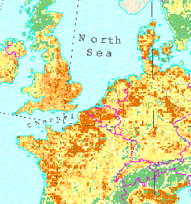
Story and Simulation (SAS) Iterative Process
Start here
European Land Use Change Scenarios
The main driving forces behind land use change are climate change, population growth and technical and economic development, particularly of the transport and agriculture sectors.
The environmental impacts of land use change are complex, and may affect air quality, water quality and quantity, landscape structure and biodiversity …

Slide 30
Open Discussion
Why Develop Scenarios?
1. Are you familiar with scenarios that have been developed in the past? If so, describe those scenarios. What do you find interesting about them?
2. What do you think are the most important reasons for developing scenarios?

Slide 31
Overview
Session 1: What is a Scenario?
Session 2: Examples
Session 3: Purpose, Process and Substance
Session 4: Policy Analysis
Session 5: Developing Scenarios
Session 6: Exercise on Scenario Development

Slide 32
Short History of Scenarios
Formal scenarios first used after World War II as a method for war game analysis by the American military establishment
1960s in strategic planning applications in companies
In the 1970s Royal Dutch Shell Oil Company refined the scenario approach
Late 1980s GBN helped in the widespread of scenarios in the business world
Early 1990s used as a tool for civil dialogue (e.g., South Africa, Guatemala, …), or for countries futures (e.g., The Netherlands, Scotland, ...)
Mid 1990s onwards wide spread in NGOs and environmental agencies

Slide 33
Short History of Scenarios
Today, scenario development is used in a wide variety of contexts:
  political decision-making
  business planning
  Global, regional, and national environmental assessments
  local community management

Slide 34
Short Term Country Scenarios
Mont Fleur: 4 Scenarios
Ostrich: a negotiated settlement to the crisis in South Africa is not achieved, and the country’s government continues to be non-representative
Lame Duck: a settlement is achieved, but the transition to a new system is slow and indecisive
Icarus: the transition is rapid, but the new government unwisely pursues unsustainable, populist economic policies
Flight of the Flamingos: the government’s policies are sustainable, and the country takes a path of inclusive growth and democracy

Slide 35




YES
Are the government’s
Flight of the
policies sustainable?
Flamingos
NO
Inclusive
YES
democracy and
Is the transition rapid
growth
and decisive?
-
Is a settlement
YES
NO
negotiated?
NO
Current
Icarus
negotiations?
-
Macro
economic
Lame Duck
population
Incapacitated
government
Ostrich
(Non
representative
government)
Notes:
The group developed a narrative for each of these stories. A 14-page report was included as a supplement in a national newspaper, and a 30-minute video was produced. Furthermore, the scenarios were directly presented to more than 50 groups.
The Mont Fleur scenarios were not in themselves novel. The remarkable thing about the exercise was the involvement of such a heterogeneous group of important people developing and delivering the message. The scenarios were broadly understood and discussed in many circles. Through this process, it became clear that Flamingo was a feasible and broadly desirable outcome, although some of the decisions it implied were not in line with those that might have been proposed by some of the parties at the start of the exercise. Thus, the informal process of producing the Mont Fleur scenarios produced substantive messages, informal networks and changes in thinking about the challenges that the country faced.
A key lesson learned through the Mont Fleur process is that a successful scenario effort must be credible, informal, reflective and inclusive. The team needs to be respected, open-minded and representative of all of the important perspectives on the issues at hand.

Slide 36
Mont Fleur: 4 Scenarios
Ostrich: a negotiated settlement to the crisis in South Africa is not achieved, and the country’s government continues to be non-representative.
Lame Duck: a settlement is achieved, but the transition to a new system is slow and indecisive.
Icarus: the transition is rapid, but the new government unwisely pursues unsustainable, populist economic policies.
Flight of the Flamingos: the government’s policies are sustainable, and the country takes a path of inclusive growth and democracy.

Slide 37
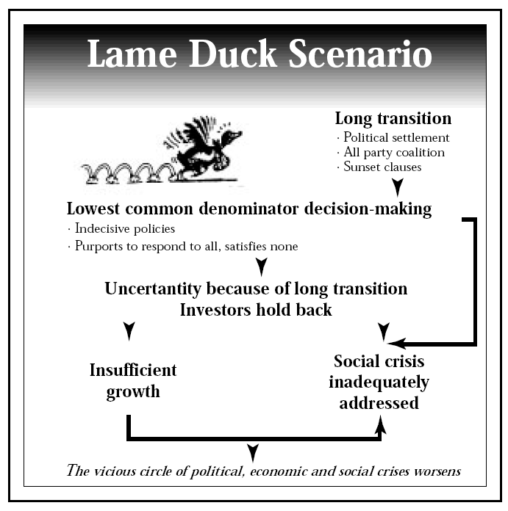
Mont Fleur – South Africa
Representation

Slide 38
Mont Fleur: Bridging Divides
The exercise was remarkable for bringing together diverse interests, and for the breadth of understanding in many circles.
It became clear that the Flamingo was the most feasible and broadly desired approach.
The process resulted in substantive messages, informal networks and changes in thinking about the challenges the country faced.
Notes:
The group developed a narrative for each of these stories. A 14-page report was included as a supplement in a national newspaper, and a 30-minute video was produced. Furthermore, the scenarios were directly presented to more than 50 groups.
The Mont Fleur scenarios were not in themselves novel. The remarkable thing about the exercise was the involvement of such a heterogeneous group of important people developing and delivering the message. The scenarios were broadly understood and discussed in many circles. Through this process, it became clear that Flamingo was a feasible and broadly desirable outcome, although some of the decisions it implied were not in line with those that might have been proposed by some of the parties at the start of the exercise. Thus, the informal process of producing the Mont Fleur scenarios produced substantive messages, informal networks and changes in thinking about the challenges that the country faced.

Slide 39
The GCC and the World: Scenarios to 2025
Developed by the World Economic Forum in 2007
Multi-stakeholders project involving participants from the private, public and non-governmental spheres (over 300)
Rationale:
  The region will continue to draw the world’s attention not just in terms of energy security, but also due to its fast growing capital markets and innovative cities;
  The world needs to anticipate what may throw the region off-track and what opportunities exist to help the GCC exceed the expectations
Notes:
39
The group developed a narrative for each of these stories. A 14-page report was included as a supplement in a national newspaper, and a 30-minute video was produced. Furthermore, the scenarios were directly presented to more than 50 groups.
The Mont Fleur scenarios were not in themselves novel. The remarkable thing about the exercise was the involvement of such a heterogeneous group of important people developing and delivering the message. The scenarios were broadly understood and discussed in many circles. Through this process, it became clear that Flamingo was a feasible and broadly desirable outcome, although some of the decisions it implied were not in line with those that might have been proposed by some of the parties at the start of the exercise. Thus, the informal process of producing the Mont Fleur scenarios produced substantive messages, informal networks and changes in thinking about the challenges that the country faced.

Slide 40
The GCC and the World: Scenarios to 2025
Two key questions concerning GCC future
  Will leaders in the GCC countries be able to successfully implement the necessary and relevant economic and political reforms and enforce the rule of law, both in public and in private governance?
  Will the GCC countries be able to maintain internal order and stability, in particular vis-à-vis a complex and uncertain regional situation?
Notes:
40
The group developed a narrative for each of these stories. A 14-page report was included as a supplement in a national newspaper, and a 30-minute video was produced. Furthermore, the scenarios were directly presented to more than 50 groups.
The Mont Fleur scenarios were not in themselves novel. The remarkable thing about the exercise was the involvement of such a heterogeneous group of important people developing and delivering the message. The scenarios were broadly understood and discussed in many circles. Through this process, it became clear that Flamingo was a feasible and broadly desirable outcome, although some of the decisions it implied were not in line with those that might have been proposed by some of the parties at the start of the exercise. Thus, the informal process of producing the Mont Fleur scenarios produced substantive messages, informal networks and changes in thinking about the challenges that the country faced.

Slide 41
The GCC and the World: Scenarios to 2025
Three Scenarios
  Oasis
  Sandstorm
  The Fertile Gulf
Notes:
41
The group developed a narrative for each of these stories. A 14-page report was included as a supplement in a national newspaper, and a 30-minute video was produced. Furthermore, the scenarios were directly presented to more than 50 groups.
The Mont Fleur scenarios were not in themselves novel. The remarkable thing about the exercise was the involvement of such a heterogeneous group of important people developing and delivering the message. The scenarios were broadly understood and discussed in many circles. Through this process, it became clear that Flamingo was a feasible and broadly desirable outcome, although some of the decisions it implied were not in line with those that might have been proposed by some of the parties at the start of the exercise. Thus, the informal process of producing the Mont Fleur scenarios produced substantive messages, informal networks and changes in thinking about the challenges that the country faced.

Slide 42
The GCC and the World: Scenarios to 2025
Oasis: regional stability continues to be a challenge, however, GCC are able to achieve substantial institutional reforms. They develop strong identities and work together to coordinate diplomatic and economic policies through technocratic governance and a stronger internal market
Sandstorm: regional instability is the defining factor that affects the ability of GCC to effectively carry out necessary institutional reforms. A number of conflating factors make the surround region significantly turbulent, including conflict between the US and Iran and spillover of violence from Iraq
The Fertile Gulf: rise of the GCC as innovation hubs in a global environment characterized by robust demand for energy and increasing globalization. Regional stability gives the opportunity to focus on enhancing their human capital at all levels, investing heavily in education while proceeding carefully with political and institutional reforms to support their growing economies and societies
Notes:
42
The group developed a narrative for each of these stories. A 14-page report was included as a supplement in a national newspaper, and a 30-minute video was produced. Furthermore, the scenarios were directly presented to more than 50 groups.
The Mont Fleur scenarios were not in themselves novel. The remarkable thing about the exercise was the involvement of such a heterogeneous group of important people developing and delivering the message. The scenarios were broadly understood and discussed in many circles. Through this process, it became clear that Flamingo was a feasible and broadly desirable outcome, although some of the decisions it implied were not in line with those that might have been proposed by some of the parties at the start of the exercise. Thus, the informal process of producing the Mont Fleur scenarios produced substantive messages, informal networks and changes in thinking about the challenges that the country faced.

Slide 43
Long–Term Global Scenarios –Intergovernmental Panel on Climate Change (IPCC)
To provide plausible pictures of future greenhouse gas emissions, four families of scenarios were developed by IPCC.
The scenarios were based on literature, six alternative modelling approaches, and a participatory approach.
The scenarios are a basis for analysing drivers of future emissions and to assess associated uncertainties.

Slide 44
IPCC Scenario Framework
Global
A1
B1
Social &
Environmental
Economic
A2
B2
Regional
population
economy
environment
energy use
land use
technology
Notes:
Explain different dimensions
Explain main drivers
Explain different worlds:
A1:
A2:
B2:
B1:

Slide 45

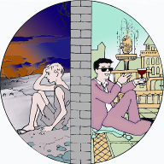
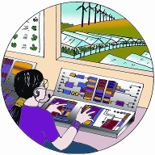

Long - Term Global Scenarios
World Development
Globalization Regionalization
Millennium
Assessment Scenarios
Proactive Reactive
Global Orchestration
Order from Strength
Environmental Management
TechnoGarden
Adapting Mosaic

Slide 46
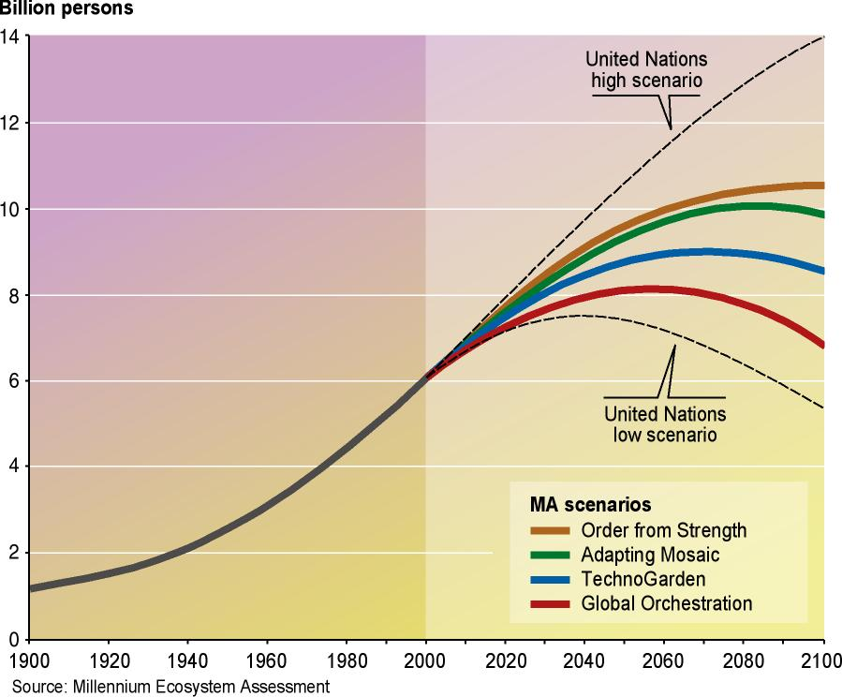
Changes in Indirect drivers: Population Scenarios

Slide 47
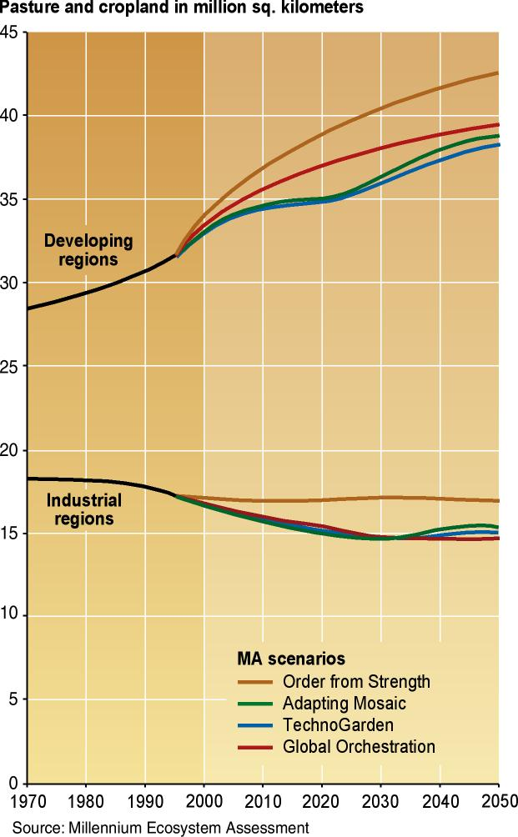
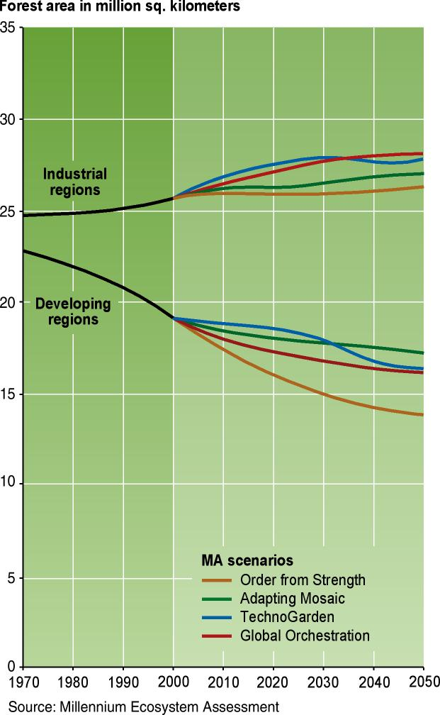
Changes in direct drivers: Changes in crop land and forest area under MA Scenarios

Slide 48
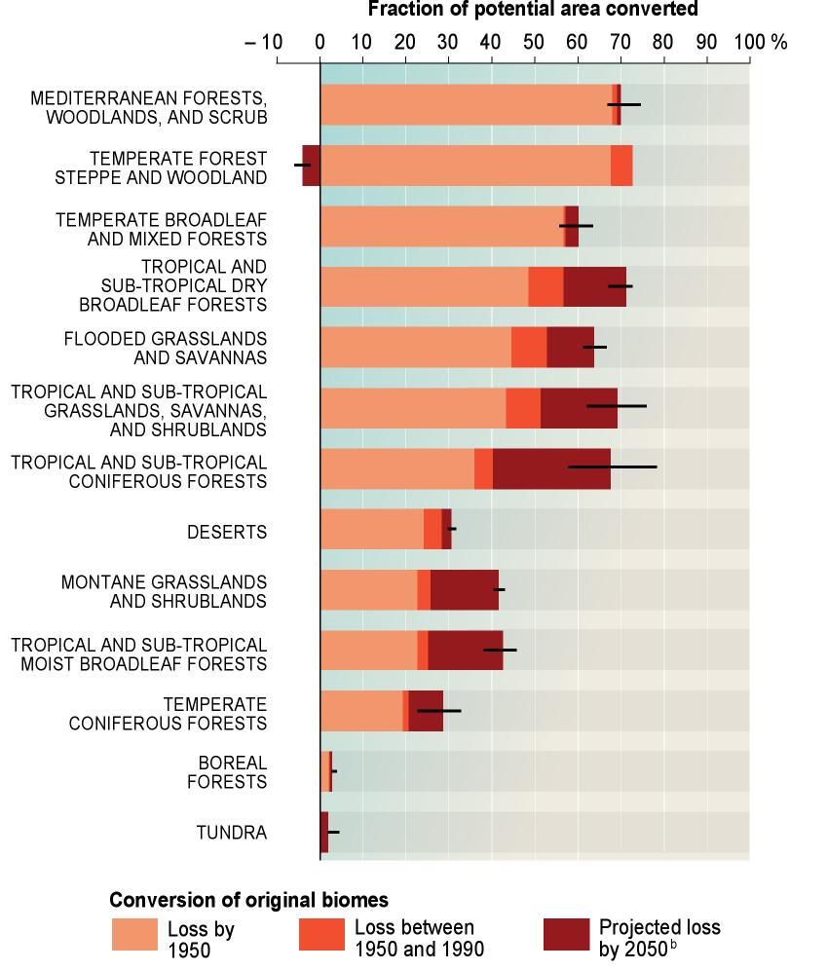
Changes in direct drivers:
Habitat transformation
  Further 10–20% of grassland and forestland is projected to be converted by 2050
Overexploitation, overfishing
  Pressures continue to grow in all scenarios
Invasive alien species
  Spread continues to increase

Slide 49


MA Scenario Storylines
  Global Orchestration Globally connected society that focuses on global trade and economic liberalization and takes a reactive approach to ecosystem problems, but that also takes strong steps to reduce poverty and inequality and to invest in public goods such as infrastructure and education
  Order from Strength Regionalized and fragmented world, concerned with security and protection, emphasizing primarily regional markets, paying little attention to public goods, and taking a reactive approach to ecosystem problems

Slide 50


MA Scenario Storylines
  Adapting Mosaic Regional watershed-scale ecosystems are the focus of political and economic activity. Local institutions are strengthened and local ecosystem management strategies are common; societies develop a strongly proactive approach to the management of ecosystems
  TechnoGarden Globally connected world relying strongly on environmentally sound technology, using highly managed, often engineered, ecosystems to deliver ecosystem services, and taking a proactive approach to the management of ecosystems in an effort to avoid problems

Slide 51
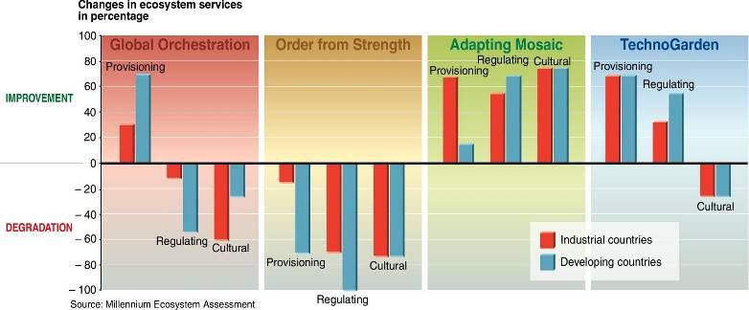
Degradation of many services can be reversed by 2050
In three of the four MA scenarios, many currently degraded ecosystem services were enhanced by 2050
Notes:
MA Synthesis Figure 15. Number of Ecosystem Services Enhanced or Degraded by 2050 in the Four MA Scenarios
The Figure shows the net change in the number of ecosystem services enhanced or degraded in the MA scenarios in each category of services for
industrial and developing countries expressed as a percentage of the total number of services evaluated in that category. Thus, 100% degradation
means that all the services in the category were degraded in 2050 compared with 2000, while 50% improvement could mean that three out of six
services were enhanced and the rest were unchanged or that four out of six were enhanced and one was degraded. The total number of services
evaluated for each category was six provisioning services, nine regulating services, and five cultural services.
P. 18: “Three of the four MA scenarios show that significant changes in policies, institutions, and practices can mitigate many of the negative consequences of growing pressures on ecosystems, although the changes required are large and not currently under way. [5] All provisioning, regulating, and cultural ecosystem services are projected to be in worse condition in 2050 than they are today in only one of the four MA scenarios (Order from Strength). At least one of the three categories of services is in better condition in 2050 than in 2000 in the other three scenarios.
(See Figure 15.) The scale of interventions that result in these positive outcomes are substantial and include significant investments in environmentally sound technology, active adaptive management, proactive action to address environmental problems before their full consequences are experienced, major investments in public goods (such as education and health), strong action to reduce socioeconomic disparities and eliminate poverty, and expanded capacity of people to manage ecosystems adaptively. However, even in scenarios where one or more categories of ecosystem services improve, biodiversity continues to be lost and thus the long-term sustainability of actions to mitigate degradation of ecosystem services is uncertain.

Slide 52
But the actions needed are significant and not underway (policies)
  Investments in public goods (e.g., education and health) and poverty reduction
  Elimination of trade barriers and distorting subsidies
  Use of active adaptive management
  Investment in education
  Investment in new technologies
  Payments for ecosystem services
Notes:
MA Synthesis SDM p. 18: The scale of interventions that result in these positive outcomes are substantial and include significant investments in environmentally sound technology, active adaptive management, proactive action to address environmental problems before their full consequences are experienced, major investments in public goods (such as education and health), strong action to reduce socioeconomic disparities and eliminate poverty, and expanded capacity of people to manage ecosystems adaptively. However, even in scenarios where one or more categories of ecosystem services improve, biodiversity continues to be lost and thus the long-term sustainability of actions to mitigate degradation of ecosystem services is uncertain.

Slide 53
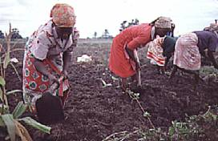
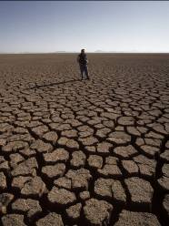

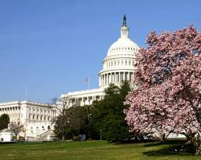
MA Main Findings
Humans have radically altered ecosystems in last 50 years
Changes have brought gains but at growing costs that threaten achievement of development goals
Degradation of ecosystems could grow worse but can be reversed
Workable solutions will require significant changes in policy
Scenarios Analysis Findings

Slide 54
Medium Term National Scenarios
Abu Dhabi Environmental Scenarios
Part of Abu Dhabi Emirate IEA Report (launched in 19 March 2007)
Three Scenarios
  Souk
  Business as Usual
  Zayed Vision

Slide 55
Three Scenarios
Market Forces (Souk)
  Development in ADE is dominated by market forces & mechanisms: economic growth at any cost!
Policy Reforms (Business as Usual)
  Strong policy constraints are placed by ADE government on market forces to minimize their undesirable effects on human and environment
Sustainability (Zayed Vision)
  Proactive solutions; human and environment are central to planning: ADE adapts long-term integrated strategic planning with the objective of achieving superior quality of life and healthy environment
  Human development rather than material acquisition is advanced

Slide 56
شبكة مجتمعية إيجابية
+ve societal Grid
Atomized, Unbound, unstructured
شبكات تراتبية، غير محصورة وغير منظمة
شبكات تراتبية منظمة ومحصورة
Ranked and bounded
limits
إدارة وتنظيم
البيئة قادرة على التحمل لكن بحدود
Manage
cope
البيئة متقلبة
تكيف وإدارة أزمات
Nature Robust but with limits
Nature capricious
حدود الاحتمال
- +
تحمل المخاطر
منطق القضاء والقدر
Risk absorbing, fatalist rationality
Risk minimizing, Procedural rationality
تقليل المخاطر
منطق منهجي
+ +
مجموعات سلبية
مجموعات إيجابية
ترابط مجتمعي ضعيف، منافسة غير مقيدة
ترابط مجتمعي قوي، منافسة مقيدة
-ve Group
Unbound, unstructured networks
شبكات غير محصورة وغير منظمة
شبكات غير منظمة ولكن محصورة
+ve Group
Unstructured, but bound enclaves
البيئة قادرة على التحمل
Nature Robust
تحريم وأخلاقيات
Taboo
commoditize
استثمار ومتاجرة
- -
البيئة هشة
نحن ضد الآخرين
Nature Fragile
Us vs. Them
+ -
أخذ المخاطرة
منطق واقعي
Risk taking, substantive rationality
Risk avoiding, critical rationality
عدم أخذ المخاطرة
منطق انتقادي
شبكة مجتمعية سلبية
-ve societal Grid

Slide 57
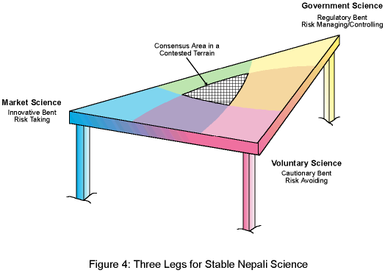
What is the mechanism to reach this consensus?
ماهي الآلية للوصول إلى منطقة الاجماع العام؟
المسئولين والسلطات الرسمية
التنظيم وإدارة المخاطر والتحكم
Bureaucratic Hierarchy
Regulations, Risk Managing/controlling
منطقة الاجماع العام والسياسة المستقرة (الحل الأمثل) – التضامن المجتمعي
Consensus Area, stable policy- Community Solidarity
قوى السوق/المصالح الفردية
انتهاز الفرص/أخذ المخاطر
Market Individualism
Opportunities, Risk taking
قوى الضغط المجتمعي
أخذ الحذر وعدم المخاطرة
Activists and Pressure Groups
Cautionary, Risk avoiding
الاطار العام للإدارة والتنمية المستدامة
General Framework for Sustainable Development

Slide 58
Driving Forces Main Categories
  Governance
  Demography
  Economic Development
  Human Development
  Science and Technology
  Culture
  Regional Integration & Cooperation

Slide 59
Example of Driving Froce Analysis: Governance
Sub-Driver | Market Forces | Policy Reform | Sustainability
Dominant actor and power balance | Private sector with strong government support; power more to the private | Government with civil society support; power more to the government | Balanced civil society, government, and private sector, power more to the civil society
Governance approach | Top-down (with emphasis on hierarchical structures) | Top-down (but with stakeholders consultation) | Balanced Bottom-up and top-down approaches
Level of public participation | Low public participation | Medium public participation | High public participation
priority | Maximum economic growth (presumption: social and environmental concerns will naturally be dealt with) | Social development and environmental management and economic development | Social and environmental welfare with economic sufficiency
Mainstreaming of social & environmental policies | Low | Medium | High

Slide 60
Market Forces Scenario (Souk)
Overall Conclusion
An environmentally depressing scenario for Abu Dhabi Emirate
The Emirate will be facing considerable environmental problems, and the situation will deteriorate
The environment will have least priority and will be overridden by investment and maximum economic development policies

Slide 61
Policy Reform Scenario (BAU)
Overall Conclusion
Improvement of human well-being and decrease of environmental degradation due to assigning higher priority on human resources development, health, and the environment.
However, investment and economic development policies and population growth rates continue to exert great pressures on the environment
Governance approach remains reactive

Slide 62
Sustainability Scenario (Zayed Vision)
Zayed Al-Nahyan Vision
"We are responsible for taking care of our environment & wildlife, protect it and preserve it not only for the sake of our current generation, but also for the sake of our children and grandchildren, it is our duty to bare loyal to our ancestors as well as our successors"

Slide 63
Sustainability Scenario (Zayed Vision)
Overall Conclusion
A balance is struck between natural and human managed ecosystem in the long-term
Practices will lead to conservation and efficient use of natural resources and sound management of the environment, providing an ideal conditions for human wellbeing
Although economic growth will be moderate, there will be considerable improvement in health and environmental welfare, and the cost of pollution on ADE’s GDP is reduced considerably

Slide 64
Summary of Scenarios Impact on
ADE Main Environmental Issues
Environmental Issue | Souk | BAU | Zayed
Water Scarcity & Groundwater Quality
Land Degradation & Desertification
Degradation of Coastal & Marine Environment
Urban Environment conditions
Biodiversity Loss
Legend
very high
high
moderate
low

Slide 65
Key Messages for Policymakers
  The most important choices affecting the environment in the future are not necessarily environmental choices
  Environment policies should not be compartmentalized, they should be integrated/mainstreamed into the national socio-economic development planning
  The path to sustainable development is long, and achieving long-term goals requires long-term thinking
  The trend towards less environmental regulation and self-regulation (market forces scenario), can lead to the complication of many environmental problems and consequently may lead to social problems
  There are always “short-term” trade-offs, mainly between economic growth and environmental sustainability/human wellbeing

Slide 66
Strategic Recommendations to Decision Makers
  Investment in Human development in the fields of education, training, and capacity building (establishing a knowledge-based society), accompanied by effective, well-planned national substitution programs
  Investment in R&D to solve societal problems
  Regional integration and cooperation with the GCC countries and ultimately with the Arab countries in the field of food production, R&D in desalination and water treatment technology, bio-reserves, protected areas, GMOs, and the protection of the Arabian Gulf marine environment

Slide 67
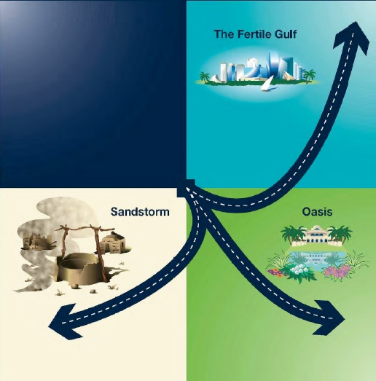
The GCC Countries and the World
Scenarios to 2025

Slide 68
The GCC Countries and the World
Scenarios to 2025
2 Key Scenarios Questions
  Will leaders in the GCC countries be willing and able to implement the necessary economic and political reforms and enforce the rule of law, both in public and in private governance?
  How can the GCC countries maintain internal order and stability, in particular vis-à-vis a complex and uncertain regional situation?

Slide 69
The GCC Countries and the World: 2025
2 Key themes as being crucial to the future of the GCC countries, driving forces (critical uncertainties)
  Education and Innovation
    Moving away from oil dependence; diversification, but existing skills low; little research, development and innovation; import of foreign workers and technologies; Education policies to develop an innovative-based economies that do not rely on natural resources
  Leadership and Governance
    Traditionally-organized family groups; political reforms with varying degrees; managing internal stability and reforms, and leadership will play critical role in the future

Slide 70

Medium Term Regional & Global Scenarios - UNEP GEO-3 Scenarios
A set of scenarios built on pre-existing exercises including work by the Global Scenario Group and the IPCC
Each scenario was developed at regional and sub-regional levels for the period 2002-2032
Scenarios included all aspects of sustainable development with an emphasis on environmental descriptions and policies
Scenario drivers included demographic, economic, social, technological, environmental, cultural, and political
Notes:
Development of scenarios for the United Nations Environment Programme’s (UNEP’s) third Global Environmental Outlook (GEO-3) has been described in detail by Bakkes et al. and others (2004). The scenarios were built on existing and ongoing exercises, in particular the work of the Global Scenario Group (Raskin et al.and others 2002) and the Intergovernmental Panel on Climate Change (2000). A key aspect of the GEO-3 process was that, although global in extent, each scenario was developed at regional and sub-regional levels (using UNEP’s regions and sub-regions, see http://www.unep.org/geo/region.htm). The scenarios were to be developed using a holistic approach that included all aspects of sustainable development, but offered an environmental window by emphasizing environmental descriptions and policies. The narratives included the current state and trends, drivers, a story line into the future, and a vision of the future. The scenarios used a thirty30-year time period (i.e., 2002-32). The categories of drivers were: demographic, economic, social, technological, environmental, cultural, and political drivers.

Slide 71




Markets First
Security First
Sustainability First
Policy First

Slide 72
IPCC Scenarios
A1: Rapid economic growth, a global population that peaks in mid 2100s and declines, and rapid introduction of new technologies.
A2: Heterogeneous work with themes of self-reliance and preservation of local identities. A continuously increasing global population; economic growth is regional.
B1: Rapid changes in economic structure toward service and information economy, reduction in material intensity and introduction of resource-efficient technologies.
B2: Emphasis is on local solutions to economic, social and environmental sustainability. Intermediate level of economic development, less rapid and more diverse technological change than in B1 and A1.

Slide 73
Medium Term Regional & Global Scenarios - UNEP GEO-3 Scenarios
A set of scenarios built on pre-existing exercises including work by the Global Scenario Group and the Intergovernmental Panel on Climate Change.
Each scenario was developed at regional and sub-regional levels for the period 2002–2032.
Scenarios included all aspects of sustainable development with an emphasis on environmental descriptions and policies.
Scenario drivers included demographic, economic, social, technological, environmental, cultural, and political drivers.
Notes:
Development of scenarios for the United Nations Environment Programme’s (UNEP’s) third Global Environmental Outlook (GEO-3) has been described in detail by Bakkes et al. and others (2004). The scenarios were built on existing and ongoing exercises, in particular the work of the Global Scenario Group (Raskin et al.and others 2002) and the Intergovernmental Panel on Climate Change (2000). A key aspect of the GEO-3 process was that, although global in extent, each scenario was developed at regional and sub-regional levels (using UNEP’s regions and sub-regions, see http://www.unep.org/geo/region.htm). The scenarios were to be developed using a holistic approach that included all aspects of sustainable development, but offered an environmental window by emphasizing environmental descriptions and policies. The narratives included the current state and trends, drivers, a story line into the future, and a vision of the future. The scenarios used a thirty30-year time period (i.e., 2002-32). The categories of drivers were: demographic, economic, social, technological, environmental, cultural, and political drivers.

Slide 74
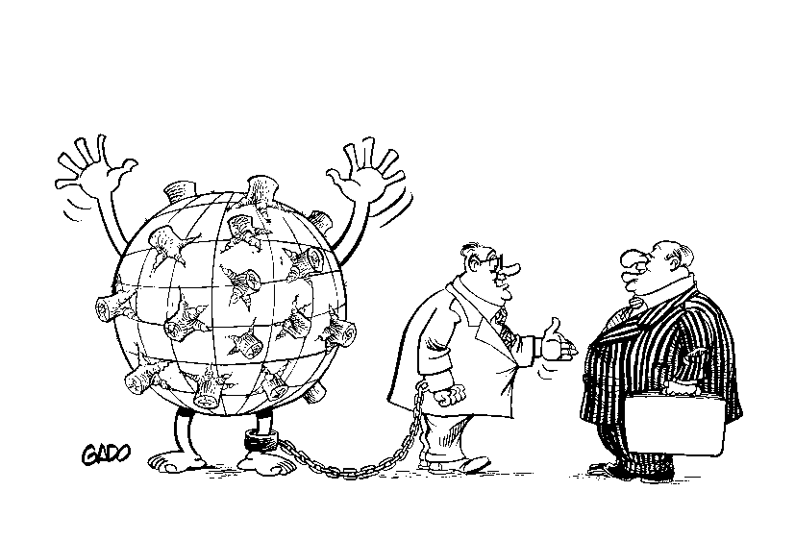
UNEP GEO-3 Scenarios
Market First
Most of the world adopts values and expectations prevailing in industrialized countries.
Trust is placed in globalization and liberalization as this will enhanced corporate wealth, create new enterprises and employment, and ultimately help people and communities insure against or fix social and environmental problems.
Economic imperatives undermine corrective influences, such as ethical investing.
Notes:
Markets First. This assumed that Mmost of the world adopts the values and expectations that prevail in today’s industrialized countries. The wealth of nations and the optimal play of market forces dominate social and political agendas. Trust is placed in further globalization and liberalization to enhance corporate wealth, create new enterprises and employment opportunities, helping people and communities to afford to insure against (or pay to fix) social and environmental problems.
Ethical investors, together with citizen and consumer groups, try to exercise growing corrective influence, but are undermined by economic imperatives. The powers of state officials, planners and lawmakers to regulate society, economy and the environment continue to be overwhelmed by expanding demands.
Policy First. Decisive initiatives are taken by governments in an attempt to reach specific social and environmental goals. A coordinated pro-environment and anti-poverty drive balances the momentum for economic development at any cost. Environmental and social costs and gains are factored into policy measures, regulatory frameworks and planning processes. All these are reinforced by fiscal levers and incentives, such as carbon taxes and tax breaks.
International ‘“soft law’” treaties and binding instruments affecting environment and development are integrated into unified blueprints, and their status in law is upgraded. At the same time, fresh provision is made for open consultation processes to allow for regional and local variants.
Security First. This scenario assumes a world of striking disparities, where inequality and conflict prevail. Socio-economic and environmental stresses give rise to waves of protest and counteraction. As such, troubles become increasingly prevalent. , tThe more powerful and wealthy groups focus on self-protection, creating enclaves akin to the present -day ‘“gated communities’.” Such islands of advantage provide a degree of enhanced security and economic benefits for dependent communities in their immediate surroundings, but exclude the disadvantaged mass of outsiders. Welfare and regulatory services fall into disuse, but markets continue to operate outside the walls.
Sustainability First. A new environment and development paradigm emerges in response to the challenge of sustainability, supported by new, more equitable values and institutions. A more visionary state of affairs prevails, where radical shifts in the way people interact with one another and with the world around them stimulate and support sustainable policy measures and accountable corporate behaviour.
There is much fuller collaboration between among governments, citizens and other stakeholder groups in decision -making on issues of close common concern. A consensus is reached on what needs to be done to satisfy basic needs and to realize personal goals without beggaring others or spoiling the outlook for posterity.

Slide 75
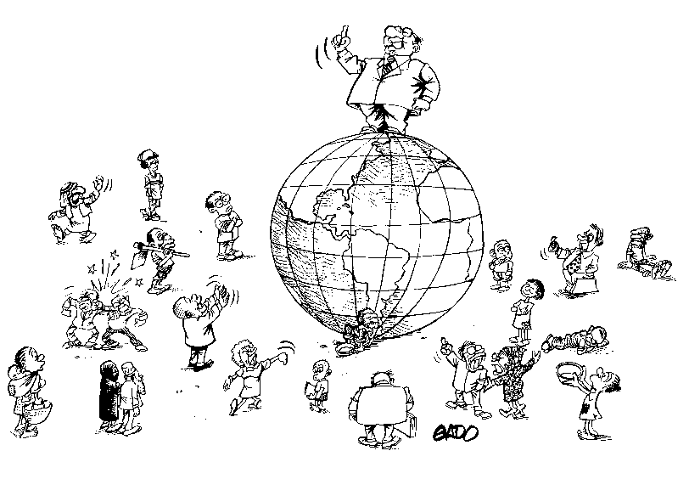
UNEP GEO-3 Scenarios
2. Policy First
Environmental and social costs and gains are factored into policy measures, regulatory frameworks and planning processes. All these are reinforced by fiscal levers and incentives, e.g., carbon taxes and tax breaks.
International “soft law” treaties and binding instruments affecting environment and development are integrated into unified blueprints, and their status in law is upgraded. Fresh provision is made for open consultation processes to allow for regional and local variants.
Notes:
Policy First. Decisive initiatives are taken by governments in an attempt to reach specific social and environmental goals. A coordinated pro-environment and anti-poverty drive balances the momentum for economic development at any cost. Environmental and social costs and gains are factored into policy measures, regulatory frameworks and planning processes. All these are reinforced by fiscal levers and incentives, such as carbon taxes and tax breaks.
International ‘“soft law’” treaties and binding instruments affecting environment and development are integrated into unified blueprints, and their status in law is upgraded. At the same time, fresh provision is made for open consultation processes to allow for regional and local variants.
Security First. This scenario assumes a world of striking disparities, where inequality and conflict prevail. Socio-economic and environmental stresses give rise to waves of protest and counteraction. As such, troubles become increasingly prevalent. , tThe more powerful and wealthy groups focus on self-protection, creating enclaves akin to the present -day ‘“gated communities’.” Such islands of advantage provide a degree of enhanced security and economic benefits for dependent communities in their immediate surroundings, but exclude the disadvantaged mass of outsiders. Welfare and regulatory services fall into disuse, but markets continue to operate outside the walls.
Sustainability First. A new environment and development paradigm emerges in response to the challenge of sustainability, supported by new, more equitable values and institutions. A more visionary state of affairs prevails, where radical shifts in the way people interact with one another and with the world around them stimulate and support sustainable policy measures and accountable corporate behaviour.
There is much fuller collaboration between among governments, citizens and other stakeholder groups in decision -making on issues of close common concern. A consensus is reached on what needs to be done to satisfy basic needs and to realize personal goals without beggaring others or spoiling the outlook for posterity.

Slide 76
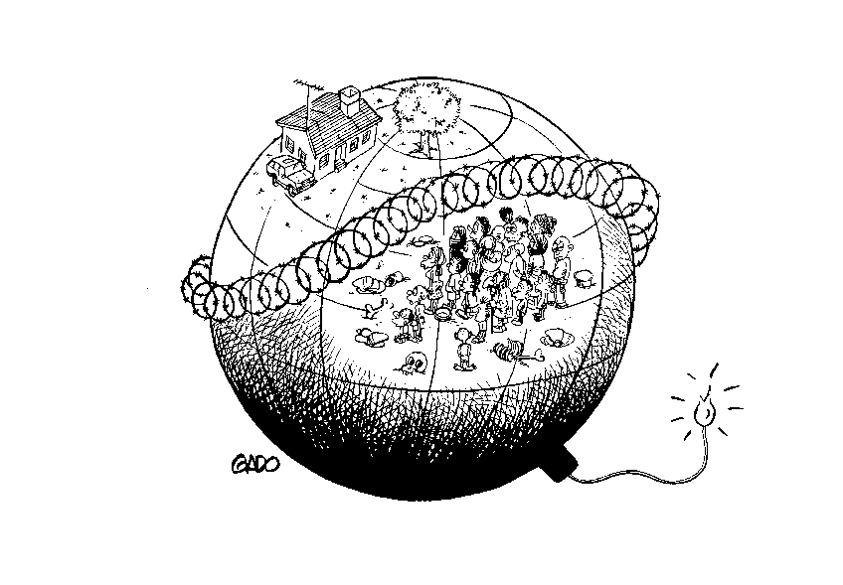
UNEP GEO-3 Scenarios
3. Security First
Assumes a world of striking disparities, where inequality and conflict prevail. Socio-economic and environmental stresses give rise to waves of protest and counteraction.
Powerful and wealthy groups focus on self-protection, creating islands of advantage. Nearby and dependent communities experience enhanced security and economic benefits, but the disadvantaged mass of outsiders are excluded.
Welfare and regulatory services fall into disuse, but markets continue to operate outside the walls.
Notes:
Security First. This scenario assumes a world of striking disparities, where inequality and conflict prevail. Socio-economic and environmental stresses give rise to waves of protest and counteraction. As such, troubles become increasingly prevalent. , tThe more powerful and wealthy groups focus on self-protection, creating enclaves akin to the present -day ‘“gated communities’.” Such islands of advantage provide a degree of enhanced security and economic benefits for dependent communities in their immediate surroundings, but exclude the disadvantaged mass of outsiders. Welfare and regulatory services fall into disuse, but markets continue to operate outside the walls.
Sustainability First. A new environment and development paradigm emerges in response to the challenge of sustainability, supported by new, more equitable values and institutions. A more visionary state of affairs prevails, where radical shifts in the way people interact with one another and with the world around them stimulate and support sustainable policy measures and accountable corporate behaviour.
There is much fuller collaboration between among governments, citizens and other stakeholder groups in decision -making on issues of close common concern. A consensus is reached on what needs to be done to satisfy basic needs and to realize personal goals without beggaring others or spoiling the outlook for posterity.

Slide 77
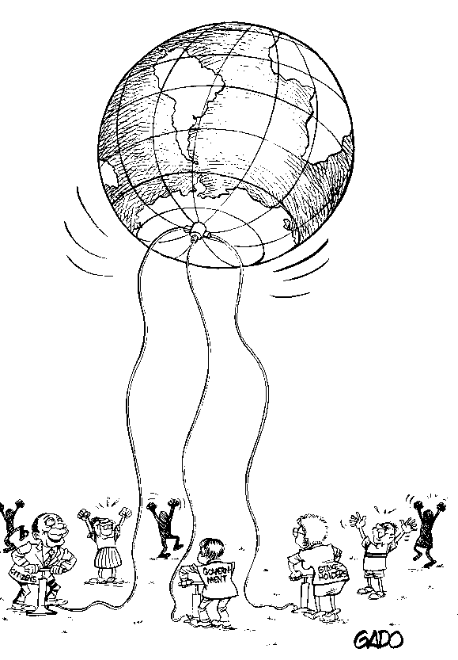
UNEP GEO-3 Scenarios
4. Sustainability First
A new environment and development emerges, supported by more equitable values and institutions. Radical shifts in the way people interact with one another and with the world around them stimulate and support sustainable policy measures and accountable corporate behaviour.
There is fuller collaboration among governments, citizens and other stakeholder groups in decision-making on issues of common concern.
A consensus is reached on what needs to be done to satisfy basic needs and to realize personal goals without beggaring others or spoiling the outlook for posterity.
Notes:
Sustainability First. A new environment and development paradigm emerges in response to the challenge of sustainability, supported by new, more equitable values and institutions. A more visionary state of affairs prevails, where radical shifts in the way people interact with one another and with the world around them stimulate and support sustainable policy measures and accountable corporate behaviour.
There is much fuller collaboration between among governments, citizens and other stakeholder groups in decision -making on issues of close common concern. A consensus is reached on what needs to be done to satisfy basic needs and to realize personal goals without beggaring others or spoiling the outlook for posterity.

Slide 78
Exercise: Looking for Images of the Future in the Present
Which of the four scenarios described in GEO-3 do you feel is currently unfolding?
Illustrate this with an example of a situation or event in the recent past or present that you think represents a characteristic of the future as described by your chosen scenario.

Slide 79
Overview
Session 1: What is a Scenario?
Session 2: Examples
Session 3: Purpose, Process and Substance
Session 4: Policy Analysis
Session 5: Developing Scenarios
Session 6: Exercise on Scenario Development

Slide 80
Purpose, Process and Substance
Why? Purpose | Open exploration or decision support?
How? Process | Metaphorical Imagination or Cartesian (left brain – right brain)?
What? Substance | Simple or complex?

Slide 81
Alternative Objectives
Exploration
  Awareness raising
  Stimulation of creative thinking
  Insight into the way societal processes influence each other.
Decision Support
  Concrete strategic options
  Scenarios with a range of options from desirable, middle of the road and undesirable.
Keep in Mind
  ... most exercises will have a bit of both objectives
  …especially in the former, the process is as important as the product.
Notes:
The first theme addresses the objectives of a scenario analysis as well as subsequent demands on design of the scenario development process. On one end of the spectrum is the goal of exploration. This might include awareness raising, stimulation of creative thinking, and gaining insight into the way societal processes influence one another. In such an exercise, the process is often as important as the product ; the product (i.e., the scenario or set of scenarios), which may even be discarded at the end of the process. At the other end of the spectrum is the goal of direct decision support. In this case, scenarios might propose concrete strategic options. Decision-support scenario exercises often contain value-laden combinations of scenarios that are described as desirable, middle-of-the-road and undesirable. The two types of project goals often are combined: exploratory scenarios are developed first, after which new scenarios are developed by zooming in on aspects relevant to strategy development.

Slide 82
Alternative Approaches
Intuitive
  Scenario development viewed as an art form and qualitative knowledge and insights are used.
  Involves development of storylines, collages and interactive group sessions with diverse participants.
Technical
  Scenario development viewed as a rational and analytical exercise.
  Involves use of quantified knowledge and computer models.
Keep in Mind
  ... the two approaches have complementary strengths and weaknesses
  …most recent exercise attempt to combine the two
Notes:
Process design, the second overarching theme, focuses on how scenarios are produced. It addresses aspects such as the degree of quantitative and qualitative data used, or the choice among stakeholder workshops, expert interviews, and desk research. On one end of the spectrum, there is the intuitive approach, which considers scenario development as an art form, and leans heavily on qualitative knowledge and insights. Creative techniques, such as development of stories or storylines or collages of pictures, are typical intuitive approaches to scenario analysis. Interactive group sessions with a diversity of participants are often central to storyline development. At the other end of the spectrum is the technical approach. Contrary to the intuitive approach, the technical school regards scenario development primarily as a rational and analytical exercise. This technical school tends to work from quantified knowledge, and often relies on computer models in developing scenarios. As noted previously, bBoth approaches have their strengths and a number of recent studies have worked to combine the two approaches (see e.g., UNEP 2002, IPCC 2000, and Rijsberman 2000).

Slide 83
Alternative Levels of Detail
Complex stories
  intricate webs of variables and linkages, multiple issues, multiple scales
Simple stories
  small set of variables and few linkages, may focus on a single issue at a single scale
Notes:
The third theme, scenario content , focuses on the composition of the scenarios. It focuses on the nature of variables and dynamics in a scenario, and how they interconnect. With regard to scenario content, we distinguish between complex and simple scenarios. A multitude of interpretations of the term complex exists. Here, a complex scenario is one that is composed of an intricate web of causally related, interwoven, and elaborately arranged variables and dynamics. Complex scenarios manifest alternative patterns of development consisting of a series of action-reaction mechanisms. They often draw on a broad range of actors, factors, and sectors, and use multiple temporal or spatial scales. In contrast, simple scenarios are more limited in scope. A simple scenario might focus on a single topic, considering only the immediate or first-order effects of changes in the external environment. Simple scenarios may also limit themselves to extrapolation of trends. The term “simple” is not meant to indicate poor quality. An exercise with a narrow focus or a short-term perspective may not require the relatively lengthy and demanding investment of developing complex scenarios, which can be a benefit in many other circumstances. Furthermore, a simple scenario can be more effective in communicating its message than a complex scenario.

Slide 84
Keep in Mind
  … theories should be as simple as possible, but no simpler (simple does not imply simplistic)
  ... your scenario should not be harder to communicate than the real world

Slide 85
Thinking about Scenarios from a Policy Perspective
Are there existing policies you wish to explore as part of the scenario exercise?
Notes:
Are there existing policies you wish to explore as part of the scenario exercise?
A standard use of scenario analysis is to compare the feasibility, effectiveness, and broader impacts of alternative policies (or combinations thereof), e.g., taxes vis-à-vis tradable permits on certain pollutants. This can be done by assessing scenarios that differ only with respect to the absence or inclusion of the policies of interest. Remembering the basic uncertainties that underlie the use of scenarios, the robustness of existing policies can be assessed by exploring their feasibility, effectiveness and broader impacts across a range of scenarios that differ with respect to other significant factors.
If there are no relevant, existing policies, then one purpose of the scenario exercise should be the identification of policy options. Even where they do exist, the exercise can, of course, be useful for expanding the set of policy options for consideration.
Is there a preconceived end vision, or at least some aspects of a vision, i.e., specific targets?
In many cases, a scenario exercise is used to explore the feasibility and broader implications, e.g., tradeoffs, of meeting a specific target, e.g., an 80 per cent reduction in CO2 emissions by 2050. If the vision is used to define the scenarios, i.e., the range of scenarios to be explored is restricted to only those for which the target is achieved, the exercise takes on the character of a standard back cast. At a minimum, the presence of a preconceived end vision implies that there are at least some metrics against which a scenario and its policies can be evaluated as being “successful.”
In the absence of any preconceived vision, the question of how to evaluate a scenario and the impacts of policies, in particular any definition of “success,” is less clear. There will almost certainly be metrics that can be used for this purpose. Even where clear targets do exist, these other metrics are important for evaluating the broader implications of achieving the targets.
Are the effects of a policy of such magnitude that they would fundamentally alter the basic structure of the scenario?
Depending on how the scenario is defined and the perspective of the person using them, policies can be seen as essentially determining the scenario or as merely affecting some aspects of it. For example, if a scenario is defined by the international trade in agricultural commodities, a group like the WTO or some larger countries could conceive of policies that will alter the overall level and terms of this trade. Small countries and individual producers, on the other hand, are more likely to take these as given. In the latter case, the policy question to be asked can be phrased as, “What can we do to cope best with the set of possible situations we might face?” In the former, a more relevant question would be, “What could we do to create a particular situation?”

Slide 86
Thinking about Scenarios from a Policy Perspective
Is there a preconceived end vision, or at least some aspects of a vision, i.e., specific targets?
Are the effects of a policy of such magnitude that they would fundamentally alter the basic structure of the scenario?
Notes:
Are there existing policies you wish to explore as part of the scenario exercise?
A standard use of scenario analysis is to compare the feasibility, effectiveness, and broader impacts of alternative policies (or combinations thereof), e.g., taxes vis-à-vis tradable permits on certain pollutants. This can be done by assessing scenarios that differ only with respect to the absence or inclusion of the policies of interest. Remembering the basic uncertainties that underlie the use of scenarios, the robustness of existing policies can be assessed by exploring their feasibility, effectiveness and broader impacts across a range of scenarios that differ with respect to other significant factors.
If there are no relevant, existing policies, then one purpose of the scenario exercise should be the identification of policy options. Even where they do exist, the exercise can, of course, be useful for expanding the set of policy options for consideration.
Is there a preconceived end vision, or at least some aspects of a vision, i.e., specific targets?
In many cases, a scenario exercise is used to explore the feasibility and broader implications, e.g., tradeoffs, of meeting a specific target, e.g., an 80 per cent reduction in CO2 emissions by 2050. If the vision is used to define the scenarios, i.e., the range of scenarios to be explored is restricted to only those for which the target is achieved, the exercise takes on the character of a standard back cast. At a minimum, the presence of a preconceived end vision implies that there are at least some metrics against which a scenario and its policies can be evaluated as being “successful.”
In the absence of any preconceived vision, the question of how to evaluate a scenario and the impacts of policies, in particular any definition of “success,” is less clear. There will almost certainly be metrics that can be used for this purpose. Even where clear targets do exist, these other metrics are important for evaluating the broader implications of achieving the targets.
Are the effects of a policy of such magnitude that they would fundamentally alter the basic structure of the scenario?
Depending on how the scenario is defined and the perspective of the person using them, policies can be seen as essentially determining the scenario or as merely affecting some aspects of it. For example, if a scenario is defined by the international trade in agricultural commodities, a group like the WTO or some larger countries could conceive of policies that will alter the overall level and terms of this trade. Small countries and individual producers, on the other hand, are more likely to take these as given. In the latter case, the policy question to be asked can be phrased as, “What can we do to cope best with the set of possible situations we might face?” In the former, a more relevant question would be, “What could we do to create a particular situation?”

Slide 87
Forecasting and Backcasting
Forecasting
Where is society going?
Backcasting
Where do we want to go?
How do we get there?
Where do we want not to go?
How do we avoid getting there?
?
Notes:
Some scenarios look forward – they are called “forecasts”. They describe how future conditions might develop from current conditions and driving forces. Typical so-called “business-as-usual” projections are forecasts. They generally focus on the continuation of current trends and relationships into the future. But scenarios that predict breakdowns and crises are also forecasts, where the analysts project the breakdown of continuity and the structural integrity of the system.
Others scenarios are called “backcasts”. They differ from forecasts by beginning with an image of the future. They then seek to identify plausible development pathways for getting there. Backcasts are very useful to sustainable development studies. With backcasts we can ask: Where do we want to go? And: How do we get there? For example, in a water sustainability study we might imagine the future of a water basin where there is investment in water infrastructure, more efficient use and water allocation rules that balance between different users and environmental requirements. Then, we might explore the changes of polices, values and technologies that could get us from here to there.

Slide 88
Coping and Creating
Coping
The only relevant discussions about the future are those where we succeed in shifting the question from whether something will happen to what would we do if it did happen
Arie de Geus
Former Head of Group Planning, Shell International
Creating
We resolve further to halve, by the year 2015, the proportion of the world’s people whose income is less than one dollar a day
excerpt from the UN Millennium Declaration

Slide 89
Overview
Session 1: What is a Scenario?
Session 2: Examples
Session 3: Purpose, Process and Substance
Session 4: Policy Analysis
Session 5: Developing Scenarios
Session 6: Exercise on Scenario Development

Slide 90
Policy Analysis
Are there existing policies you wish to explore (feasibility, effectiveness, impacts of alternative policies) as part of the scenario exercise?
Is there a preconceived end vision, or at least some aspects of a vision, i.e., specific targets?
Are the effects of a policy of such magnitude that they would fundamentally alter the basic structure of the scenario? (i.e., imposed policy, coping or creating particular situation)

Slide 91
Case | Existing Policies | Pre-conceived end vision? | Policies determine the scenario? | Potential Uses
A | Y | Y | Y | Test ability of policy to create conditions for success
B | Y | Y | N | Test the extent to which the policy can affect change
C | Y | N | Y | Explore role of policy in determining nature of future
D | Y | N | N | Explore effects of policies under fixed conditions
E | N | Y | Y | Identify policies that can create conditions for success
F | N | Y | N | Identify policies that can meet specific targets
G | N | N | Y | Identify policies that may influence the future
H | N | N | N | Identify policies and their implications

Slide 92
Example of CASE B
Existing policies and clear targets
“Testing policies to limit pollutant emissions from the power sector in the United States”
Energy Information Administration (EIA) in the United States
Analysis of potential costs and impacts of various existing policies to limit emissions

Slide 93
Example of Case C
Policies exist that are assumed to determine the future of the region
“Exploring the future of the environment in Latin America and the Caribbean”
GEO Latin America and the Caribbean: Environmental Outlook 2003
Compared and contrasted the four scenarios
Each scenario had significantly different implications for the environment

Slide 94
Example of Case F
Need to identify policies based on existing target
“Identifying policies to achieve a 60 per cent reduction in carbon emissions by 2050
in the United Kingdom”
UK’s Department of Trade and Industry
work yielded a number of new policy initiatives and measures to achieve the target
scenario analysis was model-based
technology portfolios in each sector that could achieve the target and their evolution over time were identified, as well as cost

Slide 95
Exercise: Characterizing a Policy
Scenario: For your issue, a set of national scenarios is to be developed. Discuss the following:
What existing policies would be relevant for consideration in the scenario?
Is there an end vision for the issue, and if so, what is it?
Would the policies determine the scenario or merely influence parts of them?
Characterize the policy using the table
Discuss results in plenary

Slide 96
Overview
Session 1: What is a Scenario?
Session 2: Examples
Session 3: Purpose, Process and Substance
Session 4: Policy Analysis
Session 5: Developing Scenarios
Session 6: Exercise on Scenario Development

Slide 97
Tailoring Scenario Development to a National IEA
The framework for scenario development has been tailored to GEO in three ways:
It is explicitly policy-relevant;
It is intended to be comprehensive enough to allow a broad range of issues that arise in sustainability analyses; and
It is presented as a participatory, stakeholder-driven process.

Slide 98
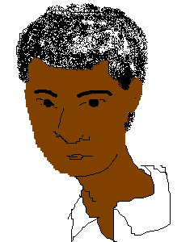
Elaborating a Scenario
Boundaries
Spatial
Temporal
Critical Uncertainties
Resolution affects future course
Story of the Present
Historic context
Important features
Actors and events
Major issues of concern
Important themes
Important elements of the story
Images of the Future
Driving Forces
Trends and processes at play
Narrative
Coherent vision
Quantification
Technical rigor
Stakeholders
Notes:
The GEO scenarios were elaborated in a number of steps. The boundaries of the scenarios were set: the spatial boundary was defined by the regional structure, the thematic boundaries were defined by the emphasis on the environment and the connections to development, and the temporal boundaries were defined by the 30 year time horizon. Key dimensions included population, economic growth, equity, poverty, and numerous environmental and resource indicators. For those of you who are mathematically inclined, you can think of these key dimensions as forming an abstract multi-dimensional space – scenarios can be represented as different trajectories through this space. Describing the current situation for each region was a key factor in elaborating the scenarios. This included the historic context (as I mentioned earlier the report provides a 30 year retrospective from 1972), a description of important polices and institutions affecting the state of the environment, and analyses of current environmental conditions. Then, the important driving forces were introduced. Critical uncertainties were identified; these include major environmental and social tensions that, depending on how they are resolved, could significantly alter the future course of events. Narratives were developed that give the plot of the scenario story, and communicate effectively to a wide audience. The scenario story and the quantitative analysis lead to different images of the future.

Slide 99
Placing a National Scenario Exercise in Context
See the Scenario Process as Part of the Whole IEA Process:
In many cases, the scenario process will be nested within an overall GEO process. Thus, it should be aware of, and to the extent possible, work in concert with the other processes.
Recognize the Significance of Developments at Other Scales for a National Scenario Process:
Although the focus here is on national GEO processes, a study might be complemented by the development of scenarios on other levels: global, regional and local.

Slide 100
Steps in a Scenario Methodology
Clarifying the Purpose and Structure of the Scenario Exercise
  Identifying stakeholders and selecting participants.
  Establishing the nature and scope of the scenarios.
  Identifying themes, targets, indicators, and potential policies.
Laying the Foundation for the Scenarios
  Identifying drivers.
  Selecting critical uncertainties.
  Creating a scenario framework.
Developing and Testing the Scenarios
  Elaborating the scenario narratives.
  Undertaking the quantitative analysis.
  Exploring policy.
Communication and Outreach

Slide 101
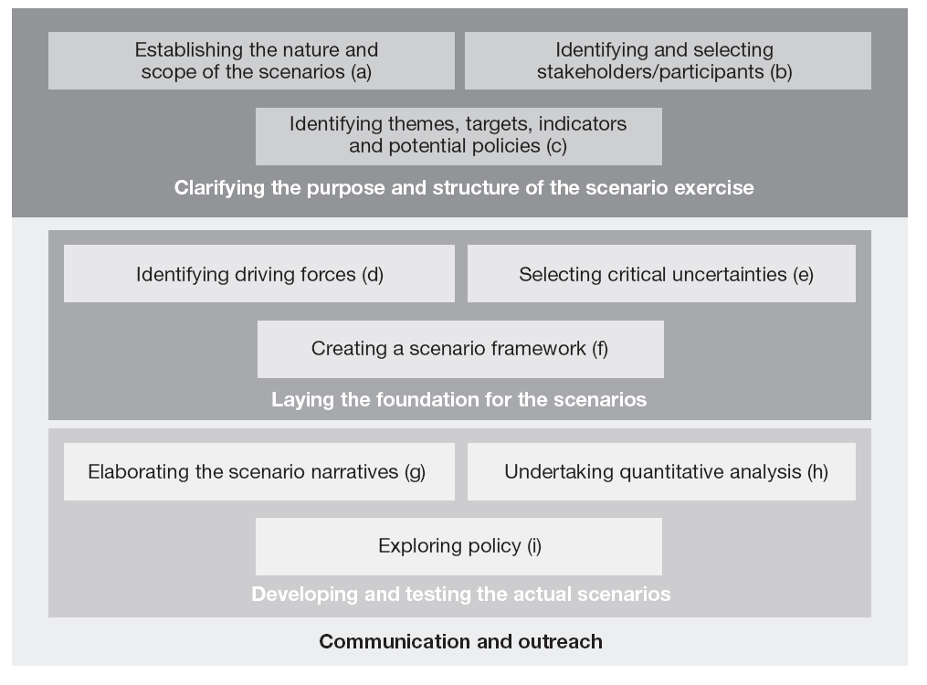
Steps in a Scenario Methodology

Slide 102
  Establishing the Nature and Scope of the Scenarios
  Purpose: Establish a clear view of the scenario to be used.
  Output: Depending on type of scenario, could include time horizon, qualitative and quantitative balance, nature of policy analysis and available resources.

Slide 103
a) Establishing the Nature and Scope of the Scenarios – 11 Questions
What is the problem that we want addressed in the scenario project?
Are there existing policies we wish to explore as part of the exercise?
Do we have a preconceived vision, or specific targets, for the scenarios?
Why is scenario development appropriate for dealing with the problem?
Who is the audience?

Slide 104
a) Establishing the Nature and Scope of the Scenarios – 11 Questions
What types of scenarios are needed? Would a backcasting or forward-looking approach be better?
What time frame should be considered? Should the scenarios be narrative and/or quantitative?
How are the scenarios to be connected with scenarios developed for higher levels (e.g., regional or global)?
What do we want to have achieved by the end of the scenario process?
What resources are needed to achieve the goal and is it possible/desirable to make that investment?
What are the expected roles of the scenario team and other stakeholders?

Slide 105
b) Identifying Stakeholders and Selecting Participants
  Purpose: To ensure the process benefits from a cross-section of society, improving the likelihood of buy-in from the audience.
  Output: A list of participants and alternates.

Slide 106
b) Identifying Stakeholders and Selecting Participants
Identify which organization or institution is convening this scenario exercise, and consider participant(s) from this group.
Identify other audiences by deciding who the scenarios are intended to reach. This could be the same audience as for the national GEO as a whole.
Identify other key stakeholders–who has an important stake in the country’s future, who are the decision-makers, and who are the people directly impacted by such decisions.

Slide 107
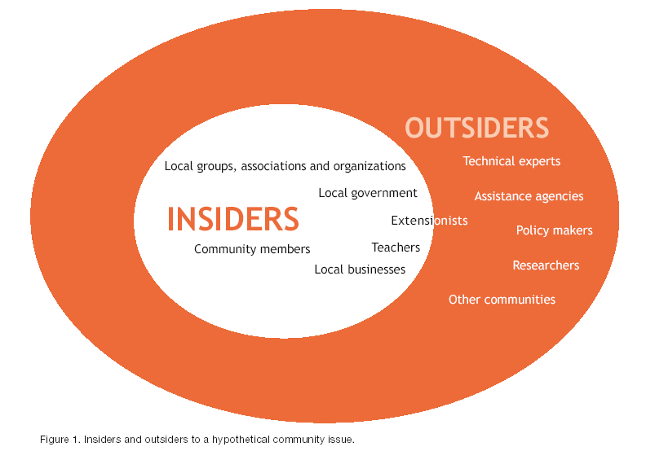

Slide 108
c) Identifying Themes, Targets, Potential Policies, and Indicators
  Purpose: To provide more specific details on the scope of the exercise
  Outputs:
    A clearer understanding of the real-world system for which the scenario exercise is being undertaken
    Preliminary lists of: key themes, targets and goals (including constraints or thresholds to be avoided), policies to be considered, specific indicators

Slide 109
c) Identifying Themes, Targets, Potential Policies, and Indicators

Slide 110
c) Identifying Themes, Targets, Potential Policies, and Indicators

Slide 111
c) Identifying Themes, Targets, Potential Policies, and Indicators
How would you describe the current social, economic and environmental situation in your country?
  What themes did you include?
  What indicators did you use?
How did it get to be this way?
  What other themes/issues did you need to include to explain the history?
  How did you characterize the key dynamic relationships?
  What past policies/actions/events were significant?
What is on the present day agenda?
  Have commitments been made/goals and targets been set?
  Have policies been proposed or put in place?
  What are people’s hopes and fears?

Slide 112
Steps in a Scenario Methodology
Laying the Foundation for the Scenarios
  Identifying driving forces.
  Selecting critical uncertainties.
  Creating a scenario framework.

Slide 113
d) Identifying Driving Forces
  Purpose: To identify the key trends and dynamics that will determine the course of the future.
  Steps:
  Review the previous discussions surrounding the past, present, and future.
  What factors have had or could have the most influence on other parts of the system? For example, what comes across as more of a cause than an effect? (Do not ignore those that may not have had a big effect in the past.)
  What are key trends? How persistent are they?

Slide 114
d) Identifying Driving Forces
A Typical Catalogue

Slide 115
e) Selecting Critical Uncertainties
  Purpose: To select critical uncertainties – those driving forces that are especially important in determining how the future evolves, but whose future development is highly unpredictable.
  Output: A small set of critical uncertainties.

Slide 116
e) Selecting Critical Uncertainties
For each driving force:
Consider the degree of uncertainty. Is there a great deal of uncertainty, or relatively little?
Consider the relative impact/importance of this driving force into the future.
Plot the driving force on a chart of impact/importance versus uncertainty.
Identify the two or three driving forces that are highest impact and highest uncertainty.
Notes:
Consider each driver in turn, and recall the range of possible ways it could evolve.
Consider the degree of uncertainty in each this driver. How much variation is there in the range of possible ways it could evolve? Is there a great deal of uncertainty, or relatively little?
Consider the relative impact/importance of each this driver into the future. Does the way that it evolves make a major difference in the overall vision for the future, or does it make a relatively minor difference?
Plot each the driver on the chart of impact/importance versus uncertainty. (In Figure 8, each circle represents a particular driver.) The farther to the right, the greater the uncertainty in how that driver could develop. The farther upward, the more significant is the impact of that driver.
Identify the two or three drivers that are highest impact and highest uncertainty. (In Figure 8, the two drivers that have the combination of the highest importance and highest uncertainty are labeled CU1 and CU2.)

Slide 117
e) Selecting Critical Uncertainties
Charting Importance and Uncertainty
Critical
Uncertainties
high
Other Influential Factors with one
likely trend – ‘inevitables’
Importance
Hmm?
low
Uncertainty
high

Slide 118
Which driving forces are critical uncertainties?
For each driving force:
Consider the degree of uncertainty. Is there a great deal of uncertainty, or relatively little?
Consider the relative impact/importance of this driving force into the future
Plot the driving force on the chart of impact/importance versus uncertainty
Identify the two or three driving forces that are highest impact and highest uncertainty
CU#1
CU#2
Importance
Uncertainty
Notes:
Consider each driver in turn, and recall the range of possible ways it could evolve.
Consider the degree of uncertainty in each this driver. How much variation is there in the range of possible ways it could evolve? Is there a great deal of uncertainty, or relatively little?
Consider the relative impact/importance of each this driver into the future. Does the way that it evolves make a major difference in the overall vision for the future, or does it make a relatively minor difference?
Plot each the driver on the chart of impact/importance versus uncertainty. (In Figure 8, each circle represents a particular driver.) The farther to the right, the greater the uncertainty in how that driver could develop. The farther upward, the more significant is the impact of that driver.
Identify the two or three drivers that are highest impact and highest uncertainty. (In Figure 8, the two drivers that have the combination of the highest importance and highest uncertainty are labeled CU1 and CU2.)

Slide 119
f) Creating a Scenario Framework
  Purpose: To use the critical uncertainties to establish the scenario framework.
  Output: A small set of clearly defined scenario “skeletons”.

Slide 120
f) Creating a Scenario Framework
  Various methods have been proposed to go from critical uncertainties to scenario skeletons; three common ones are:
  scenario axes based on two critical uncertainties
  scenario axes based on two clusters of critical uncertainties
  clustering mini-stories based on critical uncertainties into coherent scenarios

Slide 121
f) Creating a Scenario Framework
Scenario Axes Based on Two Critical Uncertainties
Using two of the critical uncertainties define four possible futures
“Scenario B”
“Scenario A”
Critical Uncertainty #2
Critical Uncertainty #1
“Scenario C”
“Scenario D”

Slide 122
f) Creating a Scenario Framework
Scenario Axes Based on Two Clusters of Critical Uncertainties
Same as before, but first cluster the critical uncertainties
Developments in Global Environmental Governance
Rate and Nature of Technological Changes

Slide 123
f) Creating a Scenario Framework
Example 1: CarSEA
More Globally Connected
“Neo-plantation”
“Quality Over Quantity”
More
Short-term Exploitation
More Carrying- capacity Sensitivity
“Growing Asymmetries”
“Diversify Together”
More Regionally Focused
Notes:
Here two axes are explored, one under control of stakeholders the other not directly under control.

Slide 124
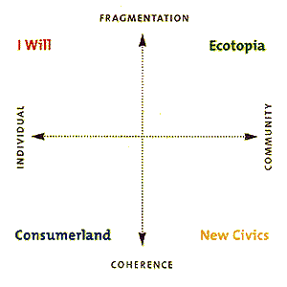
f) Creating a Scenario Framework
Example 2: Wired

Slide 125
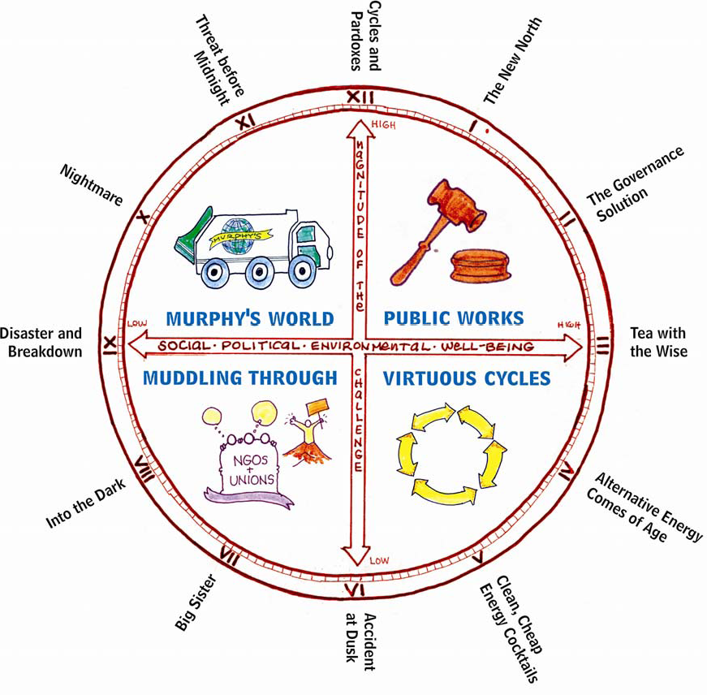
f) Creating a Scenario Framework
Example 3: Canadian Nuclear Waste Management

Slide 127
f) Creating a Scenario Framework
Clustering Mini-Stories
C.U. 1
C.U. 2
C.U. 3
C.U. 4
Story 1b
Story 4a
Story 3a
Story 2b
Story 3b
Story 1a
Story 4c
Story 2a
Story 4b
Story 2c
Scenario 1
Scenario 2
Scenario 3

Slide 128
Steps in a Scenario Methodology
Developing and Testing the Scenarios
  Elaborating the scenario narratives.
  Undertaking the quantitative analysis.
  Exploring policy.

Slide 129
g) Elaborating the Scenario Narratives
  Purpose: To create a detailed, compelling description of the scenario.
  Output: A several page long scenario narrative.
Notes:
For each scenario do the following steps.
Current state and trends:. Lead a discussion among the stakeholders of aspects of today’s world that seem to represent characteristics of the particular future scenario being developed. Exploreing each to of the themes from Step 7.3, identify as many of these “seeds of the future” as possible. These will help flesh out a plausible picture of how our current world could evolve into the future depicted in the scenario.
End picture:. Lead a discussion among the stakeholders of the end vision of the scenario. Once the critical uncertainties have been resolved, what would the world look like? Add detail and texture that will help round out the end vision of the scenario, and create an integrated, self-consistent snapshot of the end state. Consider each theme and driver, and provide some detail. Consider what aspects of life have changed for the better or worse. Consider what challenges have been resolved, and what challenges have emerged and still lie ahead.
Time lineTimeline:. Lead a discussion to connect the current state to the end picture through a plausible historical route. Consider the interactions between among the themes and how they would evolve together in a self-consistent manner. You might want to draw on a poster paper or whiteboard a timeline spanning the period from present to the time horizon of the scenario, and have the group brainstorm specific events occurring at specific times. Consider each theme and each driver. (You might want to draw several parallel time linestimelines to keep track of different themes or drivers.) Referring to step (b), consider the challenges that have been resolved or that have emerged, and reflect these in events on the time line.
Using the current state, the end picture and the timeline, your group can now expand these to create a coherent narrative. Add detail and texture that will help round out each scenario and create an integrated, self-consistent and, compelling storyline. Your group might want to consider describing crises and shocks, or branch points where two scenarios diverge because of specific different societal decisions. Your group might also want to use novel and compelling ways of presenting information within the narratives, such as news stories, advertisements, memoirs and, “day-in-the-life” vignettes.
While developing your scenario narratives, create a name for each scenario. Try to find a name that captures the essence of the scenario, and differentiates it clearly from the others.

Slide 130
g) Elaborating the Scenario Narratives
For each scenario, consider five areas:
Current state: Aspects of today’s world that represent characteristics of the scenario being developed.
End picture: The end vision of the scenario, assuming that critical uncertainties have been resolved.
Timeline: Connect the current state to the end picture through a plausible historical route.
Notes:
For each scenario do the following steps.
Current state and trends:. Lead a discussion among the stakeholders of aspects of today’s world that seem to represent characteristics of the particular future scenario being developed. Exploreing each to of the themes from Step 7.3, identify as many of these “seeds of the future” as possible. These will help flesh out a plausible picture of how our current world could evolve into the future depicted in the scenario.
End picture:. Lead a discussion among the stakeholders of the end vision of the scenario. Once the critical uncertainties have been resolved, what would the world look like? Add detail and texture that will help round out the end vision of the scenario, and create an integrated, self-consistent snapshot of the end state. Consider each theme and driver, and provide some detail. Consider what aspects of life have changed for the better or worse. Consider what challenges have been resolved, and what challenges have emerged and still lie ahead.
Time lineTimeline:. Lead a discussion to. Consider the interactions between among the themes and how they would evolve together in a self-consistent manner. You might want to draw on a poster paper or whiteboard a timeline spanning the period from present to the time horizon of the scenario, and have the group brainstorm specific events occurring at specific times. Consider each theme and each driver. (You might want to draw several parallel time linestimelines to keep track of different themes or drivers.) Referring to step (b), consider the challenges that have been resolved or that have emerged, and reflect these in events on the time line.
Using the current state, the end picture and the timeline, your group can now expand these to create a coherent narrative. Add detail and texture that will help round out each scenario and create an integrated, self-consistent and, compelling storyline. Your group might want to consider describing crises and shocks, or branch points where two scenarios diverge because of specific different societal decisions. Your group might also want to use novel and compelling ways of presenting information within the narratives, such as news stories, advertisements, memoirs and, “day-in-the-life” vignettes.
While developing your scenario narratives, create a name for each scenario. Try to find a name that captures the essence of the scenario, and differentiates it clearly from the others.

Slide 131
g) Elaborating the Scenario Narratives
Create a coherent narrative using current state, end picture and timeline. Add detail and texture.
Create a name for each scenario that captures the essence of the scenario and differentiates it clearly from others.
Notes:
For each scenario do the following steps.
Current state and trends:. Lead a discussion among the stakeholders of aspects of today’s world that seem to represent characteristics of the particular future scenario being developed. Exploreing each to of the themes from Step 7.3, identify as many of these “seeds of the future” as possible. These will help flesh out a plausible picture of how our current world could evolve into the future depicted in the scenario.
End picture:. Lead a discussion among the stakeholders of the end vision of the scenario. Once the critical uncertainties have been resolved, what would the world look like? Add detail and texture that will help round out the end vision of the scenario, and create an integrated, self-consistent snapshot of the end state. Consider each theme and driver, and provide some detail. Consider what aspects of life have changed for the better or worse. Consider what challenges have been resolved, and what challenges have emerged and still lie ahead.
Time lineTimeline:. Lead a discussion to. Consider the interactions between among the themes and how they would evolve together in a self-consistent manner. You might want to draw on a poster paper or whiteboard a timeline spanning the period from present to the time horizon of the scenario, and have the group brainstorm specific events occurring at specific times. Consider each theme and each driver. (You might want to draw several parallel time linestimelines to keep track of different themes or drivers.) Referring to step (b), consider the challenges that have been resolved or that have emerged, and reflect these in events on the time line.
Using the current state, the end picture and the timeline, your group can now expand these to create a coherent narrative. Add detail and texture that will help round out each scenario and create an integrated, self-consistent and, compelling storyline. Your group might want to consider describing crises and shocks, or branch points where two scenarios diverge because of specific different societal decisions. Your group might also want to use novel and compelling ways of presenting information within the narratives, such as news stories, advertisements, memoirs and, “day-in-the-life” vignettes.
While developing your scenario narratives, create a name for each scenario. Try to find a name that captures the essence of the scenario, and differentiates it clearly from the others.

Slide 132
Qualitative trends for indicators

Slide 133
h) Undertaking the Quantitative Analysis
  Purpose: To enhance and elaborate the scenario narrative with quantitative information.
  Output: Specific, scientifically defensible quantitative information.
Notes:
Determine the approach to be used for quantification (e.g.e.g., which tools and models to use, how these will be linked to each other, and how these will be informed by/inform the narratives).
Assemble the necessary data and relationships.
Use the tools and models to produce the quantitative estimates.

Slide 134
h) Undertaking the Quantitative Analysis
Steps:
Determine the approach to be used for quantification (e.g. what models and tools and how these will be informed by/inform the narratives).
Assemble the necessary data and relationships.
Use the tools and models to produce the quantitative estimates.

Slide 135
h) Undertaking the Quantitative Analysis
Aim:
To numerically express inputs, science-based relationships, assumptions, and results.
Quantitative analysis should use tools that:
Can be applied and compared across widely differing scenarios. They should not artificially constrain your scenarios.
Are as simple, transparent, and user-friendly as possible. Can yield clear, useful results.

Slide 136
h) Undertaking the Quantitative Analysis
The Standard Approach
Results
mysterious black box
Models
Assumptions
Theory
Facts

Slide 137
h) Undertaking the Quantitative Analysis
An Alternative Approach
Results
More flexible, more transparent, but “thinner.”
Models
Assumptions
Theory
Facts

Slide 138
Scenario Indicators Compared Quantitatively

Slide 139
h) Undertaking the Quantitative Analysis
Example Tools
more specific
MAGICC/SCENGEN http://www.cgd.ucar.edu/cas/wigley/magicc/
WEAP http://www.weap21.org/
LEAP http://forums.seib.org/leap/
IMPACT http://www.ifpri.org/themes/impact.htm
IMAGE http://www.ciesin.org/datasets/rivm/image2.0-home.html
QUEST http://www.envisiontools.com http://www.basinfutures.net/
IFs http://www.du.edu/~bhughes/ifs.html
IPAT-S http://ipat-s.kb-creative.net/
Polestar http://www.seib.org/polestar/
Stella, Vensim, GAMS, Matlab, Excel, etc., etc., etc.
more generic

Slide 140
i) Exploring Policies
  Purpose: To explore the feasibility, appropriateness, effectiveness, and robustness of various policies.
  Key Points:
    Policies may be introduced at an early stage and may represent an uncertainty defining a scenario,
    Policies may be introduced as part of implementing a scenario.
    Policies should be analysed, including assessment against goals and targets.
Notes:
: As discussed in the previous section, the nature of policy analysis can differ markedly across, and sometimes within scenario exercises. In some cases, the introduction of policies into the scenarios will occur at a very early stage, e.g., they may represent one or more of the key uncertainties defining the scenarios. In other cases, the exercise may involve developing scenarios, which, from the standpoint of the users, are incomplete in that they do not include specific policy assumptions, and are only finalized with the introduction of potential policies. In either case, it is important to reflect upon and analyse the feasibility, appropriateness, effectiveness, and robustness of particular policies. This should be done, in part, by comparing the scenarios as defined by key indicators, against key goals and targets.

Slide 141
Steps in a Scenario Methodology:
Communication & Outreach
Communication of scenarios is particularly important if the scenarios are to succeed in inspiring new visions of the future.
Example–the success of the Mont Fleur scenarios, which were published first in a newspaper and thus, widely communicated.

Slide 142
Steps in a Scenario Methodology:
Communication & Outreach
Outreach is important in order to generate a discussion with all stakeholder groups about the content and implication of the scenarios.
This provides “buy-in” to the results of the scenario exercise from a group much larger than that involved in the development and analysis of the scenarios.
It also can provide valuable feedback on the results.
This can be achieved through a series of workshops in which the scenarios are presented and discussed.

Slide 143
Steps in a Scenario Methodology:
Communication & Outreach
Communication and outreach should take place throughout the scenario process, and not merely occur at the end.
Involvement of a range of stakeholders in the various stages of the process should be seen as part of the communication and outreach effort.

Slide 144
Overview
Session 1: What is a Scenario?
Session 2: Examples
Session 3: Purpose, Process and Substance
Session 4: Policy Analysis
Session 5: Developing Scenarios
Session 6: Exercise on Scenario Development

Slide 145
Steps in a Scenario Methodology

Slide 146
Steps in a Scenario Methodology
Clarifying the Purpose and Structure of the Scenario Exercise
  Identifying stakeholders and selecting participants.
  Establishing the nature and scope of the scenarios.
  Identifying themes, targets, indicators and potential policies.
Laying the Foundation for the Scenarios
  Identifying drivers.
  Selecting critical uncertainties.
  Creating a scenario framework.
Developing and Testing the Scenarios
  Elaborating the scenario narratives.
  Undertaking the quantitative analysis.
  Exploring policy.
Communication and Outreach

Slide 147
Groups Exercise
Select a facilitator for each group to lead the discussion and report back
Work on developing scenarios (simple “prototype” scenario exercise)
Follow the steps

Slide 148
Step 1
Identify historical areas of change and renewals within your boundary conditions
  Create a timeline of events in the past 50 or 100 years that impacted your region of concern
Population & development accelerates
e.g. of major events and eras of change
1973
1990
50 or 100 years ago
0
Rapid Economic growth

Slide 149
Step 2
Identify the focal question (write them on the board)
  What are the current problems in the region of concern?
  What are your main concerns or issues about the future in the region of the exercise?
Keep these, will return to them frequently during future discussions to make sure that they stay central to the exercise

Slide 150
Step 3
Identify driving forces
  What are the key driving forces of the past, do you think they will continue to be important in the future?
  What are important changes happening in the community? What is causing those changes?
  What are things that stay the same in the community? What keeps them from not changing?
  List driving forces under STEEP categories, add others if there is a need

Slide 151
Cont., Step 3
Classify driving forces as certain and uncertain in the future
Classify driving forces as critical and uncritical in the future
Try to draw the diagram
Select the most critical and uncertain to form the basis of the scenario framework
Importance
Uncertainty

Slide 152
Step 4
Define scenarios framework based on driving forces from previous step
Define time frame
“Scenario B”
“Scenario A”
Critical Uncertainty #2
Critical Uncertainty #1
“Scenario C”
“Scenario D”

Slide 153
Step 5
Discuss qualitatively trends in drivers and their impact on issues of concern in each scenario, (can use symbols as up or down or no change)
Driver/ issue | Indicator | Scenario 1 | Scenario 2 | Scenario 3 | Scenario 4
demography | Population growth rate | Increases rapidly | Increases slowly | Increases moderately | stabilized
Economic growth | GDP per capita
Education | Female enrollment in primary and secondary school… | … | … | … | …

Slide 154
Step 6
Develop an end picture and a time line of events, their chain-reaction, and the end picture for each scenario
Helps in writing the narrative storyline of the scenarios
Event 2
Event ..
Event n
Event 1
Event 3
Event ..
now
e.g., 2015 MDGs
e.g., 2030
End Picture

Slide 155
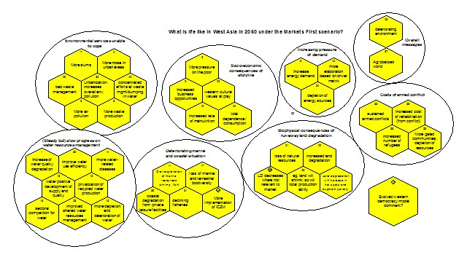
Example of Scenario End Picture

Slide 156
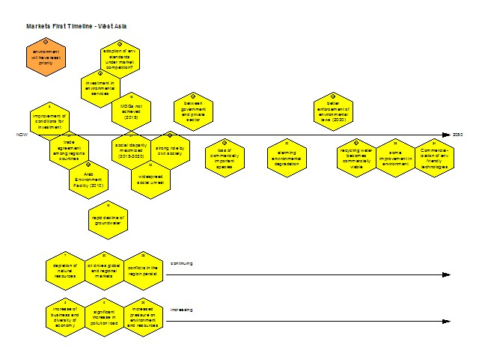
Example of scenario timeline

Slide 157
Step 7
Write down the narrative of the scenarios (short story)
Based on the time line and end picture and qualitative description of the driving forces

Slide 158
Step 8
Identify three most important opportunities and 3 most important threats for each scenario
For each opportunity
  Think of how to make advantage of it
  How to prepare for it
For each threat
  what need to be done to prevent it
  If not possible to prevent, how to mitigate its impacts

Slide 159
Step 9
Formulate recommendations to policymakers and decision makers
  …
  ….

Slide 160
Actual Exercises
Three steps
  Drivers and their impact on issues of concern.
  End picture.
  Time line
  Chose one uncertainty and assess across the scenarios

Slide 161
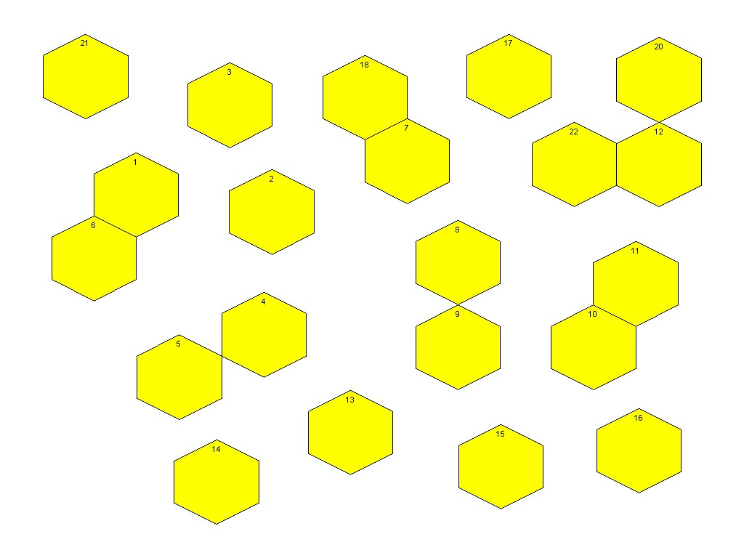

Slide 162
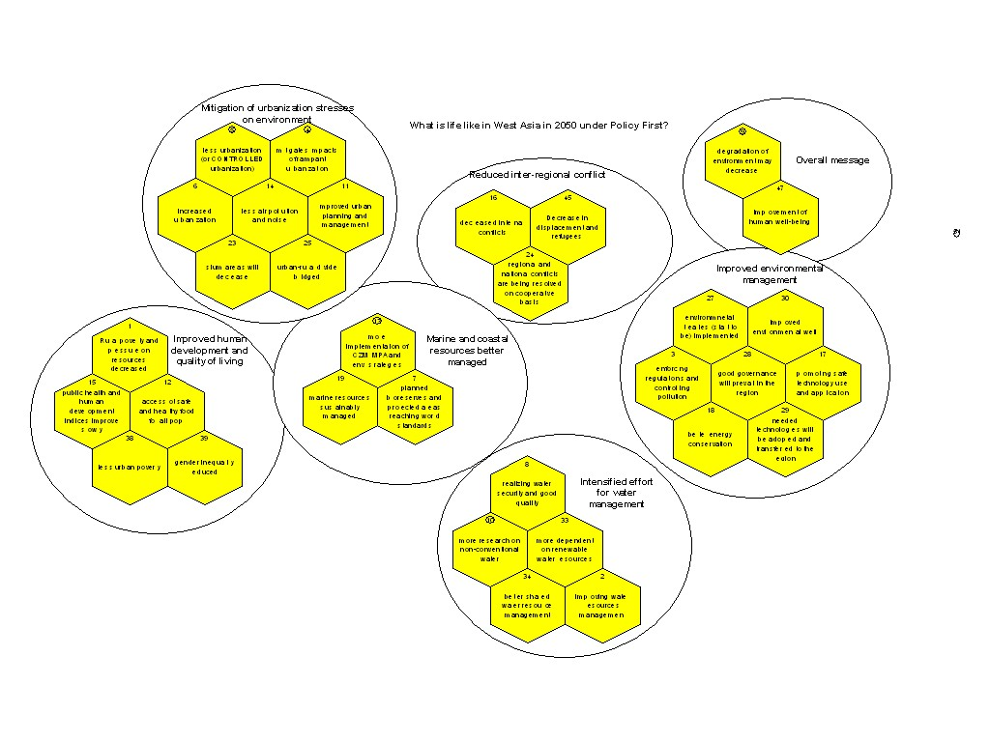

Slide 163
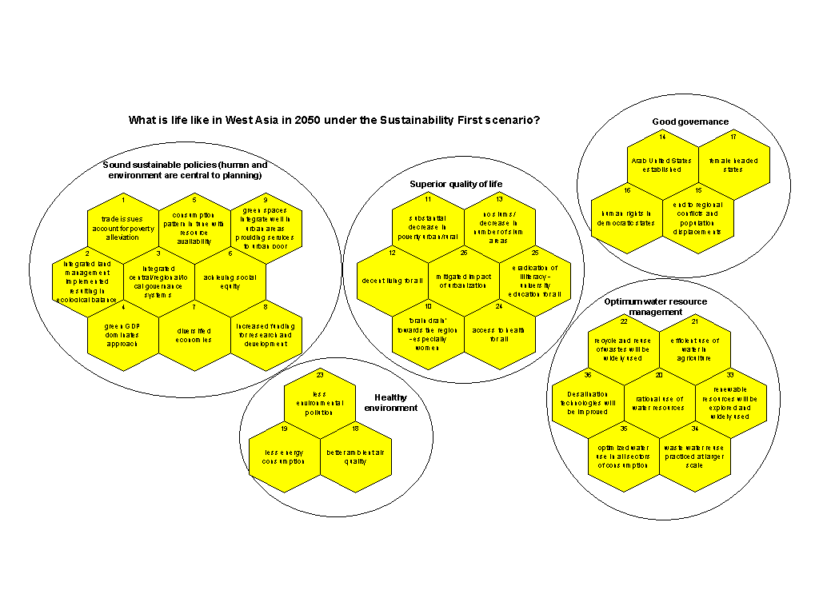

Slide 164
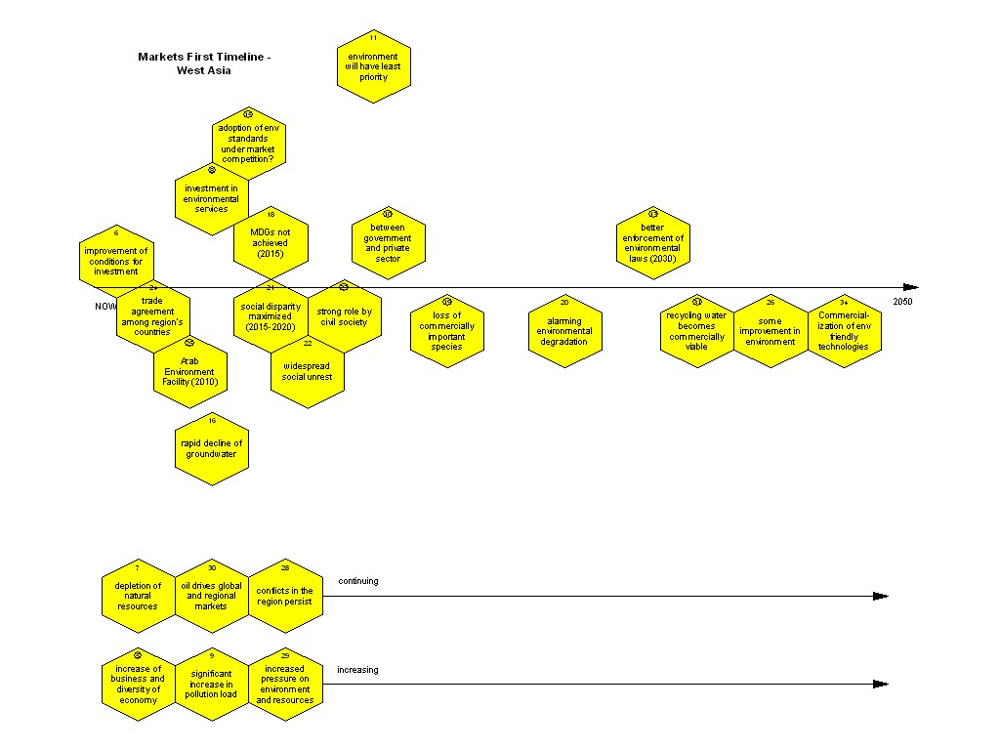

Slide 165
Example of Scenario End Picture

Slide 166
Example of scenario timeline

