Slide 1


Integrated Environmental Assessment Training Manual for the Arab Region
Module 7
Creating communication
outputs from the assessment

Slide 2
Session at a Glance
Session 1: Introduction
Session 2: Preparing to communicate
Session 3: Choosing what to produce
Session 4: How do we do it?
Session 5: Reaching Out

Slide 3
Introduction
This module focuses on finding innovative communication outputs for IEA, and provides practical steps for dissemination.

Slide 4
Learning Objectives
Demonstrate an ability to link target group(s) and content with presentation format and communication channels.
Understand, consider and systematically implement the dissemination plan.
Organize the production processes.
Understand the importance of distribution/dissemination, with emphasis on approaching the media

Slide 5
Exercise: Mapping Existing Communication Outputs (15 minutes)
In groups of 2-3 people,
Discuss your experiences working with different communication formats and distribution channels, both traditional (i.e., printed) and non-traditional (i.e., electronic/multi media).
What are your observations and experiences about using different formats?
What results, if any, were achieved?
Notes:
5

Slide 6
Session at a Glance
Session 1: Introduction
Session 2: Preparing to communicate
Session 3: Choosing what to produce
Session 4: How do we do it?
Session 5: Reaching Out

Slide 7
Reviewing your Impact Strategy
Consider:
  The environmental issues you want to communicate;
  The persons and groups in a position to influence these issues;
  The knowledge that the national IEA process will generate; and
  Leveraging opportunities for getting key information to the influential target audiences

Slide 8
Leverage Opportunities for Influence
  Think strategically
  Link target group(s) and content with your choice of innovative communication format and channels
  Consider your budget constraints at all times

Slide 9
Session at a Glance
Session 1: Introduction
Session 2: Preparing to communicate
Session 3: Choosing what to produce
Session 4: How do we do it?
Session 5: Reaching Out

Slide 10
Pillars of Media
Source (sender): success depends on sender’s credibility, communication skills, positive attitude towards oneself, message, and recipient; and on extent of sender’s knowledge and information.
Recipient: level of education, age, gender, financial conditions, social status, culture, and background.
Message: clear objective, simple presentation
Media: magazines, newspapers, radio, television, electronic publishing.
Notes:
10

Slide 11
Choosing What to Produce
Target Groups,
Content,
Budget,
Format,
Channels

Slide 12
1. Identifying your Target Group
Consider:
  Those you want to reach with your message
  The mandated audience of your IEA, such as governments
  Language and cultural differences
  Specific and broad audiences
  End users versus “broadcasters”
  Refer to the target groups identified in Module 3.

Slide 13
The Most Common Target Groups
Governments (environmental agencies)
Planners
Politicians
Researchers and analysts
Media
Non-governmental organizations (NGOs)
General public
Schools and universities
Industries and businesses

Slide 14
Group Exercise: Who is reading what? (20 minutes)
Objective: To reflect on how various groups access information, who are their peers, to whom do they listen, and what you as a producer can offer to your target groups.
Process:
  Form groups of maximum 6 people
  Each group receives a user-group role
  Two sub-groups form in each group
    Sub-group 1: Those preparing the assessment
    Sub-group 2: Those representing a target group
  Discuss the types of products that can be offered (15 minutes)
Notes:
14

Slide 15
Group Exercise: Who is reading what? (20 minutes)
Target Group or Focus Group | What are the needs of the target group | What is the message | Formats
Government representatives of environment-related sectors (e.g., transport, agriculture) | Become convinced about the linkage and situation… | Global warming and its causes … | Extended brochure of 10 pages; indicator based analyses …

Slide 16
2. Content: Tailoring Your Message
Connect your message to the characteristics of the target group, such as:
    Knowledge
    Attitude
    Level of education
    Lifestyle
    Culture
    Interests
    Involvement in the problem and solution
  …And, make sure the message is credible and trustworthy to your audience.
Notes:
16
A You also need last thing to consider your reach and is your credibility as the sender of the message. Are you able to reach your target group(s)? Will they find your message trustworthy? If the answer to either of these questions is “no,” you should reconsider your message or your audience.

Slide 17
Success conditions for media messages
Clarity of the message: sender-recipient harmony. Confusion and overlaps could hinder understanding of the message. Such confusion could be caused by the message containing unknown phrases, or by poor print.
Message circumstances: these greatly impact the level of message acceptance or none. The cultural, social, and psychological background of the recipient influences their response to such circumstances.
Social values and principles: success depends on the extent of recipient’s understanding of and involvement in the community’s values.

Slide 18
Formulating Specific Messages for your Audience
Questions to ask:
  Do the messages form a coherent story?
  Are there any conflicts, ambiguities or uncertainties in the content that need to be made explicit?
  How much background does the audience have?
  How do they view the environment – as a necessity or a luxury?
  What motivates your target audience to act?

Slide 19
Target Groups and Content
Decision – makers: Keep content short, specific, fact based and consist of the latest information.
Media: Keep content short, with findings relevant for media use, and messages that can easily be linked to other issues in the news.
Students: Explain content well and keep language simple.
Scientists: Keep content fact-based, and use the latest data. Your language can be scientific, and include technical terms.

Slide 20




Slide 21
3. Tailoring to your Budget
Include personnel time in costs, as well as design, publishing, distribution, office supplies and contingency costs.
Some formats, such as web-based products are less expensive than others, such as print.
Consider innovative ways to raise funds, such as co-publishing or sponsorship.

Slide 22
Exercise: What are the main budget lines? (10 minutes)
What are the main competencies and budget lines for producing a report and a website?
What are potential financial options?
Optional Table
Activities | Unit | Cost
Writers | 5 experts X 1 month | …
Editing | 1 editor X 2 weeks | …
Notes:
22

Slide 23
4. Formats
Spoken options include visits, interviews, speeches, meetings, press conferences, training sessions, radio broadcasts, discussion groups and hearings.
Written options include reports, flyers, newsletters, posters and brochures.
Visual options include presentations, television, slide shows, films and videos.
Digital options include Internet, CD-ROM’s, PC-demos, e-mail bulletins, discussion groups and online conferences.

Slide 24
Formats: What is Communication Effectiveness?
Your message is:
  Received by target audience
  Interpreted adequately by recipients as intended by senders
  Remembered over a sufficient period of time
  Triggered an appropriate reaction
Effectiveness = Impact of Message
  Cost of Producing Message
Notes:
24
Edan
Communication efficiency of a channel means that the maximum number of recipients hasve been reached per unit cost
Number of recipients reached
Efficiency= --------------------------------------------------
The cost of producing message

Slide 25
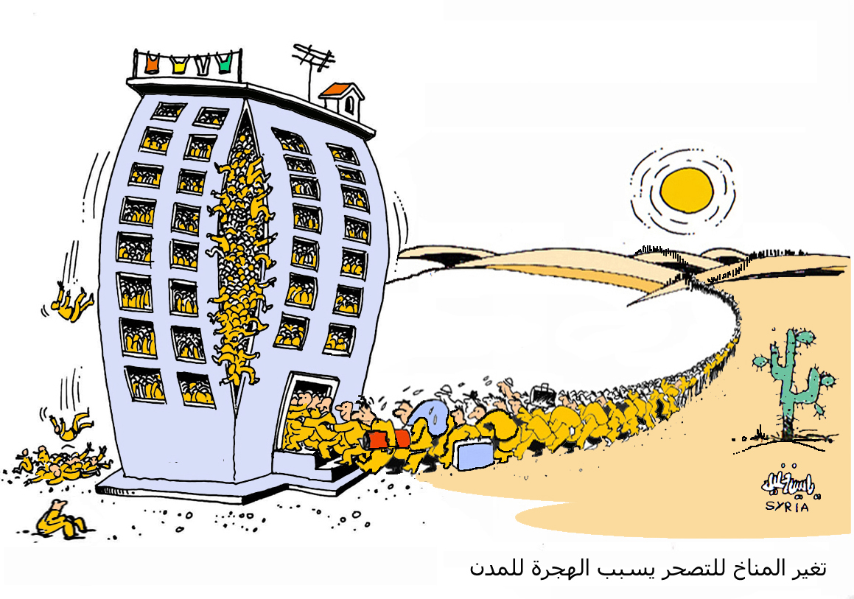
Climate change towards desertification causes migration to urban areas.

Slide 26
What is communication efficiency?
The maximum number of recipients have been reached per unit cost.
Efficiency = Number of recipients reached
Cost of Producing Message
Notes:
26
maximum number of recipients hasve been reached per unit cost
Number of recipients reached
Efficiency= --------------------------------------------------
The cost of producing message

Slide 27
5. Choosing Multiple Channels
Understand the channels your audience uses
  In Norway, newspapers are often read
  In Uzbekistan, people avidly listen to the radio
Choose multiple channels
  To offset the weaknesses and gain from the strengths of each channel

Slide 28
Reaching your Audience
What range of direct communication methods are available to you, beyond radio, TV and newspapers?
What channels will reach your audience in their language and reflect their culture?
How will you ensure repetition and continuation of messages over a longer time period?

Slide 29
Dissemination of an Environmental Report
A Possible Outline
Timing | Dissemination Activity | Purpose | Target Audience | Potential Impact | Media Used | Follow up/Action Taken
Date | Special event involving media | Launch of report, get attention | Key partners (ministries, NGOs, media) | Media coverage, outreach in ministries | Event launch, media contacts | Media monitoring& free distribution to ministries

Slide 30
Discussion: Media Relations in Your Country
(40 minutes)
In groups of 4, discuss the needs and available resources for communication.
Part 1:
  What ongoing relations with mainstream media exist within your organization/ department?
  Do you have staff/members who are familiar with mainstream media norms and needs? Do these staff/members have sufficient time to do consistent media outreach?

Slide 31
Discussion: Media Relations in Your Country
(40 minutes)
Part 2:
  Make a list of responsive journalists and other “insiders,” and describe plans to use them to spread your message.
  Does your organization have a distribution network? Is it updated and ready to be used?

Slide 32
Exercise: Creating a Communications Map (30 minutes)
The aim of the exercise is to find out what are the best communication channels, considering given time, resources and possibilities.
Create a map of communication options by comparing strengths and weaknesses, using the following format.

Slide 33
Exercise: Creating a Communications Map
(30 minutes)
Channel | Strength | Weakness | Priority
Television | Can reach many people. Visual medium has greater impact. | Expensive to produce and buy time. Short format does not allow for more awareness.
Press (Magazines, papers)

Slide 34
Session at a Glance
Session 1: Introduction
Session 2: Preparing to communicate
Session 3: Choosing what to produce
Session 4: How do we do it?
Session 5: Reaching Out

Slide 35
How do we do it?
Print products
Electronic/digital products
Visual presentation of date (including cartographic processes and timesaving techniques)

Slide 36
1. Print Products: 9 Common Steps
Specifications including size, design guidelines and sometimes a dummy report.
Contents including text, graphics, pictures, as well as picture text, references and headings.
Quality control, revisions and editing.
Translation (if needed.)
Pre-design to test the design and make revisions before developing all the contents.

Slide 37
1. Print Products: 9 Common Steps
Layout of contents in the design chosen.
Proofreading to make revisions before the report goes to the printers.
Test print to get rid of the last mistakes, correct colours, identify missing elements, etc.
Print and disseminate to your target audiences.

Slide 38
Exercise: Budgeting Needs and Skills (30 minutes)
What expertise and skills do you needs to succeed with your project?
In groups of 4-5, make a budget and time plan based on:
  Who will be involved in the project (inside and outside expertise)?
  What are direct expenses (e.g., meetings, communication, printing, transport)?
  How much it cost?
  What is the time frame of the different steps?

Slide 39
Electronic / Digital Products
Publishing on the web allows greater flexibility.
Contents can be easily added, removed or changed on the web.
It is important to keep contents updated regularly to keep the interest of readers.
Some countries have limited web access.

Slide 40
Electronic / Digital Products
Keep text short and focused on your key message;
Use small image sizes so more people can download them;
Include links to other websites or further information.
For those with reduced web access or for audiences such as schools, you can develop a CD Rom.

Slide 41
Electronic / Digital Formats
PDF: a widely used and very useful way of transferring documents on the web or through email.
HTML: The coding language used to create “hypertext” documents for the web.
RSS: Technologies that make it easy to share content among different web sites.
WEBLOG (BLOG): A publicly accessible journal created by an individual and shared over the web.
Notes:
41
PDF. PDF stands for Portable Document Format, and has become a widely-used way of publishing electronic documents. PDF is probably the best way to transfer and view documents on the web or through e-mail. Once you have Acrobat Reader installed (which is already in most recent computers) all you need to do is click on the PDF file and it automatically opens. If Acrobat Reader is not already installed, it can be downloaded free from the web (http://www.freesoftwarepack.com/Adobe_Reader.html). However, creating a PDF file requires Acrobat Professional, which must be purchased.
HTML. Hypertext Markup Language is the coding language used to create hypertext documents for the web. In HTML, a block of text can be surrounded with electronic “tags” that indicate how it will appear on a computer screen (e.g., bold face or italics). Also, in HTML a word, a block of text, or an image can be linked to another file on the Web. HTML files are viewed with a web browser.
RSS. Rich Site Summary and RDF (Resource Description Framework) are web technologies that make it easy to automatically share content, such as news items, among different web sites. A web site can allow other sites to publish some of its content by creating an RSS document, and registering the document with an RSS publisher. A web publisher can post a link to the RSS feed so users can read the distributed content on his/her site.
WEBLOG (BLOG). This is a publicly accessible personal journal created by an individual, and shared over the web. The activity of updating a blog is "blogging," and someone who keeps a blog is a "blogger." Blogs are typically updated daily using software that allows people with little or no technical background to update and maintain the blog. Postings on a blog almost always are arranged in chronological order, with the most recent additions featured most prominently.

Slide 42
Exercise: Create an outline of a web structure (1 hour)
Working in groups of 4,
Use the report provided to transform the table of contents into a diagram of a web report.
Display on a larger poster.
Present results in plenary.
Notes:
42
A paper report has a linear structure, where the reader goes through the contents in a predefined order. Web reports have a hierarchical structure, where the reader can choose to move horizontally from topic to topic, or vertically perusing a topic more in depth. Working in groups of four, take an existing report provided by the instructor and transform the report’s table of contents into a diagram of a web report. The web structure can be displayed on a large poster. Duration of the exercise 1 hour. Present results of the exercise at the plenary. The needs for exercise: A3 paper, markers of 4-5 colours.

Slide 43
Visual Presentation of Data
The most powerful, meaningful and culturally important messages are those that combine words and pictures in equally respectful ways.
Memorable visual messages with text have the greatest power to inform, educate and persuade an individual.

Slide 44
Visual Presentation of Data
Visual communication helps shape the interpretation of data and strengthens messages.
Images, maps and graphics can simplify and condense complex material;
Strengthen the readability of your assessment by:
  Using the right images and color
  Getting maps and graphics properly done
Notes:
44
Visual communication can help us shape the interpretation of data, and strengthen messages delivered through the text. Images, maps and graphics can simplify complicated insights as well as displaying complex information in a very condensed way. So, by using the right images and colours, and by getting your maps and graphics properly done, your assessments messages and readability will be strengthened. See the presentation material on improved visual communication.

Slide 45
Steps for Creating Maps and Graphics
Choose your subject and collect spatial information.
Select and start processing the data in order to extract the information you need to create your maps and graphics.
Create your maps and graphics.
Quality check your product to ensure consistency with the data.

Slide 46
Step 3: Create your Maps and Graphics
3a. Choose a visual representation (map, graphic)
3b. Set up the design with symbols, colors, lines, and titles.
Watch for:
    colors that go well together
    consistent use of symbols
    appropriate thickness of lines

Slide 47
Exercise: Improve Visual Presentation (1 hour)
Work in groups of 2-3 people
Use data provided, to develop a visual presentation
Consider:
  Graphic representation
  Font and size
  Colours
  Simplicity of presentation
Notes:
47

Slide 48
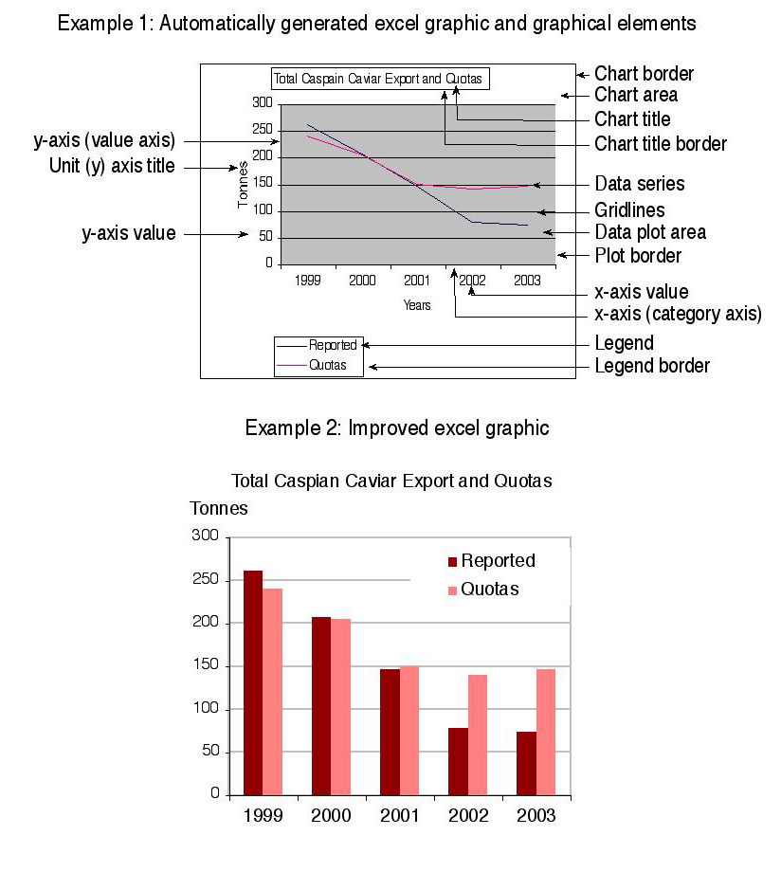
Example: Presenting Graphics Visually
Note the contrast in the two graphs.

Slide 49
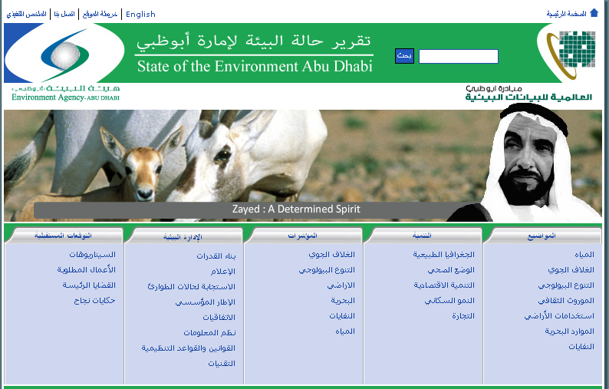
http://www.soe.ae/Abu_Frontpage.aspx?m=209

Slide 50
Session at a Glance
Session 1: Introduction
Session 2: Preparing to communicate
Session 3: Choosing what to produce
Session 4: How do we do it?
Session 5: Reaching Out

Slide 51
Dissemination of Information
Ensure you have a good distribution network
Ensure your distribution list matches your target audiences and update if needed.
Consider different ways of distributing your strategy
Keep thinking about distribution long after your product has been produced (even if hard to do)

Slide 52
Approaching the Media
Build strategic and long - lasting relationships with the media.
Channels for approaching the media include press releases, press conferences, press briefings or special media events.
Virtual and real media tours and eco-journalist festivals are approaches used by UNEP.

Slide 53
Preparing a Press Kit
A press kit helps journalists use your information, improving your chances of getting media coverage.
It is good practice to Include:
  Information on the organization behind the report
  An executive summary highlighting key findings in the report
  A press release
  Graphics
Notes:
53

Slide 54
The Press Release
A press release is a statement prepared for distribution to the media, to give journalists information that is useful, accurate and interesting.
Journalists have standards and expectations that must be met for a press release to be read and used.

Slide 55
Essential Components of a Press Release
Organization’s/department’s letterhead, name, address, phone number, e-mail, website
PRESS RELEASE in all caps
Contact person's name and contact information
IMMEDIATE RELEASE OR RELEASE DATE in all caps)
HEADLINE or TITLE in bold/caps
Body text: Date/City-who, what, when, where and why
Basic Font, page numbers, end with ###

Slide 56
EXAMPLE – Press release on the Kyoto Protocol
(shortened version)
PRESS RELEASE
FOR IMMEDIATE RELEASE
Contact: Karen Landmark
Office: +4737035717
Mail: karen.landmark@grida.no
The Kyoto Protocol – a new era starts today
After more than 10 years of negotiations, the Kyoto Protocol finally becomes legally binding for the countries that have ratified it. …
Target reached in 2002, but the emissions are increasing again
By the end of 2005, countries that are obliged to reduce their greenhouse gas emissions shall report on their progress towards reaching the emission targets set in the Protocol.
For more information: Karen landmark karen.landmark@grida.no

Slide 57
Example of regional GEO-4 press release launched by Regional Coordinator, West Asia Division of Early Warning and Assessment.
PRESS RELEASE
11 November 2007
UNEP is Launching the Global Environment Outlook
(GEO-4) in The Kingdom of Bahrain
11th November, 2007,
Manama, Kingdom of Bahrain
Manama 11 November 2007 – Under the Patronage of His Excellency Dr. Nizar Al Baharna, Minister of State for Foreign Affairs, the United Nations Environment Programme/The Regional Office of West Asia and the Arabian Gulf University in collaboration with the United Nations Information Center will launch the most comprehensive United Nations assessment report on environment, development and human well-being, which is the Global Environment Outlook (GEO-4), 10:30am on the 11th of November 2007, at Al-Tajj Hall, Sheraton Hotel Manama, Kingdom of Bahrain.

Slide 58
The Global Environment Outlook Report is the culmination of five years of intensive consultation with stakeholders in all regions of the world. It links findings on the state of the environment with policy analyses, incorporating historical, current and future perspectives, combining global perspectives with sub-global views. GEO-4 also highlights emerging environmental issues that require policy attention. The GEO-4 assessment has used the 1987 report – Our Common Future – of the World Commission on Environment and Development as the baseline for the retrospective analysis of environmental trends and development in the past 20 years. It highlights both environment and development issues, focusing on human wellbeing and role of environment in development.

Slide 59
The key priority environmental issues in the West Asia region addressed in the report are freshwater scarcity and quality, land degradation and desertification, coastal and marine environments, urban management, and peace, security and environment.
The main launch of the GEO-4 report took place at the United Nations Headquarters, New York on 25th October 2007 with a series of at least 40 launches that took place “simultaneously” in cities around the world.
For More Information Please Contact:
Dr. Adel Farid Abdel-Kader
Regional Coordinator, West Asia
Division of Early Warning and Assessment
Tel: +973 17812785/ 17812777
Mobile: +973 36044899
Fax: +973 17825110 / 17825111
Email: adel.abdelkader@unep.org.bh
http://www.unep.org.bh/Newsroom/pdf/Press%20Release_Bahrain_%20GEO%20Eng.pdf

Slide 60
Example of National press release of Abu dhabi soe press release
http://www.ead.ae/en/?T=4&ID=1673

Slide 61
Exercise: Preparing a Press Release
Using the guidance just provided, work in groups of two and write a press release for an issue or report of your choice.
Time = 45 minutes

Slide 62
Communicating Sustainability
Practice shows that if you want to achieve positive changes, a long-term approach to communicating sustainability is needed.
Continuous persuasion is recommended.
Begin with active publicity, followed by fast, consecutive improvement of the information base.

Slide 63
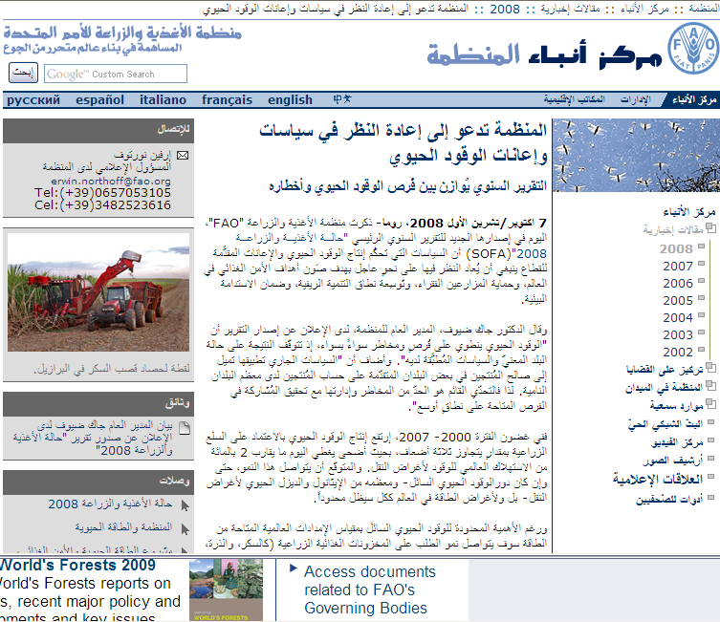
News story

Slide 64
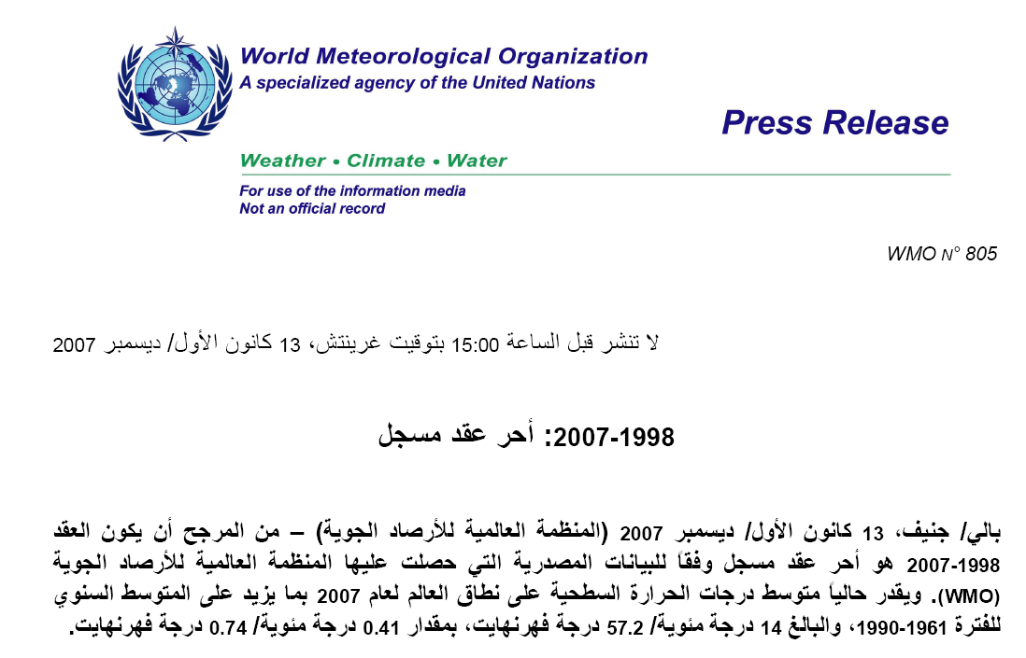
Press Release

Slide 65

Launching GEO-4 report

