Slide 1


Integrated Environmental Assessment Training Manual for the Arab Region
Module 8
Improving the IEA Process and Increasing Impact through Monitoring, Evaluation and Learning

Slide 2
Module 8 Sessions at a Glance
Introduction
Foundation of effective monitoring and evaluation
Framework, attributes and measures
Self-assessment matrix
Improvement opportunities

Slide 3
In Module 8, you will learn to develop a monitoring and evaluation plan, based on seven questions:
1. What is the purpose of the evaluation?
2. Who will use the evaluation results?
3. Who will do the evaluation?
4. What evaluation framework is practical?
5. What needs to be monitored and evaluated?
6. What are the steps to develop a self-assessment matrix?
7. How can you use the evaluation to enhance a learning culture that keeps improving your IEA process?

Slide 4
Previous experience with monitoring and evaluation
When have you been involved in a monitoring/evaluation process?
What were some of the keys to success?
What were some of the challenges?

Slide 5
Module 8 challenges you with two questions:
1. How to make sure your IEA has an evaluation component?
2. How to design an effective evaluation that keeps improving your IEA process?

Slide 6
Stages of National IEA Process – Monitoring and Evaluation Marked in Grey
Note: Monitoring and Evaluation Marked in Grey

Slide 7
Monitoring and evaluation of an IEA process and its impacts focuses on:
How the assessment process has been organized to have a desired impact on policy making.

Slide 8
Monitoring
A planned, systematic process of observation that closely follows a course of activities, and compares what is happening with what is expected to happen. Monitoring the IEA process makes sure the environmental assessment meets its goals, while working within the scope of allocated resources (i.e., time, financial, human, informational and technical).

Slide 9
Evaluation
A process that assesses an achievement against preset criteria.
Evaluations can have a variety of purposes (Section 2.1), and follow distinct methodologies (process, outcome, performance, etc).
Evaluation of the IEA process determines the extent to which achievements (outputs, outcomes and impacts) are comparable with the originally intended purpose, and what lessons can be learned for the next environmental assessment and management cycle.
The evaluation of the process is, first and foremost a capacity-development opportunity.

Slide 10
The complementary tools that build on each other’s impact to improve an IEA process
Attribute | Monitoring | Evaluation
Main focus | Collecting data on progress. | Assessing data at critical stages of the process.
Sense of completion | Sense of progress. | Sense of achievement.
Time focus | Present | Past – future.
Main question | What needs to happen now to reach our goal? | Have we achieved our goal? How can we do better next time?
Attention level | Details. | Big picture.
Inspires | Motivation. | Creativity.
Periodicity | Continuous throughout the whole process. | Intermittent; at the beginning or end of significant milestones.
Supports | Implementation of a plan. | Designing the next planning cycle.
Skills required | Management. | Leadership.
Output processing | Progress indicators needs to be closely monitored by a few people | Evaluation results need to be discussed, processed and interpreted by all stakeholders.

Slide 11
Learning
An emotional and/or cognitive transformation taking place during information collection and information processing. Learning brings about behavior change or in the ability to act differently. Learning can happen whether it is intended or unintended. Monitoring and evaluating the IEA process offer learning opportunities. Planning for and making use of these learning opportunities can bring about lessons that comprise key inputs to improve an iterative IEA process. Missing these learning opportunities decreases the influence of the IEA process on policy making.

Slide 12
Upon successfully completing Module 8, you will be able to:
Explain the importance of monitoring and evaluating;
Recognize monitoring and evaluation as learning opportunities for improving your IEA process; and
Develop a draft plan for monitoring and evaluating your national IEA process and its impact.

Slide 13
Key Elements
MONITORING…enables
EVALUATION…which leads to
LEARNING

Slide 14
Exercise 1: Previous experience with monitoring and evaluation Time: 15 minutes.
The purpose of this exercise is to share previous experiences in monitoring and evaluation.
In plenary, ask if anyone has had a positive experience with monitoring and evaluation. Request that two or three volunteers briefly share their experiences. Make a list of what made the evaluation experience positive, and use this list in the next steps of designing the evaluation of your IEA process.

Slide 15
Exercise 2: Constraints Time: 20 minutes.
The purpose of this exercise is to map constraints that organizations have in monitoring and evaluation.
In small groups, ask participants to point out areas of the IEA process where their organization could have constraints that could limit monitoring and evaluation. Compile the constraints, putting them on an enlarged IEA process chart for later use.

Slide 16
Stage 1
Start-up
...
M
O
N
I
T
O
R
I
N
G
.
.
.
.
Stage 2
Institutional set-up
Stage 3
Scoping and Design
Stage 4
Planning
Stage 5
Implementation:
Integrated Assessment
Stage 6
Communication & Outreach
Stage 7
Evaluation

Slide 18
Why Monitoring and Evaluation?
Lessons learned from IEA helps improve policy making processes, policies and state of environment.
The IEA process builds capacity for periodic policy revision through monitoring and evaluation.
Capacity is built among individuals and organizations.

Slide 19
How monitoring and evaluation became a tool to make the national process a success in India:
Monitoring and evaluation increased:
The perception of saliency,
Credibility, and
The legitimacy of the environmental assessment
Embedence of SoE reporting in state-level governance to:
Addresses environmental issues,
Strengthen capacities at the level of individuals, organizations and institutions.

Slide 20
SoE Reporting, India – Monitoring and Evaluation of a Reporting Process
The SoE reporting system of India has been monitored and evaluated closely, with the aim of embedding the reporting system in the practice of state governments. This ongoing programme involves building capacities for the preparation of SoE reports within the state/regional institutions and governments and the national government, and supporting triennial SoE reporting by state and national governments.
The process was carefully designed. Only a few expert institutions, designated national host institutions (NHI), were given the responsibility of identifying state host institutions (SHI) and building interest and capability within those SHIs to undertake SoE reporting. Beyond training, NHI also review progress made by SHIs in developing their products, provide expert input on the frameworks of analysis and critically analyze the products before final publication.

Slide 21
SHIs are responsible for identifying and mobilizing partners, facilitating a participatory process, collecting and analyzing information, interacting with NHIs and developing SoE products.
At the national level, the Indian Ministry of Environment and Forests, the lead ministry for the programme, periodically evaluates the progress made by NHIs and SHIs through review meetings. Funding is tied to the demonstration of progress.
A two-stage monitoring and evaluation process is in place. The NHIs’ performance evaluation (done by the ministry) is linked to the level of success they achieve, as indicated by the number of states that have made significant progress towards establishing systems for SoE analysis, and for publishing a final SoE report.

Slide 22
The second element relates to the linkage between NHI and SHIs, and it is only through NHI certification that an SHI receives funding. In this case, the tangible indicator is the SoE report, but interim continuity in the process is ensured by the NHI, as their ultimate evaluation is based on the number of reports they supported. As for the imperatives at the state level, a careful selection of SHIs is essential for the success of this programme. A proactive SHI, with its linkages and wherewithal, will ensure a close monitoring of the actors/institutions involved, and will deliver results.

Slide 23
Overall response to the programme has been mixed, but SHIs that have taken this initiative seriously are establishing benchmarks for all states, even those that are less responsive. Some progressive states, such as Punjab, Chandigarh and Kerala, have successfully produced SoEs, and are working towards their next products, focusing on emerging environmental challenges.

Slide 24
Monitoring and evaluation of an IEA process enhances communication between the cycle of scientific data collection and processing, and the cycle of policy making. This “coupling” function can help to ensure that evidence originating from either scientific or indigenous knowledge is fed into policy making early enough. Because it can take decades and a series of political cycles to develop the right set of policies after discovery of the first evidence of an emerging environmental problem, the role of monitoring cannot be overstated.
Without an impact strategy (Module 3) and monitoring and evaluation (Module 8), the IEA process could run the risk of not being able to influence policy making.

Slide 25
Module 8 Sessions at a Glance
Introduction
Foundation of effective monitoring and evaluation
Framework, attributes and measures
Self-assessment matrix
Improvement opportunities

Slide 26

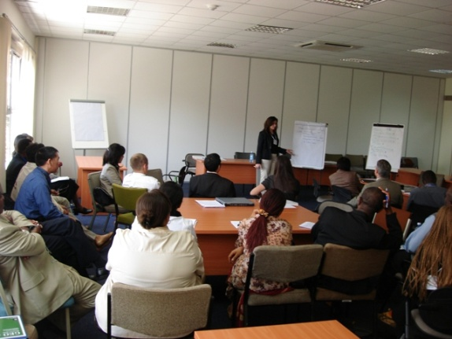
Foundation Steps for Effective
Monitoring and Evaluation
Identifying your purpose.
Identifying your primary users.
Deciding whether internal or external evaluators best serve your purpose.

Slide 27
2. Foundation of Effective Monitoring and
Evaluation
The purpose:
Judgment
Improvement
Knowledge creation

Slide 28
Discussion Questions 1
Why do you need to plan for monitoring and evaluating your IEA process and its impact at the beginning of the planning process?
Why is improvement-oriented evaluation relevant to your IEA process?

Slide 29
2.2 Users
The users of an IEA-type evaluation are individuals who:
Can revise the IEA process: have the mandate, knowledge and skills; and
Want to revise the IEA process: have a vested interest in influencing the design and implementation of the IEA process.

Slide 30

Users of a GEO-type Evaluation
People who:
Can revise the GEO process
Want to revise the GEO process

Slide 31
Identifying the users
IEA core team (may include policy-makers);
Policy and decision-makers in the broad sense (the primary users of the iea-the more active); and
The evaluation team (internal and/or external).

Slide 32
Exercise 3: Identify the users Total time: 20 minutes
The purpose of this exercise is to identify the primary users of monitoring and evaluation of the IEA process.
1. Ask participants to list the names, positions, and departments of potential primary users of the results of monitoring and evaluation. (Small groups. Time: 5 minutes.)
2. Ask participants to record the interest of these potential primary users in using the monitoring, evaluation and impact data, and if they have the mandate for revising the IEA process. (Small groups. Time: 5 minutes.)
3. Have 2–3 small groups report on their candidates, and compare results. (Whole group).(10 minutes).

Slide 33
2.3 Evaluators
A combination of internal and external evaluators is the ideal solution.
Evaluators may include:
A small internal evaluation task force (including the IEA core team, which is recommended).
External evaluators (consultants and internal evaluators of another IEA).
A combination of internal and external parties.

Slide 34
Exercise 4: Identify the evaluators
Total time: 20 minutes.
The purpose of this exercise is to identify the evaluators of monitoring and evaluation of your IEA.
1. Ask participants to decide on and justify the types of evaluators they would use for monitoring and evaluation: external, internal or a combination. Ask for suggested names, if possible. (Small groups. (Time: 10 minutes.)
2. Initiate whole group discussions. (Whole group. (Time: 10 minutes.)

Slide 35
Focusing your monitoring & evaluation
Effective Relationship Management:
  Measures of changes in the thinking and actions of policy makers
Effective Knowledge Management:
  Measures of saliency, credibility and legitimacy of IEA report
Effective Opportunity Management:
  Measures showing communication opportunities are being leveraged
Timely Completion of key activities and associated outputs

Slide 36
Module 8 Sessions at a Glance
Introduction
Foundation of effective monitoring and evaluation
Framework, attributes and measures
Self-assessment matrix
Improvement opportunities

Slide 37
3. Attributes, Framework and Measures
4 criteria for effective evaluation
1. utility,
2. feasibility,
3. propriety, and
4. accuracy (Patton 1997).

Slide 38
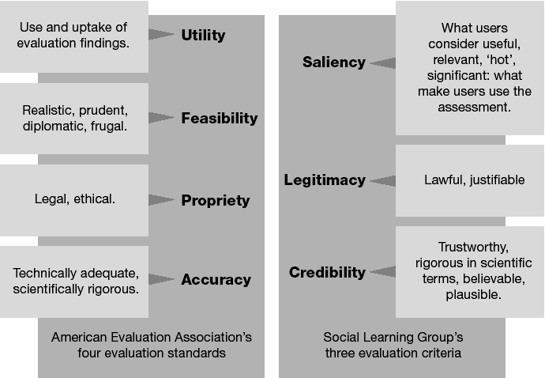
Corresponding Attributes of Effective Evaluations

Slide 39
Perceived by policy-makers as salient, credible and legitimate:
Salient. Because it addressed a global threat to survival that called for immediate attention and action from decision-makers.
Credible. Because it involved high-profile research institutions from different countries, triangulating their observations and results.
Legitimate. Because of the transparent process, engaging all relevant stakeholders and acknowledging their investment.

Slide 40
3.2 Framework
Develop a basic conceptual understanding of how the activities and outputs are linked with intended outcomes and impacts.
The intended outcomes of an iea process are the changes in the thinking and actions of policy-makers that can bring about improvements in policies and policy making processes, which, in turn, can result in environmental improvements.

Slide 41
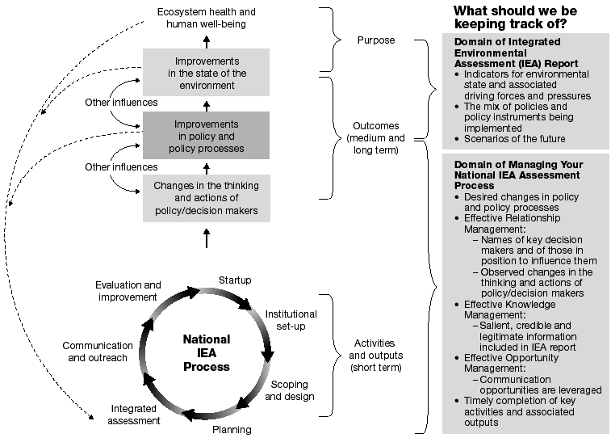
Conceptual Understanding of the National IEA Process, With Links to Ecosystem Health and Human Well-Being

Slide 42
Discussion Question 2
As a manager you know that you manage what you measure. What should you be keeping track of in your IEA process to manage it for the intended outcomes?

Slide 43
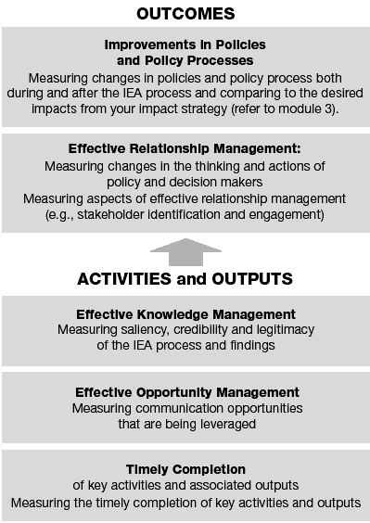
Focusing the evaluation

Slide 44
5 categories of Measures to monitor the effectiveness of IEA process
Outcome-based Measures for Improvements in Policies and Policy Processes
Outcome-based Measures for Effective Relationship Management
Activity- and Output-based Measures for Effective Knowledge Management
Activity- and Output-based Measures for Effective Opportunity Management
Measures for timely completion of activities and outputs

Slide 45
Outcome-based Measures for Improvements in Policies and Policy Processes
Measures to track improvements in policies and policy processes.
Measurement should relate to the change statement you identified in your impact strategy
Measurement should also track other observed improvements in policies and policy processes.

Slide 46
Outcome-based Measures for Effective Relationship Management
Relationships among people jointly processing and communicating ideas are what initiate change
Other important relationships to manage include people in civil society who can bring pressure to bear on decision-makers; those who can support, reinforce and strengthen your recommendations, in particular the academic community and other research institutes; and the media, through whom you reach the public and influence decision-makers.

Slide 47
Possible Measures for Effective Relationship Management
Key actors and target audiences have been defined
Up-to-date contact and mailing lists are available
Relationships with local, national and international media have been cultivated
Funders are informed of the progress and impact of your work

Slide 48
Measures for Effective Relationship Management
Identifying relationships based on behaviour
Behaviour Type
Receiving (individual, organization)
Seeking (individual, organization)
Acting Upon (individual, organization, institution)
Demanding (individual, organization, institution)
Behaviour Exhibited
Reports, emails, listserv
Target users seek new information.
Technical expertise is sought to revise policies.
Specific needs, such as monitoring data for the next IEA cycle.

Slide 49
Possible Measures for Effective Relationship Management
Key Question | Possible Measures | Possible Targets
Have key decision makers and potential influencers been identified? | Number of key persons identified for each relationship group, including specific names from each of the potential audience categories identified. | At least one key name per sector and discipline.
What important changes in the thinking and actions of key decision makers have been observed? | Types of Receiving behaviour observed (see Module 3). Such as: • Number of decision-makers as subscribers (individuals and organizations) to listserve/ e-mail newsletter. • Receive and request SoE reports. •Cell phone text messages. • Number of PDF files downloaded from the national IEA website. Types of Seeking behaviour observed (see Module 3). Such as: • Keywords entered into search engines of the national IEA website by decision-makers. • Number of targeted users (key decision makers) attending new types of meetings and using IEA vocabulary in interviews with media. (Policy-makers get IEA messages from media.) Types of Acting behaviour observed (see Module 3). Such as: • Number of times IEA technical experts are contacted by decision-makers for consultation on budgeted activities. Types of Demanding behaviour observed (see Module 3). Such as: • Number of cases targeted users (i.e., decision makers) contact national IEA leaders to request new information or process changes to be included in the next IEA cycle. | For each target actor, clarify the following: • What behaviour would you expect to see from this person(s)? • What behaviour would you like to see? • What behaviour would you love to see? [based on Outcome Mapping approach (Carden et al. 2001)]

Slide 50
Discussion Questions 3
1. Can you think of any other important measures of effective relationship management?
2. What reasonable targets would you recommend for various measures?

Slide 51
Collecting Data for Monitoring Effective Relationship Management
Requires that changes in behavior be identified and mapped
Can be a time intensive process, so it is important to set up simple ways to monitor your strategy against those measures.
Can set up a small contacts database with a journaling function

Slide 52
Possible Measures for Effective Knowledge Management
Number of subscribers to listserv
Number of subscribers to newsletter
Number of page requests for download from web site
Number of unsolicited comments on the usefulness of reports and other outputs

Slide 53
Activity- and Output-based Measures for Effective Knowledge Management
Possible Measures for Effective Knowledge Management
Key Question | Possible Measures | Possible Targets
Is the information and analysis salient for decision-makers? | Views of decision-makers on what they feel/think the key issues are. The types and forms of information decision makers require have been made available | Responses from at least five decision-makers.
Is the information and analysis credible? | Peer reviewers have been identified. Data and analysis have been peer reviewed. | Responses received from at least three peer reviewers.
Is the information and analysis produced legitimate? | Stakeholder analysis has been carried out. Relevant stakeholder groups have participated in identification of priority environmental issues. Relevant stakeholder groups have had an opportunity to comment on the findings of the analysis. | Stakeholder analysis completed. Participation from as many stakeholder groups as possible. Comments received from most stakeholder groups identified.

Slide 54
Discussion Questions 4
1. Can you think of important measures of effective knowledge management that are not identified in the table above?
2. Which measures do you feel are the most important?
3. What do you think are reasonable targets for the measures you identified?

Slide 55
Possible Measures for Effective Opportunity Management
Number and location of launch events
Number and level of conferences & workshops
Number of news releases and articles
Number of presentations to target audiences

Slide 56
Activity- and Output-based Measures for Effective Opportunity Management
Possible Measures for Effective Opportunity Management
Key Question | Possible Measures | Possible Targets
Are appropriately different outputs planned for targeting specific stakeholder groups? | Number and type of unique communication outputs for each stakeholder/audience group. | At least one each.
Have interim products been developed? | Decision-makers have been briefed on analyses being conducted and interim results. | At least at the beginning, and midway through the process. (Best if they are part of the analysis process.)
Have you communicated regularly with your stakeholders? | A scenario exercise is being conducted as part of the IEA (Module 6). Key stakeholders and target audiences are involved in the scenario analysis. Positive feedback has been received from stakeholders on the scenario analysis process. | At least a qualitative analysis is carried out. Number of stakeholder groups represented. All stakeholder groups have been part of the analysis in some manner.

Slide 57
Discussion Questions 5
1. Can you think of important measures of effective opportunity management not included in the table above?
2. Which measures do you think are most important?
3. What do you think are reasonable targets for the measures you identified?

Slide 58
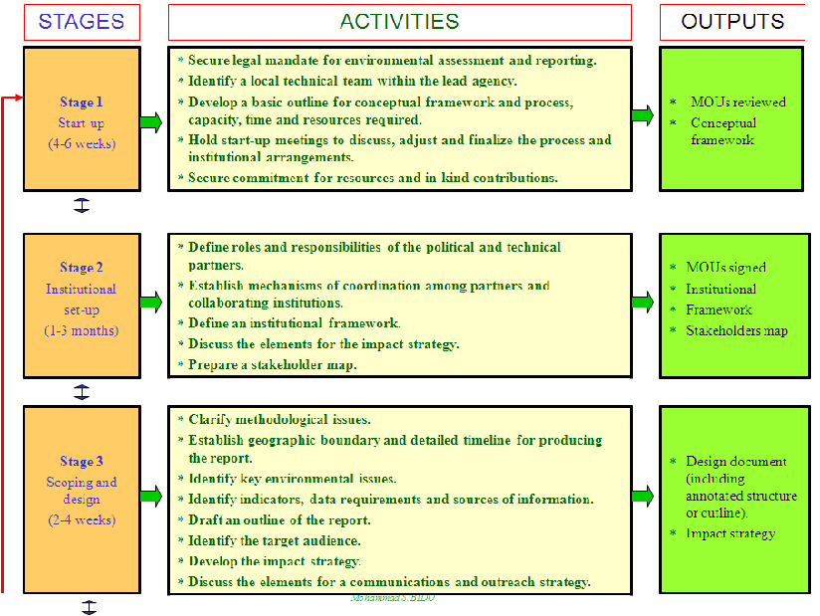
Measures for timely completion of activities and outputs

Slide 59
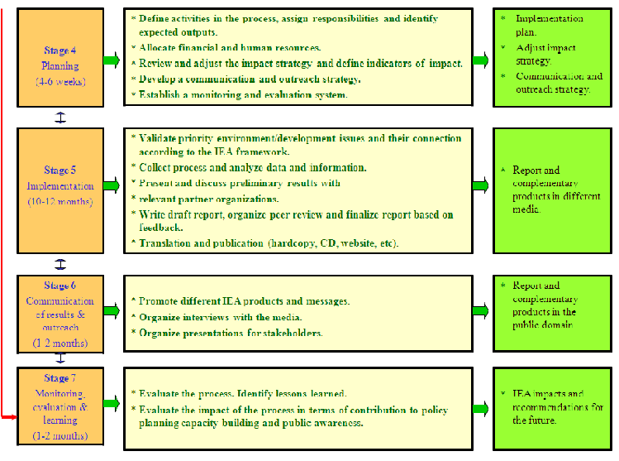

Slide 60
Suggestions for General and Stage Specific Questions and Exercises for Monitoring Progress and Promoting Learning at Specific GEO Stages
General questions for monitoring meetings | GEO Stage | Major activity | Prevailing learning condition | Stage-specific activities for monitoring meetings (see Box 7)
(1) What were the most revealing lessons for you in this stage? (2) How can you use this knowledge, attitude to improve the next stages process, outputs or targeted changes? (3) Have you achieved what we planned for in this stage? If yes, what factors helped? If not, what factors hindered. How can we reach the desired goal? (4) Are there any unexpected results, emerging phenomena, trends or questions you want to discuss? (5) How did this stage contribute to the perception of saliency, legitimacy and credibility of the national IEA process? | 1 | Inception
 | 2 | Institutional setup | Mandate | Articulate, confirm mandate
 | 3 | Scoping and design | Trust | Nurture trust Force-field analysis
 | 4 | Planning | Information processing | Create opportunities for collective information processing
 | 5 | Implementation | Shared understanding of learning | Remind participants of how they learn best Keep, start, stop doing
 | 6 | Communication | Motivation | Revisit motivation Carousel discussion
 | 7 | Evaluation | Application | Focus on lessons learned for application Samoan circle

Slide 61
Module 8 Sessions at a Glance
Introduction
Foundation of effective monitoring and evaluation
Framework, attributes and measures
Self-assessment matrix
Improvement opportunities

Slide 62
4. Planning a Self-Assessment
Some of important aspects for planning a self-assessment:
Issues for self-assessment;
Measures that will help you answer questions you have about various organizational and performance issues;
Data sources to answer these questions;
Methods of data collection best suited to your questions, realities and constraints; and
Priorities and frequency for checking progress.

Slide 63
3 Recommended steps for self-assessment
Step 1. Identify major issues and monitoring questions, and develop specific measures.
Step 2. Identify sources of data and data collection methods.
Step 3. Set priorities and frequency of monitoring.

Slide 64
Step 1. Identify Major Issues and Monitoring Questions, and Develop Specific Measures
The first step in a self-assessment is to identify major issues that should be monitored and evaluated, and the key questions associated with these issues.
Based on the framework introduced in Section 3, key issues and questions to be addressed include the following:

Slide 65
Outcomes
Your Change Statement – Have the desired improvements in policies and policy processes that you identified in your impact strategy been realized? What other improvements in policies and policy processes have you observed during and following your national IEA process?
Effective Relationship Management – What changes in the thinking and actions of policy makers and decision makers (and other important relationships) have you observed?

Slide 66
Activities and Outputs
Effective Knowledge Management – Is the right knowledge being generated, and is that knowledge salient, credible and legitimate?
Effective Opportunity Management – Are opportunities being leveraged for effectively communicating that knowledge to those persons in a position to influence change?
Timely completion of activities and outputs – Are the key activities and outputs necessary to complete your national IEA being completed on time and at the desired level of quality?

Slide 67
Outcome-based Measures: Possible Organization of Your Self-Assessment Matrix
Key Issues/Questions | Specific Measures and Target (See Tables 2, 3 and 4 for guidance) | Data Source | Data Collection Method
Your Change Statement Have the desired improvements in policies and policy processes that you identified in your impact strategy been realized? What other improvements in policies and policy processes have you observed during and following your national IEA process?
Effective Relationship Management What changes in the thinking and actions of policy-makers and decision-makers (and other important relationships) have you observed?

Slide 68
Activity and Output-based Measures: Possible Organization of Your Self-Assessment Matrix
Stage of the National GEO Process | Key Issues/Questions | Specific Measures and Targets | Data Source | Data Collection Method
Stage 1 Inception | Timely completion of activities and outputs Effective Knowledge and Opportunity Management | See Figure 6 for guidance
Stage 2 Institutional Setup | Timely completion of activities and outputs | See Table 3 and 4 for guidance
Stage 3 Scoping and Design | Timely completion of activities and outputs Effective Knowledge and Management
Stage 4 Planning | Timely completion of activities and outputs

Slide 69
Stage 5 Implementation of IEA | Timely completion of activities and outputs Effective Knowledge and Management
Stage 6 Communication and Outreach | Timely completion of activities and outputs Effective Knowledge and Management
Stage 7 Evaluation | Key Issues/Questions
 | Timely completion of activities and outputs Effective Knowledge and Management
 | Timely completion of activities and outputs Effective Knowledge and Management
 | Timely completion of activities and outputs Effective Knowledge and Management

Slide 70
Step 2. Identify Sources of Data and Data Collection Methods
With a list of specific measures developed, it is now possible to identify sources of data and data collection methods for each measure.
The data will come from a variety of sources. Accessing these data sources will demand a variety of data collection methods.

Slide 71
An overview of data collection methods for self-assessments
Questionnaire survey It is distributed—or made accessible if online—to a predetermined selection of individuals. Individuals complete and return the questionnaire or submit online.
Face-to-face interview Interviewer asks questions, usually following a guide or protocol. Interviewer records answers.
Telephone interview Interviewer asks questions, usually following a guide or protocol. Interviewer records responses.

Slide 72
An overview of data collection methods for self-assessments (Cont.)
Group techniques (interview, facilitated workshop, focus group) This involves group discussion of predetermined issue or topic in person or through teleconferencing. Group members share certain common characteristics. Facilitator or moderator leads the group. Assistant moderator usually records responses.
Document review Researchers review documents, and identify relevant information. They keep track of the information retrieved from documents.

Slide 73
Use a surface mail or a faxed questionnaire survey when: • The target population is large (for example, greater than 200). • You require a large amount of categorical data. • You want or require quantitative data and statistical analyses. • You want to examine the responses of designated subgroups, such as male and female. • The target population is geographically dispersed. • You want to clarify your team’s objectives by involving team members in a questionnaire development exercise. • You have access to people who can process and analyze this type of data accurately.

Slide 74
Guidance in the Use of Common Data Collection Methods for Self-Assessments (Cont.)
Use an e-mail or web page questionnaire when all of the above conditions are met and: • You have the appropriate software and knowledge of this method. • Your respondents have the technological capabilities to receive, read and return the questionnaire. • Time is of the essence. • You want to provide the option of typing long answers to questions. • You want to reduce production and dissemination costs.
Use face-to-face interviews when: • You need to incorporate the views of key people (key informant interview). • The target population is small (for example, less than 50). • Your information needs call for depth rather than breadth. • You have reason to believe that people will not return a questionnaire.

Slide 75
Guidance in the Use of Common Data Collection Methods for Self-Assessments (Cont.)
Use telephone interviews when: • The target population is geographically dispersed. • Telephone interviews are feasible.
Use a teleconference interview when: • The target population is geographically dispersed. • Teleconferencing equipment is in place.
Use group techniques when: • You need rich description to understand client needs. • You believe that group synergy is necessary to uncover underlying feelings. • You have access to a skilled facilitator and data recorder. • You want to learn what the stakeholders want through the power of group observation (one-way mirror or video).

Slide 76
Guidance in the Use of Common Data Collection Methods for Self-Assessments (Cont.)
Use document reviews when:
• The relevant documents exist and are accessible.
• You need a historical perspective on the issue.
• You are not familiar with the organization’s history.
• You need hard data on selected elements of the organization.

Slide 77
Step 3. Set Priorities and Frequency of Monitoring and Evaluation
Given resource and time constraints, indicators that are identified for monitoring should be prioritized.
Establishing the frequency of monitoring for each indicator, and the person responsible for that stage will help to clarify the level of effort required.

Slide 78
Exercise 5: Preparation of a Self-Assessment Matrix (Time: ~ 40 minutes.)
The purpose of this exercise is to gain experience in identifying major issues and questions, and developing specific measures relating to both outcomes and activities/outputs.
In plenary, complete Table 5 relating to outcomes by identifying specific measures for the key issues and questions outlined in the table. Also in plenary, discuss and establish targets for each measure and identify data sources and data collection methods.

Slide 79
Module 8 Sessions at a Glance
Introduction
Foundation of effective monitoring and evaluation
Framework, attributes and measures
Self-assessment matrix
Improvement opportunities

Slide 80
5. Improvement Opportunities
The following evaluation steps show how a conscious learning approach can improve the IEA process:
Formulate your change statement.
Identify measures for your change statement and other supporting measures for key outcomes and activities/outputs.
Examine performance against making the desired changes and summarize results.
Formulate lessons learned and recommendations.
Integrate (feed back) recommendations to improve the next planning cycle.

Slide 81
What do We Call Learning?
For the purpose of this module, we define learning as a process that brings about behaviour change or changes in the ability to act differently, based on emotional or cognitive changes taking place during information collection and processing.
This definition underscores three important points:
Learning is more than knowledge creation;
Learning is demonstrated by behaviour change;
Information processing, in addition to information collection, is of paramount importance.

Slide 82
4 phases in an individual learning process
1. Linking the new experience to existing knowledge (connect).
2. Using the new experience to seek new information (take-up).
3. Applying the new information in an existing context (practice).
4. Using and reviewing the new information in a new context (use and review).

Slide 83
The Learning Cycle

Slide 84
How Can We Use Learning Opportunities?
Learning opportunities naturally present themselves at the beginning and end of each IEA stage and each IEA cycle. These are the times when you need to reflect and articulate lessons learned to improve the next course of action.
Given the limited time available, we suggest that your core IEA team organize regular, mid-stage and/or stage-end monitoring and evaluation meetings to serve two purposes:
  1. Monitor progress toward and capture lessons learned to improve the next IEA stage and the next IEA cycle.
  2. Cultivate a learning, improvement-oriented approach throughout the whole IEA process.

Slide 85
Exercise 6: Learning
The purpose of this exercise is to have a first-hand experience of how learning can enhance the IEA process.
Write what comes to mind based on the following four questions:
1. What did you hear during the IEA training course (e.g., Stage 1) that you had already known? (i.e. Connect new experience to existing knowledge.)
2. What new information and insight did you gain? (i.e., Take up new knowledge.)
3. How are you going to use this new insight? (i.e., Practicing new knowledge in the current framework of operation.)
4. How else and when could you use this new information? How could you improve policy making with this new insight? (i.e., Review opportunities of using new knowledge in a new framework of operation.) (Time: 5 minutes.)

Slide 86
Exercise 6: Learning (Cont.)
Discuss your findings with your neighbors. (Time: 5 minutes.)
In plenary, discuss what insights you have gained from this exercise? How did the group discussion help you to recognize improvement opportunities in the IEA process, and have better impact, such as changes in policy making? (15 minutes.)
In this exercise you combined individual and organizational learning. The same process of promoting organizational learning could be used during the IEA process. Total time: 25 minutes.

Slide 87
Exercise 6: Learning (Cont.)
In plenary, begin work on completing Table 6 relating to activities and outputs by reviewing the stages of your IEA process (drawing on exercises completed in Module 2). Assign a group to each stage. Each group is tasked with identifying specific measures for their stage which deal with timely completion of activities/outputs as well as effective knowledge and opportunity management (using Tables 2 through 4 and Figure 6 as guidance if necessary). (Time: ~ 45 minutes.)

Slide 88
Exercise 6: Learning (Cont.)
Meet again in plenary to share the results for your stage with the group. As a group, prioritize the measures you developed in Tables 5 and 6. How many of these measures do you think your IEA team will have capacity to monitor and evaluate? (Time: ~ 15 minutes.)
The collection of self-assessment matrices for each stage will provide a good start for the actual matrix needed for your national IEA process. Total time: ~ 90 minutes
.

Slide 89
Recognizing Learning Opportunities?
Learning opportunities arise when there is a possibility or a pressing need to act in a new way.
Conditions apply to fully realize learning opportunities including:
Motivation, which often is the urgency to solve a problem, or act with the support of new knowledge;
Trust to discuss values, assumptions and ideas without repercussions;
Mandate and opportunity to apply the new knowledge; and
Shared understanding of the importance of learning (not only what to learn but also how to learn).

Slide 90
Using Learning Opportunities?
Core IEA team may organize regular but brief, mid-stage and/or stage-end monitoring and evaluation meetings to serve two purposes:
1. Monitor progress toward and capture lessons learned to improve the next IEA stage and the next IEA cycle.
2. Cultivate a learning, improvement-oriented approach throughout the whole IEA process.

Slide 91
Some Practical Considerations For
Organizing Meetings
1. Allow sufficient time (3–6 hours) for these meetings; the first part can be dedicated to monitoring issues, and the second to consolidating learning, and improving the next stage(s).
2. Be sure to invite core group members, key stakeholders and targeted policy-makers.
3. A semi-formal or informal setting, as appropriate, will be most conducive to learning.
4. Create continuity by revisiting the previous monitoring meeting’s notes.
5. Be careful to manage gender balance and representation of underprivileged groups.

Slide 92
Exercise 7: Design a monitoring meeting
The purpose of this exercise is to design a monitoring meeting thaprocesst supports learning to improve the national IEA.
In groups of four or five, design a full-day monitoring meeting for any stage of the process using the guidance provided above. (Time: 15 minutes.)
One group presents their monitoring meeting design and in plenary, discuss the important elements of monitoring meetings. (Time: 10 minutes.)
Total time: 25 minutes.

Slide 93
Thank You

