Slide 1
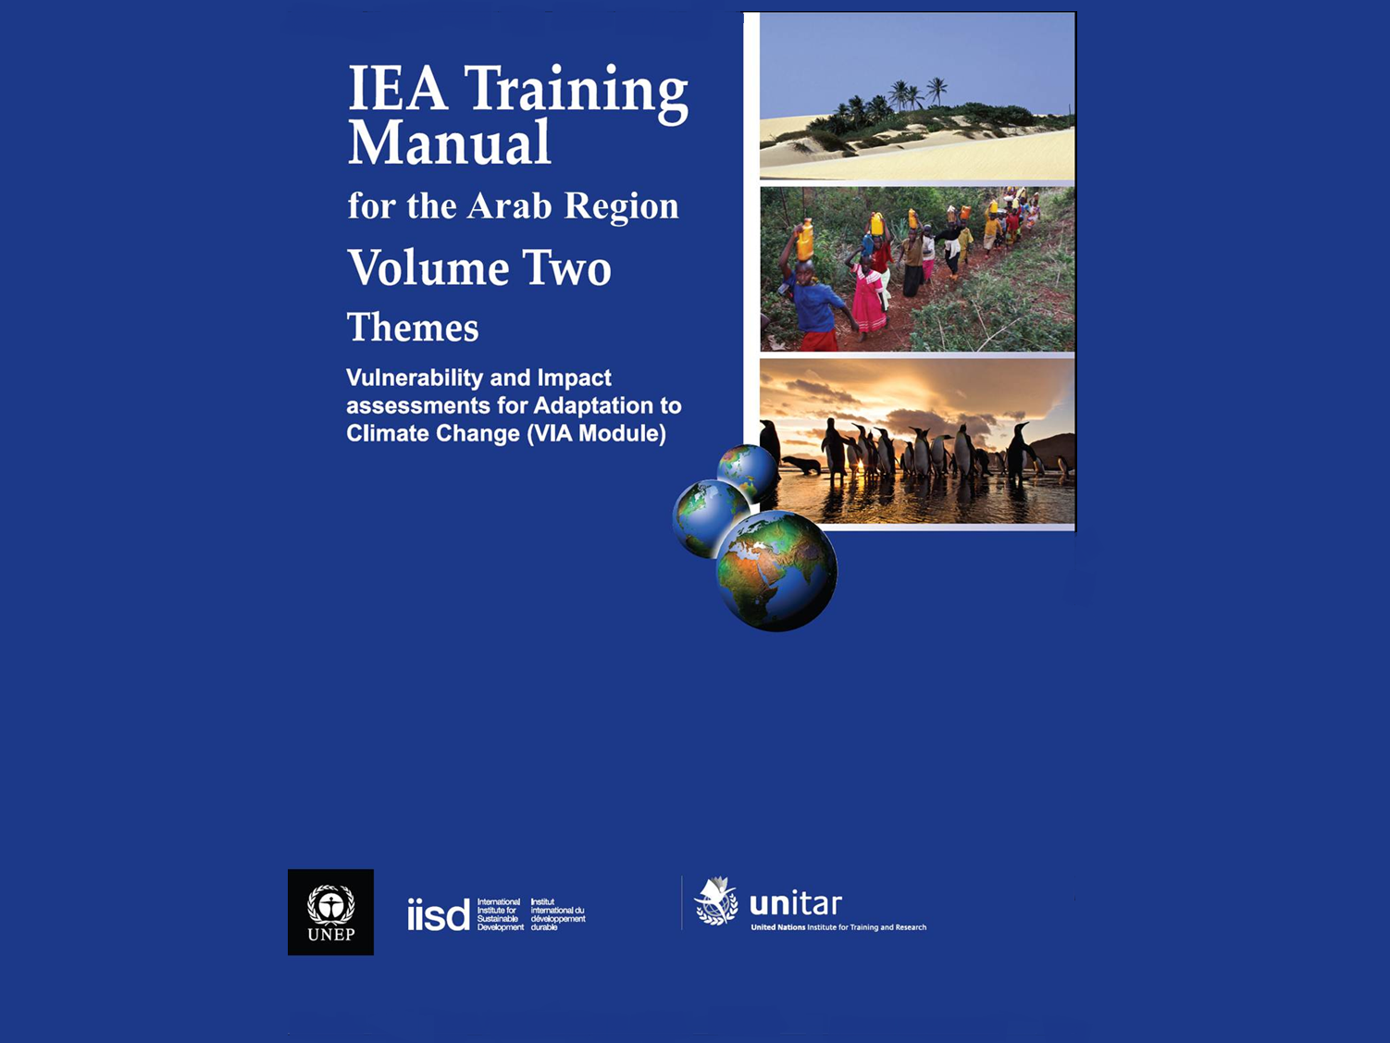

Slide 2
Session at a Glance
1. Characteristics of vulnerability and scope of the assessment
2. Vulnerability assessment and the DPSIR framework
3. Monitoring vulnerability
4. Impacts of climate change and their assessment
5. Creating responses - determining the adaptation options
6. Prioritizing the adaptation options
7. Developing a basic implementation plan and a communication strategy

Slide 3
Introduction
This module builds on the IEA process and provides training on how to include vulnerability, climate change and adaptation in the process.
It focuses on vulnerabilities, impacts of the changing climate and developing adaptive responses in the context of other issues such as ecosystems and human well-being, capacity and long-term development.

Slide 4
Purpose of the Module
The module aims at defining climate change impacts and developing adaptation and response strategies in the light of current stresses and vulnerability to climate change.

Slide 5
Climate Change (Scientific background)
  Climate change is considered a long-term global problem that entails complicated interactions between environmental elements and the socio-economic, political, institutional and technological conditions.
  Climate change has become a reality and there is a scientific consensus that the changing climate is a result of emissions basically released by man. There are indicators of this change which leads to significant impacts at the regional and international levels.

Slide 6
Impacts of Climatic Changes
Over the last 100 years, the Earth's average surface temperature rose by around 0.74°C.
The frequency and intensity of heat waves and heavy precipitation events over most areas have increased too.
A rise in sea level of 17 cm during the same period was observed.
An increase in the global mean temperature of 3°C is projected by the year 2100.
A rise in sea level between 18-58 cm is also projected by the year 2100.

Slide 7
MENA will face yield declines of up to 20% for wheat, 30% for rice, and about 47% for maize in 2050 due to climate change
MENA will need additional annual investments of 241-271 million U.S. dollars to overcome the impact of climate change on food and nutrition only. The majority of investment expenditures would be directed towards agricultural research.
The Fertile Crescent will lose its current shape and may disappear altogether due to climate change.
The annual discharge of the Euphrates River will decrease significantly (29-73%), as will the stream flow in the Jordan River.

Slide 8
Drought persistence had a devastating effect on agricultural production in Syria. Most notably was the disastrous drought that occurred during the agricultural seasons of 1999/2000 and 2007/2008, which led to substantial decline in cereal production and caused damage to thousands of families and livestock herders.
In 2008, drought reduced wheat and barley production by 47 and 67 percent, respectively, as compared to the previous year.
In 2009 frequent and persistent drought had forced 300,000 people to desert their villages in the north-eastern region of the country.
A decline in health and education standards was evident in this region and poverty has soared.

Slide 9
Key principles
First, the combination of conservation and restoration of ecosystems, development choices, adaptations and capacities that will allow us to address the issue of climate change effectively.
Second, understanding implications of climate change impacts at the local level is necessary for an effective adaptation
Third, it is important to understand adaptation as part of actions to restore ecosystems, to improve human well-being and capacities and to address long-term development.
Notes:
First point – examples: This will include important collective decisions on issues such as rural and urban development, land use, energy and water systems as well as cultural, social and psychological dimensions of values and lifestyle.

Slide 10
Session at a Glance
Relevance
Climate Change: Impacts and Vulnerabilities that the Earth System Faces
Notes:
Please consider the knowledge of your audience about the climate change; if the participants are knowledgeable about climate change

Slide 11
Definitions
According to the United Nations Framework Convention on Climate Change (UNFCCC), climate change “ is a change of climate which is attributed directly or indirectly to human activity that alters the composition of the global atmosphere and which is in addition to natural climate variability observed over comparable time periods”.
-Climate change is a disturbance in the usual climatic conditions such as temperature, storms or precipitation which distinguish each area from the other.
Notes:
From: IPCC, 2007

Slide 12
Key definitions
Climate change refers to a statistically significant variation in either the mean state of the climate or in its variability, persisting for an extended period (typically decades or longer).
Climate variability refers to variations in the mean state and other statistics (such as standard deviations, the occurrence of extremes, etc.) of the climate on all temporal and spatial scales beyond that of individual weather events.

Slide 13
Characteristics of Climate Change
One of the biggest environmental threats in human history and as the defining human challenge for the 21st century
The effects of climate change are observed on every continent and in all sectors
We are already committed to changes based on past emission of GHGs into the atmosphere, and it is the future that is being decided (Parry et al. 2008).
Notes:
The Earth’s climate is a complex system consisting of the atmosphere, land surface, snow and ice, oceans and other bodies of water, and living things. The atmospheric component of the climate system most obviously characterizes climate; climate is usually described in terms of the mean and variability of temperature, precipitation and wind over a period of time, ranging from months to millions of years (the classical period is 30 years).

Slide 14
Observed Climatic Changes
Of the last 12 years (1995–2006), 11 are among the 12 warmest since records began in 1850. The temperature increase is widespread across the world but is most marked in the northern Polar Regions.
Sea levels across the globe have risen in a way consistent with the warming. The total global rise in the 20th century amounted to 17 centimeters.
Satellite data recorded since 1978 show the annual average Arctic sea ice extent has shrunk by 2.7 per cent each decade, with larger decreases in summer. Mountain glaciers and average snow cover have declined in both hemispheres.

Slide 15
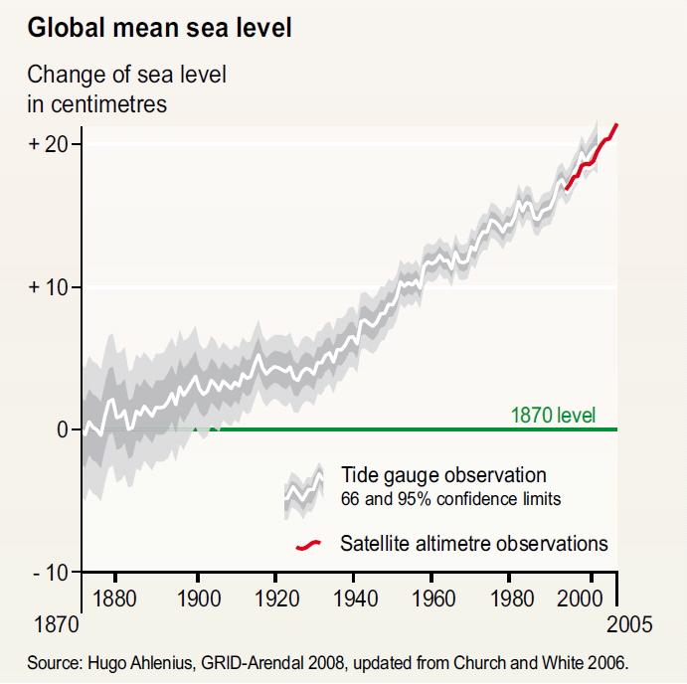
Source: UNEP, 2009

Slide 16
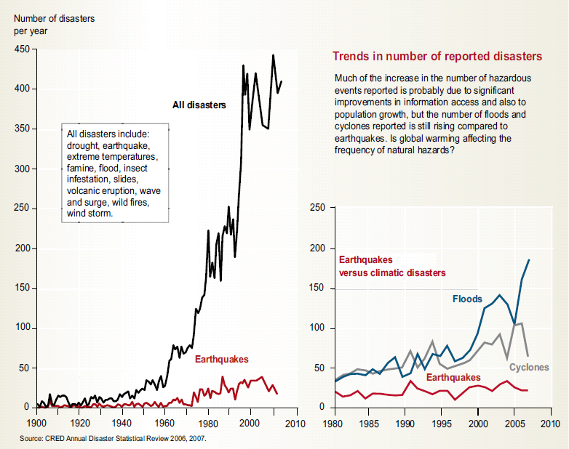
Observed Climatic Changes
UNEP, 2009
Notes:
From 1900 to 2005 precipitation (rain, sleet and snow) increased significantly in parts of the Americas, northern Europe and northern and central Asia resulting in floods, but declined in the Sahel, the Mediterranean, southern Africa and parts of southern Asia causing serious droughts. Furthermore, floods and cyclones have occurred more frequently in the last 30 years, while other disasters not influenced by climate (such as earthquakes) have been constant over years. However, lack of a systematic high quality observation before satellite observations makes it difficult to detect long-term trends.

Slide 17
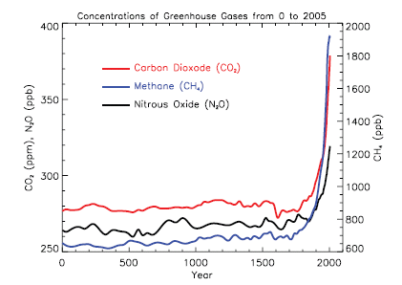
Atmospheric concentrations of important long-lived GHGs over the last 2,000 years. Increases since about 1750 are attributed to human activities in the industrial era.
Concentration units are parts per million (ppm) or parts per billion (ppb), indicating the number of molecules of the GHG per million or billion air molecules, respectively, in an atmospheric sample. IPCC, 2007

Slide 18
Projected Climatic Changes
Increased warming: most warming over land and at the highest northern latitudes, and least over the Southern Ocean and parts of the North Atlantic;
Contraction of the area covered by snow, increases in the depth at which most permafrost will thaw, and a decrease in the extent of sea ice;
Increase in the frequency of heat extremes, heat waves and heavy precipitation;
A likely increase in tropical cyclone intensity.

Slide 19
Projected temperature changes
Notes:
To address the uncertainty surrounding future level of GHGs, the IPCC has developed a series of plausible future scenarios of global development associated GHG emissions referred to as the “Special Report on Emissions Scenarios” (SRES) (Nakicenovic, et al., 2000). The scenarios are based on an extensive assessment and modeling of the socio-economic forces that drive GHG emissions. A1: This describes a future world of very rapid economic growth, global population that peaks in mid-century and declines thereafter, and the rapid introduction of new and more efficient technologies. The three A1 groups are distinguished by their technological emphasis: fossil intensive (A1FI), non-fossil energy sources (A1T), or a balance across all sources (A1B) (promotes diversification of energy sources, on the assumption that similar improvement rates apply to all energy supply and end use technologies).
A2: This describes a very heterogeneous world. The underlying theme is self-reliance and preservation of local identities. Economic development is primarily regionally oriented and per capita economic growth and technological change more fragmented and slower than other storylines.
B1: This describes a convergent world with the same global population as in the A1 storyline, but with rapid change in economic structures with reductions in material intensity and the introduction of clean and resource-efficiency. The emphasis is on global solutions to economic, social and environmental sustainability.
B2: This describes a world in which the emphasis is on local solutions to economic, social and environmental sustainability. It is a world with less rapid and more diverse technological change than in the B1 and A1 storylines. The scenario is also oriented towards environmental protection and equity with focus on local and regional levels.
Source: UNEP, 2009

Slide 20
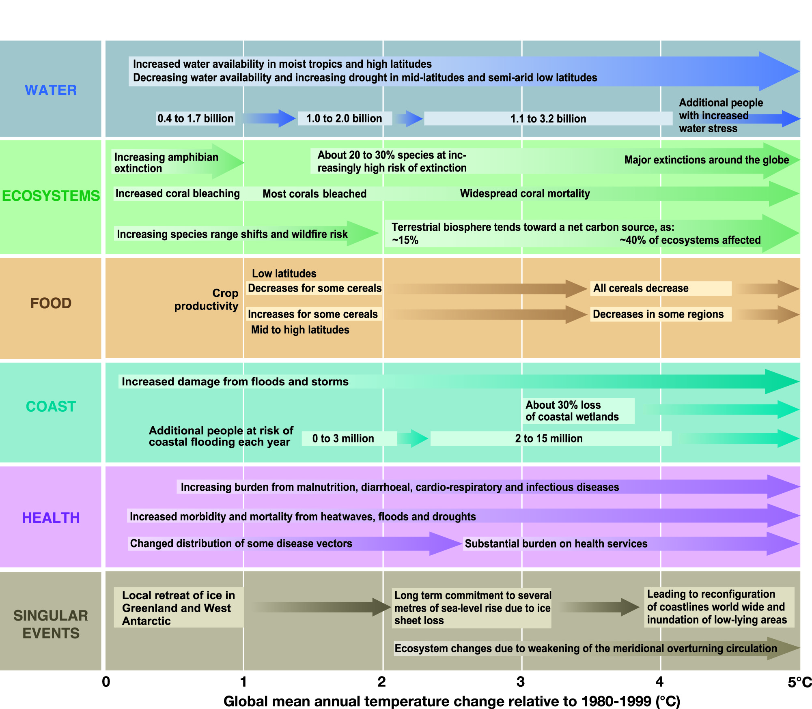
The Timing of Impacts by Sector (IPCC WGII TS 2007)
Notes:
The IPCC has brought all these impacts together in summary tables in its Technical Summary. Some of the impacts are substantial for even small increases in temperature

Slide 21
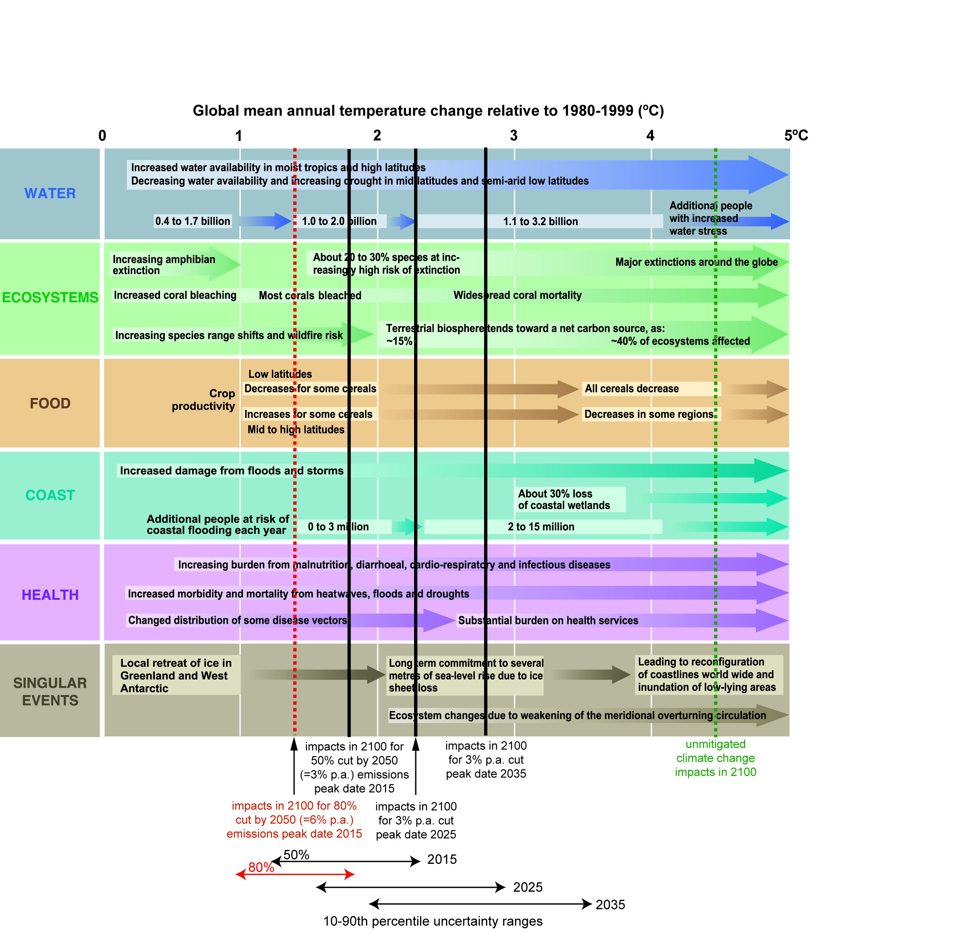
Impacts under 80% and 50% and delayed emission cuts
[Parry, Lowe, Hansen: December, 2008

Slide 22
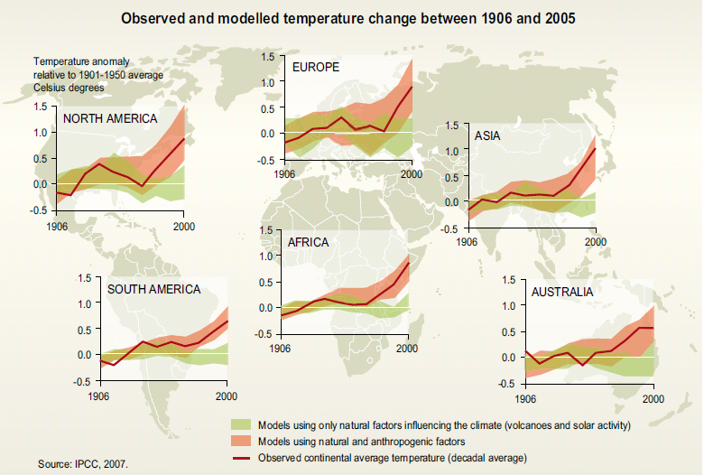

Slide 23
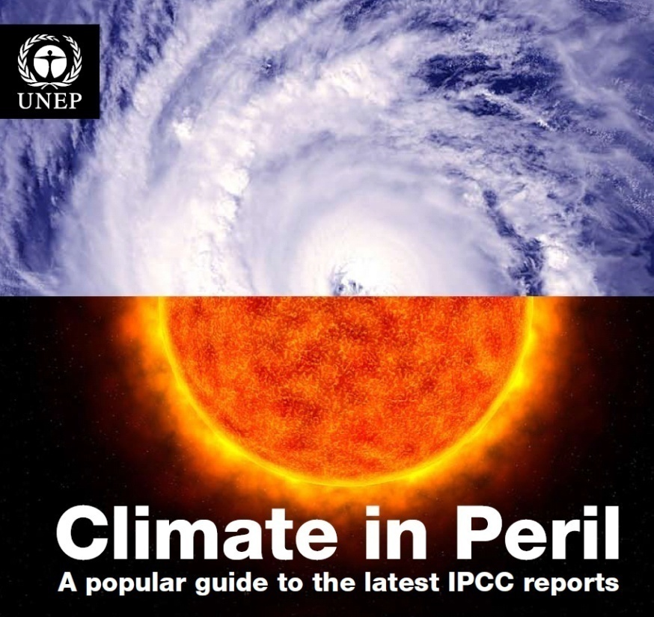
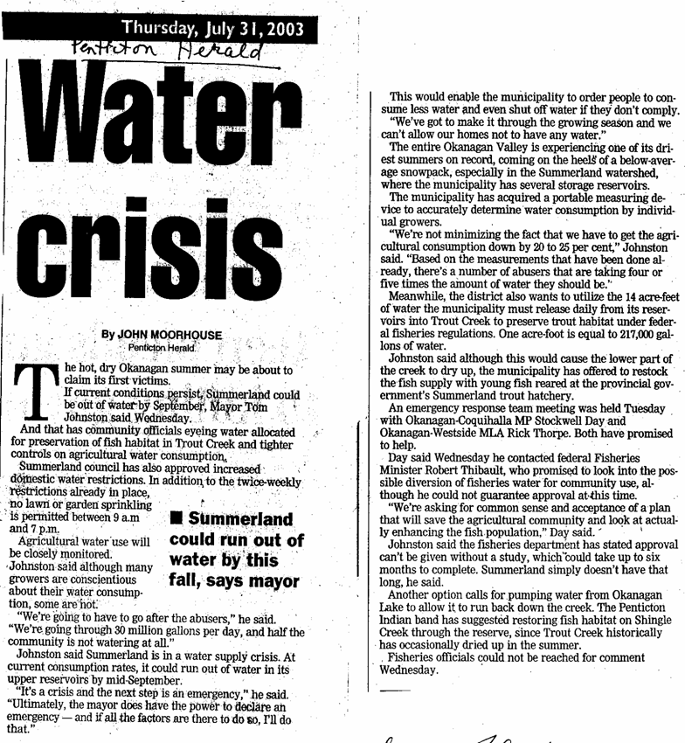
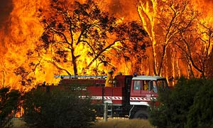
Describing Climatic and Weather Events
Five minutes, and everything was on fire
Chinese floods kill 15, displace 550000
Drought in Africa: Ethiopia's bitter harvest
Notes:
Examples of newspaper’s hand publication headlines as the input for the next exercise

Slide 24
1. Characteristics of vulnerability and scope of the assessment
2. Vulnerability assessment and the DPSIR framework
3. Monitoring vulnerability
4. Impacts of climate change and their assessment
5. Creating responses - determining the adaptation options
6. Prioritizing the adaptation options
7. Developing a basic implementation plan and a communication strategy

Slide 25
Defining Vulnerability
  People and communities are experiencing a number of threats such as climate change , environmental degradation and social and economic changes
  Impacts of these challenges interact and cumulatively increase the vulnerability of local and regional areas and populations
  Vulnerability could be defined as the degree to which human-environment systems are susceptible to, and unable to cope with, the adverse impacts.

Slide 26
Vulnerability to Climate Change
Vulnerability could be described as the degree to which a system is susceptible to, or unable to cope with, adverse effects of climate change, including climate variability and extremes.
It could include for example: whole vulnerable areas such as low-lying islands or coastal cities; negative impacts of climate change on agricultural lands, forced migration; or the mechanism causing these impacts, e.g., disintegration of the West Antarctic ice sheet.
(UNEP, 2009).

Slide 27
Characteristics of Vulnerability
Exposure
Sensitivity
Potential impacts
Adaptive capacity
Vulnerability
The exposure can be to hazards such as droughts, conflicts or extreme price fluctuations, and also underlying socio-economic, institutional and environmental conditions. The vulnerability not only depends on the exposure, but also on the sensitivity of the specific unit exposed (such as an ecosystem, a watershed, a household, a village, a country) and the capacity to cope or adapt.
Allen consulting (2005)

Slide 28
Coping and Adaptive Capacities
They are context-specific
Capacities depend on access to resources that could help in responding to threats and exposures (i. e. functioning community networks, access to low-rate loans, accessible services - health care and sanitation, irrigation systems and water storage etc.).
Capacities of the communities are often depleted when they are in conflict zones, when they are forced to migrate and in areas with low law enforcement.

Slide 29
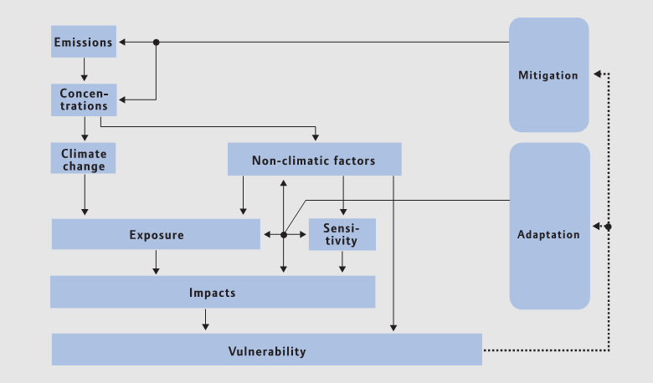
Fuessel, H.M. and R.J. T. Klein (undated). A CLIMATE RISK MANAGEMENT APPROACH TO DISASTER REDUCTION AND ADAPTATION TO CLIMATE CHANGE

Slide 30
Exposure
Sensitivity
Demography
Economy
Infrastructure
Institutions
Information
Potential Impacts
Adaptive Capacity
Vulnerability to Climate Change
Adaptation

Slide 31
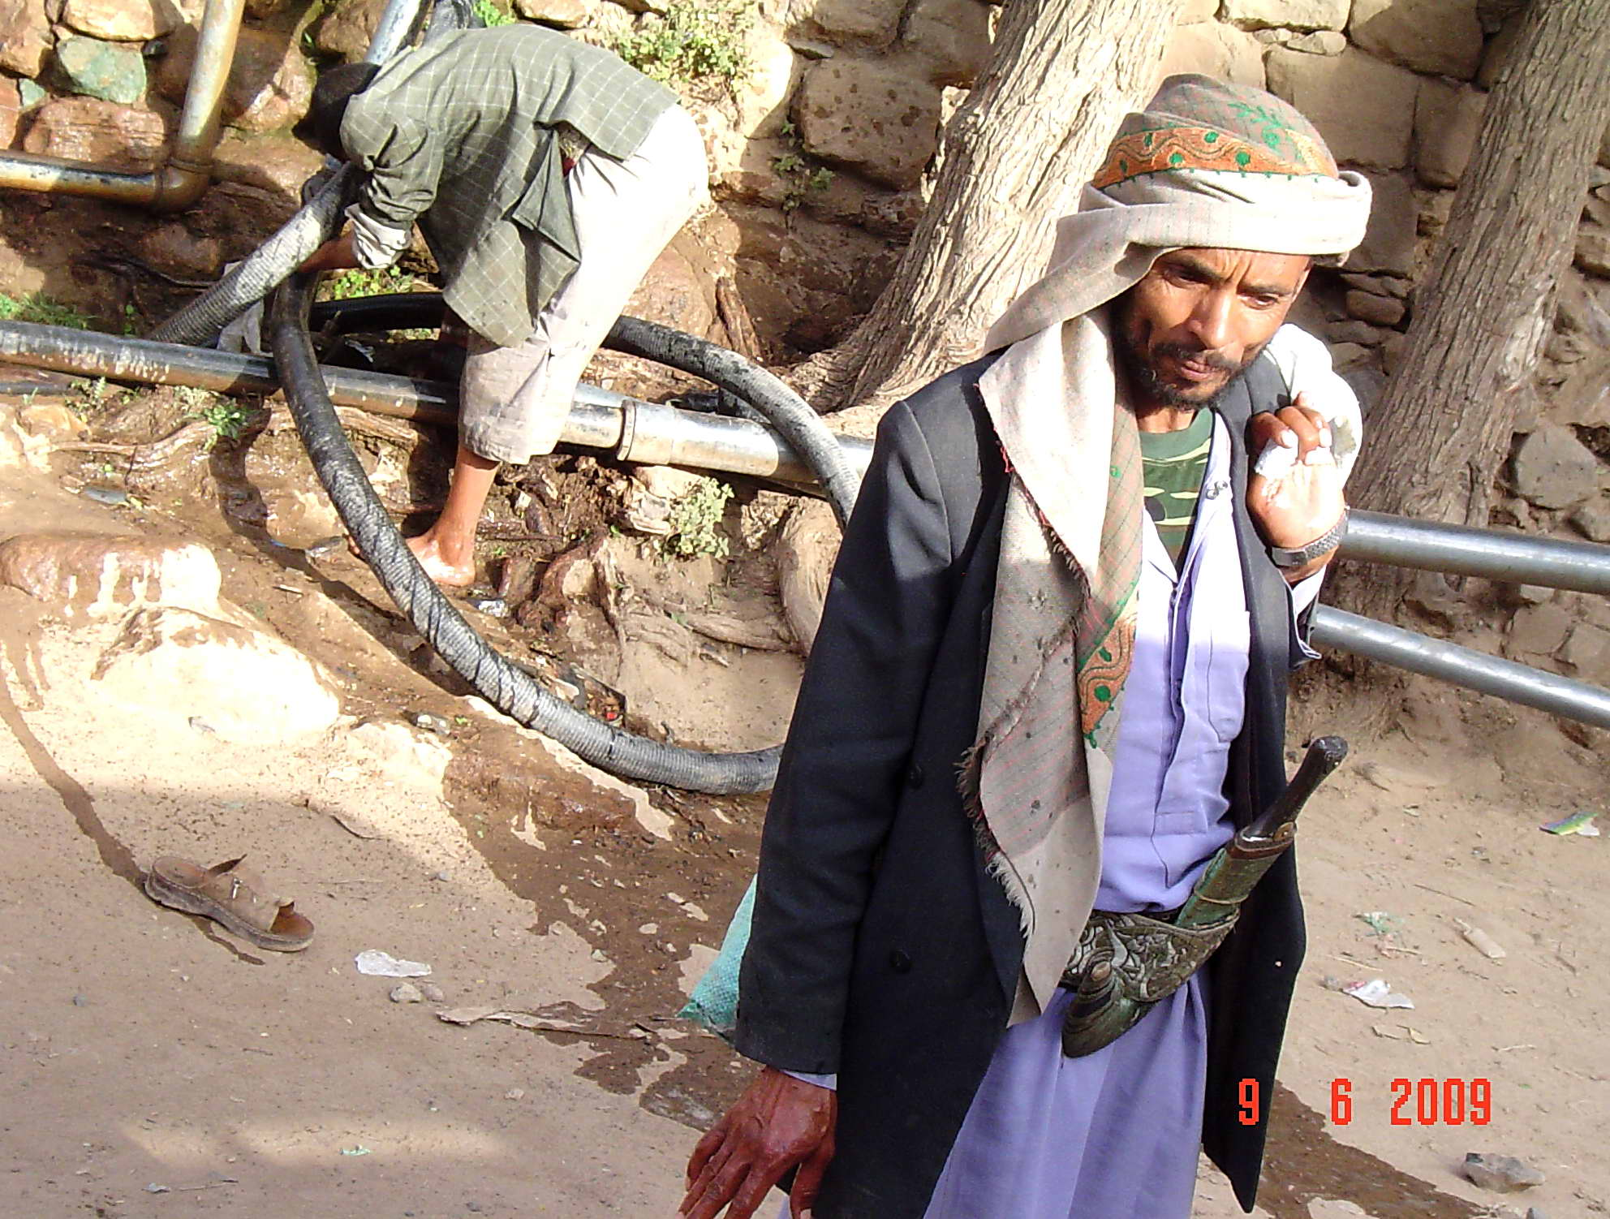
Exposure
Sensitivity
Potential impacts
Adaptive capacity
Vulnerability to climate change

Slide 32
The Concept of Double Exposures
The Arab region is home to 5% of the world's population but has access to only 1% of global fresh water resources.
Some of the world's biggest and longest-running conflicts are playing out in the region: Somalia, Iraq, the occupied Palestinian territories and Sudan.

Slide 33
Causes of Vulnerability
Example: Human health vulnerabilities
State and trends: More frequent geographically widespread epidemics of infectious and water-borne diseases
Climatic impacts: Climatic changes increase the area and number of disease vectors and more frequent heavy rainfall and drought events could disrupt water supply and sanitation
Other sensitivities and pressures: Severely degraded health care system; declining immunity, nutritional and health status of population; high poverty rates; poor programs for disease surveillance; vector control, and disease prevention.
In: Leary and Kulkarni, 2007

Slide 34
Concept of Resilience
It has been used to characterize a system’s ability to bounce back to a reference state after a disturbance, and the capacity of a system to maintain certain structures and functions despite disturbance. If the resilience is exceeded, collapse can occur.
The focus of the vulnerability reduction efforts should be on helping increasing resilience both for people and ecosystems instead of only reacting to actual impacts.
(Gunderson and Holling, 2002; Jäger and Kok, 2008; UNEP 2009)

Slide 35
Vulnerability Assessments – History
A product of three streams of research and the novelty is in the integration across these streams
Impacts assessments - for example if building a hydropower station how it could impact communities, habitat and biodiversity.
Risk and hazard assessment could include potential emergencies such as floods, earthquakes.
Assessments of multiple causes of a single effect - food security studies see hunger as the consequence of a number of stresses and issues (drought, political marginalization, inequality)

Slide 36
Criteria for Climate Change Vulnerability Assessments
The knowledge base engaged for analysis should be varied and flexible (collaborative).
Vulnerability assessments should be “place-based,” with an awareness of the nesting of scales.
The global change drivers examined should be recognized as multiple and interacting.
Vulnerability assessments should allow for differential adaptive capacity.
The information should be both prospective and historical.
Institutional aspects to uncover how they address vulnerability and implement adaptation responses

Slide 37
Defining the scope of the assessment
Resource Unit versus Jurisdictional

Slide 38
Thematic Versus Sectoral Approaches
Thematic approach:
  A more traditional approach; i.e., water, air
  Challenge is that different themes can be impacted by the same policies or sectors
Sectoral approach:
  i.e., transportation, agriculture, energy
  Challenge is that one environmental theme can be impacted by multiple sectors

Slide 39
Exercise 1
What were the contexts of the previous State of the Environment reporting processes in the country?
Having considered the contexts of previous reporting processes and the existing environmental and climate change information needs for decision making, what is the best context for assessment process in your country?
How might the new assessment process and report be designed to minimize the “cutting the cake dilemma?” Discuss issues related to analysis of trans-boundary environmental problems.

Slide 40
1. Characteristics of vulnerability and scope of the assessment
2. Vulnerability assessment and the DPSIR framework
3. Monitoring vulnerability
4. Impacts of climate change and their assessment
5. Creating responses - determining the adaptation options
6. Prioritizing the adaptation options
7. Developing a basic implementation plan and a communication strategy

Slide 41
Vulnerable to What, When and Where?
Focusing on identifying how different drivers and pressures interact and lead to vulnerability: processes such as epidemics or environmental changes, including climate change, are not occurring in isolation of one another, or in isolation of other drivers and pressures.
Vulnerability is a dynamic concept, and stressors on the human-environment system are constantly changing, as are the available capacities over time.
Differences in vulnerability between countries, regions, communities and even within households
Notes:
A community that switches to planting cash crops and whose market prices are dropping will have fewer resources to cope with severe climatic events, which could include droughts, floods or cyclones.

Slide 42
DPSIR Framework and Climate Change
Connecting causes (drivers and pressures) to environmental outcomes (state and impacts), including impacts of the changing climate, and to activities that shape the environment (policies, responses and decisions) such as adaptation and mitigation responses
An opportunity to better understand the impacts of environmental change on human systems even further is provided by the vulnerability approach.

Slide 43
As an IEA analytical framework, DPSIR entails analysis of the following components, which could be done in three stages:
Stage 1: Drivers, Pressure, State and Trends
Stage 2: Impacts
Stage 3: Responses (for vulnerability assessment, only focusing on coping and adaptive capacities)

Slide 44
HUMAN SOCIETY
DRIVERS
Indirect influence through human development
Population growth, industrial processes, energy demands,
IMPACTS
Human well-being
Crop losses, less water for people, irrigation and livestock, increased number of sick and mortality people and livestock, famine, malnutrition
Economic,
Social Goods &
Services
Wild products,
Wood availability, , reduced flood protection
capacity
PRESSURES
Ubanization, shifting to cash crops, increasing costs of health care, increase levels of GHGs
Soil infiltration, stability, structure
Evapotranspiration cycles
Natural processes
Direct influence through human interventions
RESPONSES
Mitigation
and adaptation
Adapting by building dykes, increasing irrigation, changing planted species and mitigating climate change by reducing GHGs, increasing renewable energy, energy efficiency
Ecosystem Services
Changes in vegetation, fish, and migratory birds populations, pest outbreaks
STATE AND TRENDS
Water, land, atmosphere, biodiversity
Increased occurrence of cyclones, drought, floods, changes in precipitation patterns, increase occurrence of pests
ENVIRONMENT
We should aim for understanding the vulnerability that includes identifying to which extent the system is sensitive to identified impacts in the context of available adaptive capacities.

Slide 45
Key questions
How often do the identified impacts including disasters hit the community?
Based on the elements of the DPSIR, what are the main causes of vulnerability?
What coping strategies exist for each identified impact?
What are the capacities that are lacking to address the identified impacts?
Which organizations/institutions, if any, support existing coping strategies or promote new strategies?
Who has access to/uses these capacities?
Are capacities available to address potential future adaptation strategies?

Slide 46
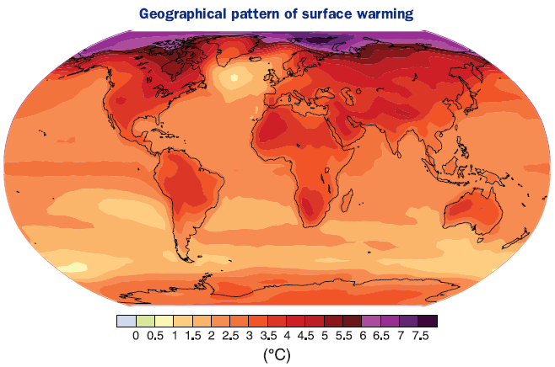
Assessing Vulnerabilities and Adaptation to Climate Change
Projected surface temperature changes for the late 21st century (2090-2099). The map shows the multi-AOGCM average projection for the A1B SRES scenario. Temperatures are relative to the period 1980-1999.

Slide 47
Example of impacts:
Changes in precipitation
State Changes | Environmental /Ecosystem Impacts | HUMAN WELL-BEING IMPACTS
 |  | Human Health | Food Security | Physical Security and Safety | Socio-economic Effect
↑↓ Precipitation | ↑ Flood damage | ↑ Water-related diseases | ↑ Crop destruction | ↑ Drowning and flood damage | ↑ Damage to property
 | ↑ Drought | ↑ Malnutrition | ↑ Crop reduction
Source: Jäger and Kok, 2008

Slide 48
Exercise 2
Small groups, based on the discussion from the previous exercise, indentify an ecosystem or an area and complete the following tasks
Identify major current exposures and sensitivities.
What are the main coping strategies and capacities that people use to respond to the exposures?
On posted notes write down key drivers and pressures that also contribute to the identified exposures, sensitivities and coping responses and stick them next to the impacts written on the flipchart.
Try to identify examples of policies and measures that help and halt coping and maintaining capacities.

Slide 49
Focus: Area /Ecosystem/
Current exposures | Current sensitivities
Examples of coping responses
Current policies and measures that help in coping with exposures | Current policies and measures that are limiting capacities to cope with exposures
Notes:
Temple for the exercise – write down the answers to the question sot this template and …..??

Slide 50
1. Characteristics of vulnerability and scope of the assessment
2. Vulnerability assessment and the DPSIR framework
3. Monitoring vulnerability
4. Impacts of climate change and their assessment
5. Creating responses - determining the adaptation options
6. Prioritizing the adaptation options
7. Developing a basic implementation plan and a communication strategy

Slide 51
Monitoring Vulnerability
So far we looked at vulnerabilities related to current climate and climate variability
We can use indicators to monitor changes in vulnerability over time and help guide decision-making
Same processes that are outlined in module 4
Vulnerability can be monitored by identifying indicators and by creating indices that could both be presented spatially and non-spatially.

Slide 52
Example of an indicator development process from South Africa
Application of criteria
Step 3
Categorization of indicators into core set and other associated sets of indicators
Step 1
Identification of a framework to guide the selection of draft indicators
Step 2
Selection of a broad set of draft indicators
Review of legislation
Consultation with key stakeholders
IEA Module 4

Slide 53
Examples of Indicators
Frequency of natural events (droughts and cyclones)
Infrastructure (road network, coastal defense etc.)
Wildfires (location, intensity)
Land use
Assets, land value, house value
Household size –
female-headed households
Food sufficiency
Population affected by disasters
Crop types, cropping systems
Irrigation rate, irrigation source
Households below poverty
Level of education or literacy
Health care delivery

Slide 54
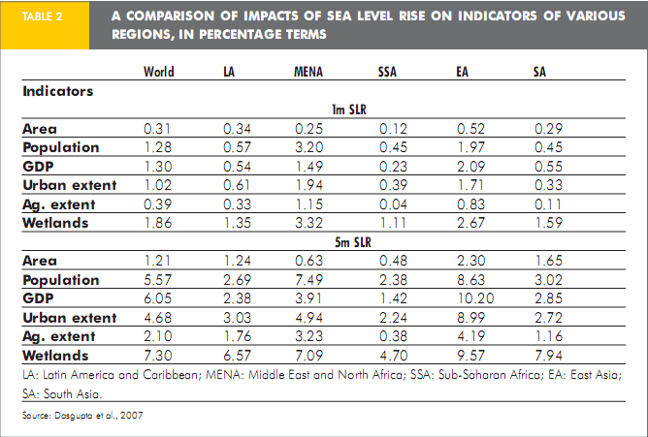
MENA Region includes: Algeria | Bahrain | Djibouti | Egypt | Iran | Iraq | Israel | Jordan
Kuwait | Lebanon | Libya | Malta | Morocco | Oman | Qatar | Saudi Arabia | Syria
Tunisia | United Arab Emirates | West Bank and Gaza | Yemen

Slide 55
Spatially represented indicators for Honduras
Population at the risk of flooding and landslides (indicate by shades of red)
Source: CIAT, 2000

Slide 56
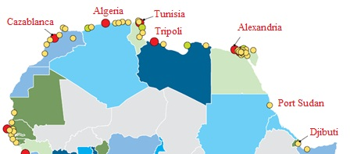
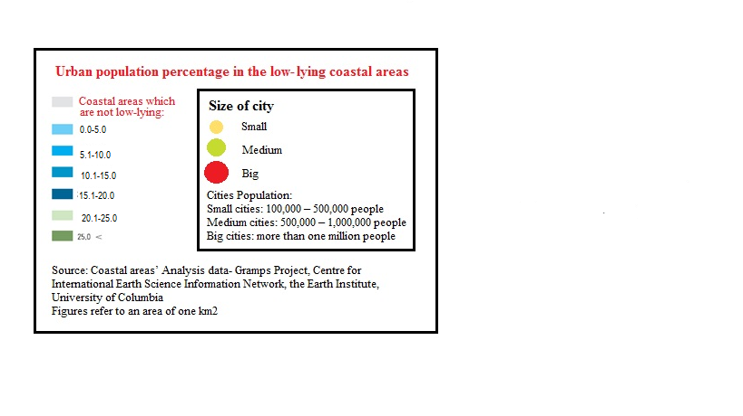
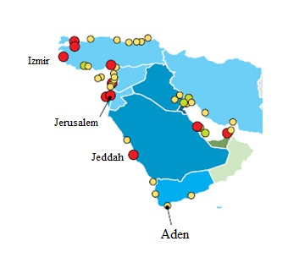

Slide 57
Optional Exercise 3
The objective of this exercise is to select and assemble a group of indicators to assist in climate change vulnerability assessments.
Continue in the same groups from the previous exercise and with the identified exposure, sensitivities and coping strategies. Try to create a brief list of potential indicators (up to 5 indicators) that can be used to monitor changes in exposure, sensitivity and applied coping strategies in the selected area/ecosystem
Approx. 15 min for the exercise

Slide 58
1. Characteristics of vulnerability and scope of the assessment
2. Vulnerability assessment and the DPSIR framework
3. Monitoring vulnerability
4. Impacts of climate change and their assessment
5. Creating responses - determining the adaptation options
6. Prioritizing the adaptation options
7. Developing a basic implementation plan and a communication strategy

Slide 59
Climatic and Non-climatic Variables
Example: Public Health Vulnerability ---- Sources of concern
Climate driven factors like fear of the spread and expansion of climate induced diseases (Malaria, Bilharzia and Leishmania) as a result of the abundance of their vectors in addition to droughts and floods.
Non- climate driven factors like degradation of the health system, lack of immunity and poverty . .

Slide 60
Impacts of Climate Change and their Assessment
The climate change impact assessments that are based on projection scenarios of future climate change presented as changes in temperature, precipitation, sea level rise and others.
Using available information and data, it is possible to analyze the potential future in climate parameters
Linking future projections with observed trends and with potential consequences of these projections on system
Using both models’ outcomes, available literature and stakeholders expertise and knowledge
Notes:
IPCC Data Distribution Centre http://www.ipcc-data.org/, FAO climate date: CLIMWAT – A climatic database for CROPWAT http://www.fao.org/nr/water/infores_databases_climwat.html Global climate forecasting and monitoring database http://iri.columbia.edu (forecasts)
Particular attention should be given to sectoral, national and regional studies, as these can provide the data needed to assess critical thresholds and specific tipping points. For instance, data on the recommended daily calorie intake, duration of the growing season, etc. are often available in poverty or food security reports. Furthermore, many regional and national reports on most climate hazards and events exist.
See, for example: USAID Famine early warning system network www.fews.net; FAO Global information and early warning system on food and agriculture www.fao.org/giews/english/index.htm
For long-term climate change and trends, data on climate parameters and future thresholds can be derived from climate change scenarios. However, considering that most scenarios are global or regional in scope, they are of limited use for national level analyses. In the same vein, the timescales used in these scenarios (50 to 100 years) is not appropriate for the decision-making process (which needs to address urgent and immediate needs on a 10 to 20 year timescale).
See, for example: IPCC Data Distribution Centre http://www.ipcc-data.org/, IPCC Reports http://www.ipcc.ch/ipccreports/index.htm
Given the often limited data, groups are recommended to focus on using historical and observed climate data and trends to construct good climate data series. If groups decide to use scenarios in the course of this exercise, they are recommended to select simple rather than complex ones. With respect to General Circulation Models (GCMs), one must always examine the accuracy of the results obtained for the study region and the parameters used. Techniques exist to transform information from a global scale, to a regional and then national one.
See, for example: Vulnerability Network & Observatory http://vulnerabilitynet.org
Assessments of Impacts and Adaptation to Climate Change in Multiple Regions and Sectors Project - http://www.aiaccproject.org/aiacc.html
The Climate Change Explorer provides users with an analytical foundation from which to explore the climate variables relevant to their particular adaptation decisions. The approach makes crucial links between understanding vulnerability, monitoring and projecting climate hazards and planning adaptation processes and is grounded on several key assumptions regarding the interpretation of climate science. The Climate Change Explorer (CCE) Tool is a desktop client that provides an interface to download, manage and visualize downscaled model output. The tool is available at http://www.weadapt.org/.
Finally, further data can be accessed at GEO data portal http://geodata.grid.unep.ch/, Global Climate Observing system (GCOS) for data sets http://www.wmo.int/pages/prog/gcos/index.php and at World Climate Research Programme (WCRP) disaster data portal http://www.disdat.be/

Slide 61
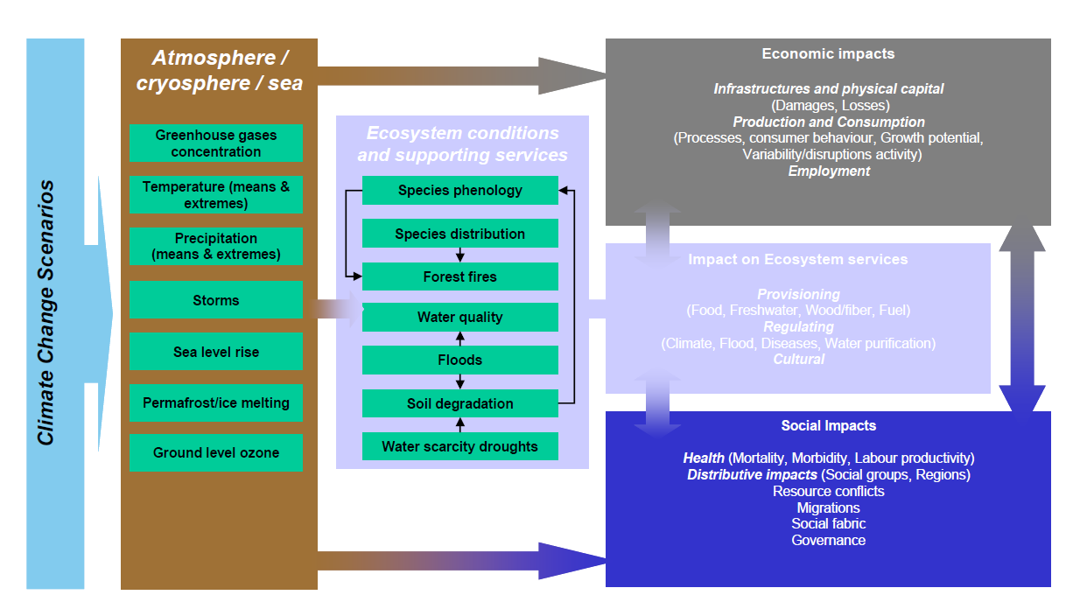
Consequences of climate change
Source: Environment DG, EU (2008).

Slide 62
Potential consequences of impacts
Climate driven phenomena | Agriculture, forestry and ecosystems | Water resources | Human health | Industry, settlements and society
Drought- affected areas increase | Land degradation Crop damage and failure Increased livestock deaths Wildfires | More widespread water stress | Increased risk of malnutrition Increased risk of water and food-borne diseases | Water shortages for settlements, industry and societies Reduced hydropower generation potential
Sea level rise Increased incidence of extreme high sea-level (excluding tsunamis) | Salinisation of irrigation water, estuaries and freshwater systems | Decreased freshwater availability due to salt-water intrusion | Increased risk of death and injuries Migration-related health effects | Costs of coastal protection versus cost of land-use relocations Movements of population and infrastructure
Sources: UNEP (2009)

Slide 63
Potential future pressures and impacts from projected climate change and changed socioeconomic futures (module 6)
2000 2010 2020 2030 2040 2050
    Present: climate and climate variability, responses and vulnerability
    Future: projected climate change, new responses, future vulnerability

Slide 64
Projecting Climate Change
Identifying scenarios of potential levels of GHGs based on projections of future socio-economic development so called global emission scenarios (SRES scenarios)
Using them as the basis for simulations by using general circulation models (GCMs),which calculate the interrelationship of the elements of the earth system and thereby project future climate trends.
Regional climate models (RCMs) are based on the results of the GCM, and project the climate in more precise geographical detail (Kropp and Scholze, 2009).
The results of these models provide estimates of how basic climatic variables will develop in the future at the global or regional level.

Slide 65
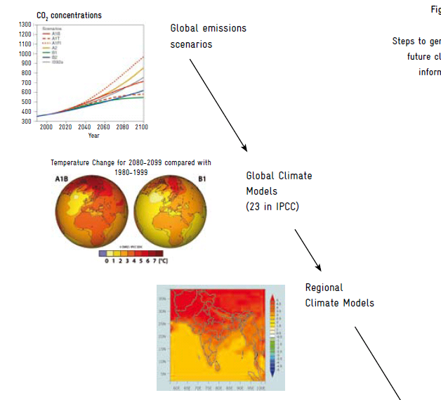
Sources: Kropp and Schulze (2009), modified

Slide 66
Projections of Climatic Variables
Basic climatic variables (minimum and maximum daily temperature, maximum and minimum rainfall, evapo-transpiration, sunshine duration, etc.)
Indicators (length of the growing season, heat wave duration index etc.)
Complex indices (level of satisfaction of different crops water needs) to identify thresholds
Many impact assessments of future climate change often use simple data and based on consultation with stakeholders and their knowledge on current impacts of climate and climatic variability the consequences of these simple data sets on agriculture, forestry and other sectors are identified .

Slide 67
Health impacts
Temperature-related mortality and morbidity
Extreme weather health effects
Air pollution health impacts
Food and water- borne diseases
Insect and vector borne diseases
Impacts related to shortage of food and water
Mental, nutritional and septic health effects
Adjusted impacts
Germs contamination means
Spores dynamics
Regional climate changes
Heat waves
Extreme weather
Temperature
Precipitation rate
Climate changes
Agricultural ecosystems
Water systems
ٍSocio-economic status Demography
Adaptation measures
Research

Slide 68
Climate Change Impacts in the Arab Region as Cited in National Reports
Tunisia: By 2030, the following impacts are projected: • A 1.1 ° C average increase in temperature • Extremity of drought events and a 28% reduction in water resources •Loss of about 20% of the agricultural land and 50% of the un-irrigated forests in the south . Arab Republic of Egypt: Potential impacts of climate change : • A substantial decline in major crop yields (wheat and maize) • An erosion in the Delta shores , seawater intrusion into freshwater and the degradation of some ecosystems as a result of climate change • A potential sea level rise of 0.5-1 m during the next hundred years will lead to the drowning of 30% of the coastal areas in Alexandria and subsequent economic damage including the following: • The dislocation of at least two million people • The loss of 195,000 jobs, • The absence of any remedial measures will lead to an economic loss estimated at about 35 billion U.S. dollars and the most affected sectors will be agriculture, industry and tourism respectively. Republic of Lebanon: Potential impacts of climate change: • The high temperature will lead to the dislocation of plant communities in the mountainous areas and the migration of species to other higher places, • Decrease in rainfall rate and the inundation of some coastal areas and small islands.

Slide 69
Climate Change Impacts in the Arab Region as Cited in National Reports
Kingdom of Morocco: By 2020, the following impacts are projected: • A 0.6 -1.1 ° C rise in temperature • A 4% reduction in the precipitation rate and an increase in drought frequency and severity which will lead to a 15% decrease in water resources. • A 50% decline in agricultural production in years of drought and a 10% reduction in normal rainfall years, • A 7-12% increase in irrigation allocations kingdom of Saudi Arabia: Potential impacts of climate change • A 2.2-2.7 ° C increase in summer temperature in the northwestern regions of the Kingdom and a rise of 0.2-0.4 ° C in the south and south-west of the country, • This increase will lead to a 5-25% reduction in agricultural production in all regions. • A sea level rise of 0.5 m by the year 2100 will drown 2663 hectares of sandy beaches in the Kingdom. Republic of Sudan: By 2060, the following impacts are projected: • A significant increase in temperature ranging between 1.5 -3.1 ° C according to seasons, • A decrease in the average precipitation rate of about 6 mm per month during the rainy season, • These changes will have a negative impact on agriculture, water resources and public health. Climate scenarios for Northern Kordofan anticipate a 1.5 ° C rise in surface temperatures between 2030 and 2060, and a 5% decrease in rainfall, which could lead to a 70% reduction in white maize crop yields. Source: National communications and various countries’ reports.

Slide 70
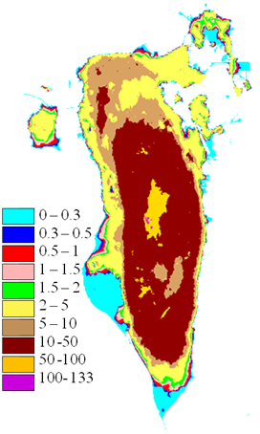
Impact of Sea Level Rise on the kingdom of Bahrain
 | -The Kingdom of Bahrain occupies an area of 740 Km2. It is an archipelago of small islands that might be at great risk of losing significant land mass as a result of sea level rise. -Eighty Km2 or more than 10% of the total area of the kingdom is estimated to be only 0.5 m above mean sea level. - More than two-thirds of the population live within 2.0 km of the coastline. -Sea level rise may pose a substantial threat to Bahrain’s resources because of their low-lying physiographical setting as well as the vulnerability of the residential, economic, tourist, and other vital activities. -As a small island state with high population density and high population growth rates, the Kingdom of Bahrain has a limited capacity to adapt to relative sea level rise which underlines the need to undertake risk assessment measures and develop an appropriative adaptive strategy to cope with impacts of sea level rise.

Slide 71
Example: Syria
Assessing vulnerability of the Climate and Adaptation Sector
Climate Change Assessment
Socio - economic impacts
Agriculture
Forestry
Biodiversity
Human Health
Water Resources
Coastal Resources
Land Use
Energy

Slide 72
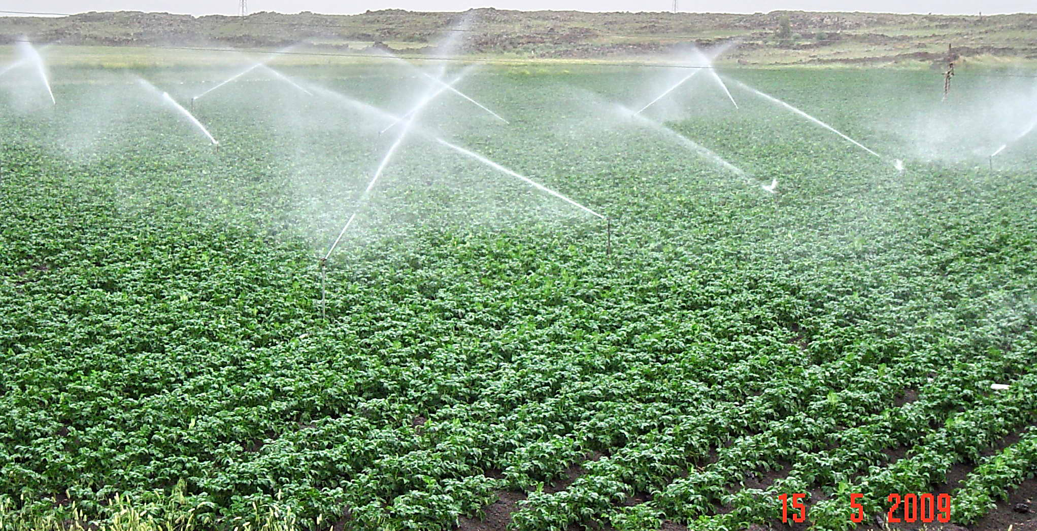
The vulnerability of the agricultural sector to climatic changes is not only determined by its exposure to climatic phenomena like rise in temperature but also by the crops’ sensitivity to these changes , the decrease in production, and farmers’ adaptive capacity towards these sensitivities. This is to be done through the reliance on temperature-tolerant crops or refraining from planting sensitive crops.

Slide 73
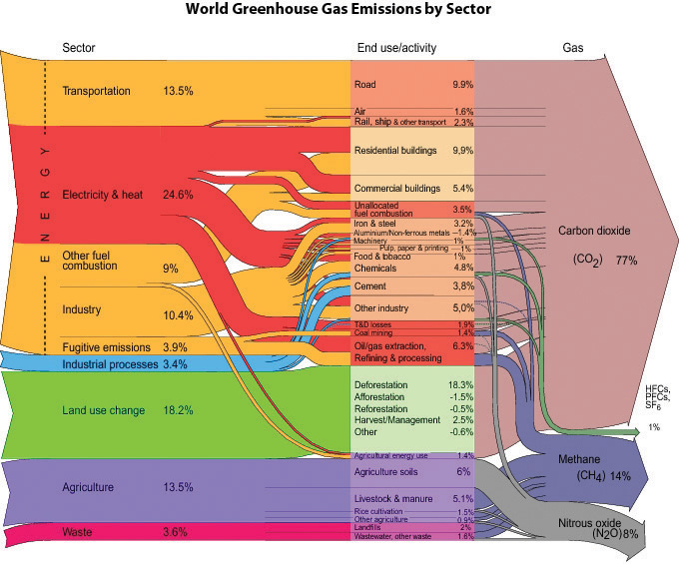

Slide 74
Uncertainties and how to address them
Projection of future emissions | Assumptions about future population, socio-economic development and technical changes are uncertain – making projections for a range of these SRES emissions scenarios.
Concentration of GHGs CO2, Methane, Sulphates | The imperfect understanding of the processes and physics in the carbon cycle, chemical reactions in the atmosphere and feedbacks between climate and the carbon cycle – The use of atmosphere-ocean general circulation models (AOGCMs) is needed.
Global Climate Change Temperature, | Incomplete description of key processes and feedbacks in the model - global climate models, project different patterns and magnitudes of climate change
Regional detail Mountain, islands, extreme weather | Natural variability could act to either add to or subtract from changes (for example in local rainfall) due to human activity. This uncertainty cannot yet be removed, but it can be quantified by running ensembles of future climate projections
Impacts Flooding, food supply | Different regionalisation techniques can give different local projections, even when based on the same GCM projection - addressed by using more RCMs or statistical downscaling for different GCMs
Jones, 2004

Slide 75
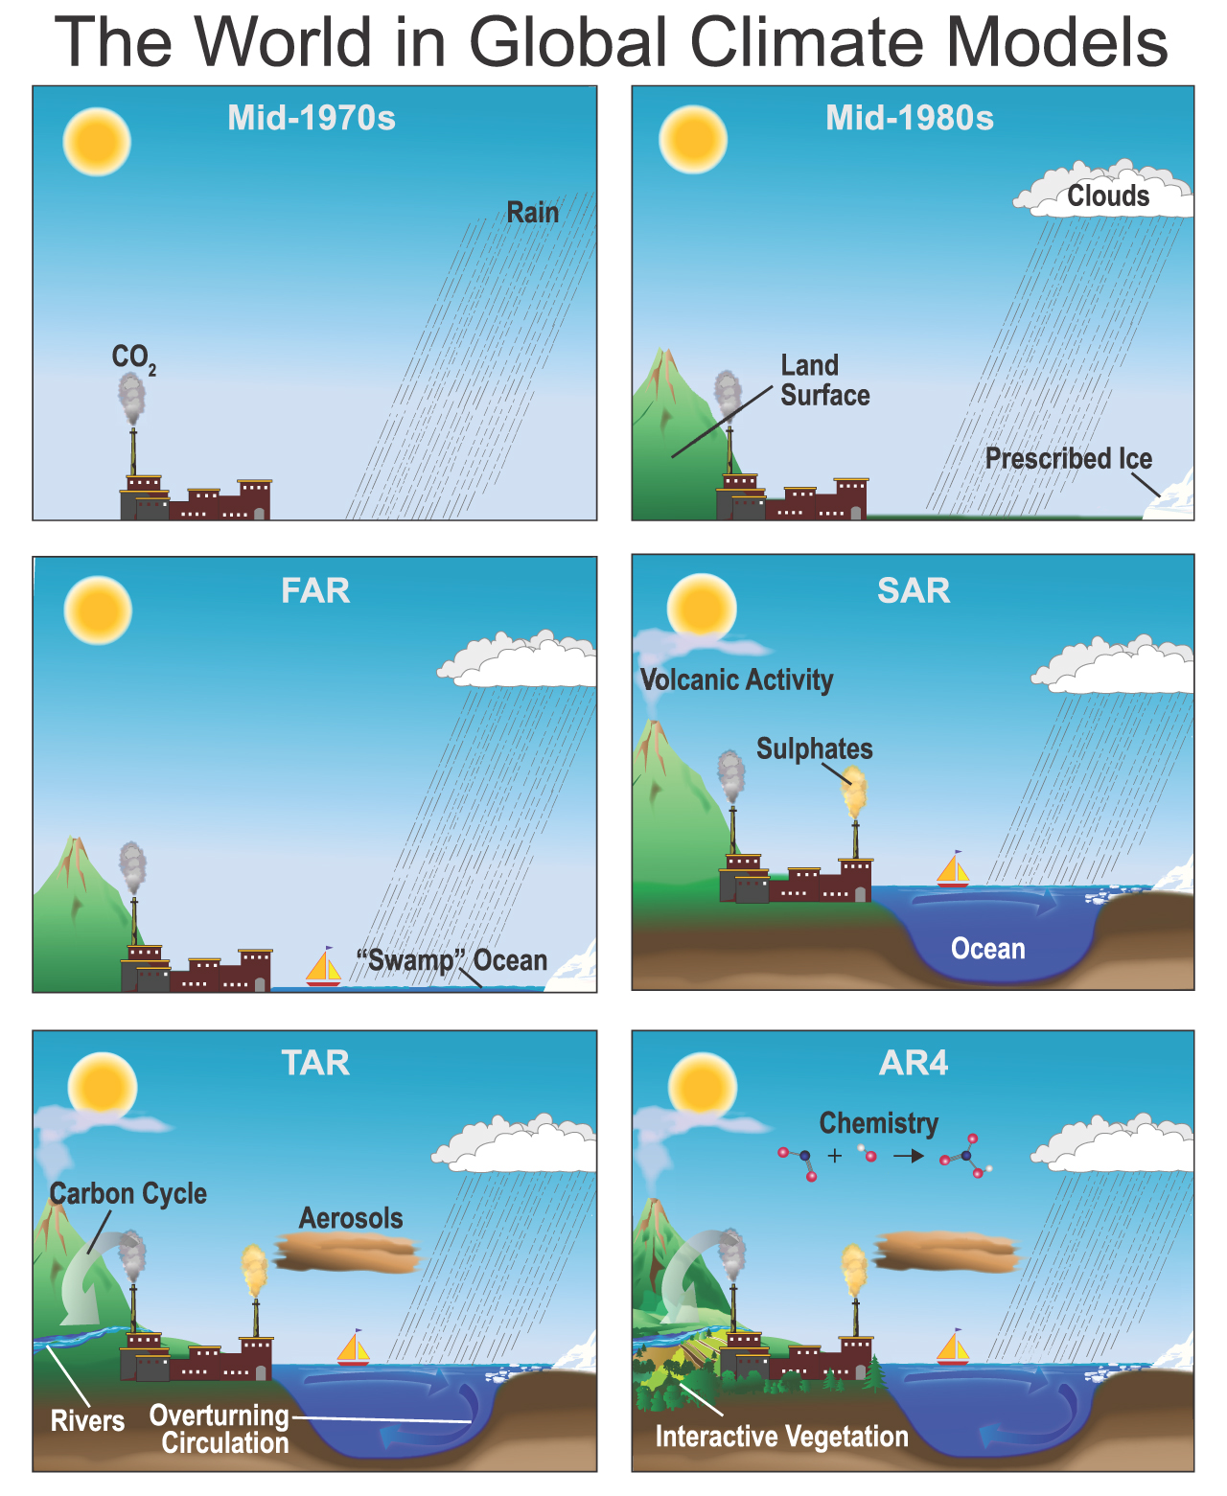
IPCC, 2007

Slide 76
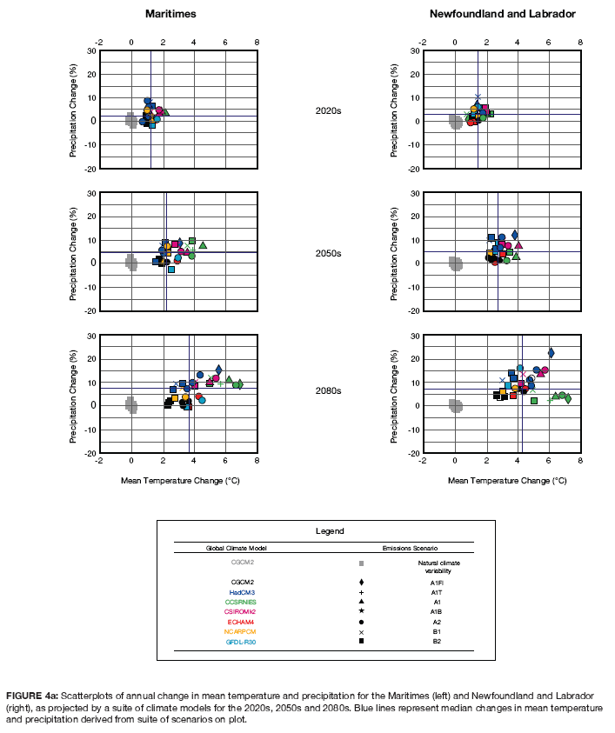
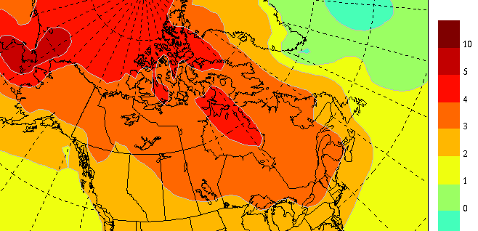
Uncertainty in models:
- working with a number of models and emissions scenarios
Example: Maritimes Canada
Mean daily temperature in 2050 in Canada by CCCM
www.cccm.ca

Slide 77
Uncertainty in models
For Mozambique, the maps below indicate that an outcome is unlikely to happen if 2 or less models projected that outcome (beige shade);likely to happen if 3-4 models projected it (orange shade); and very likely to happen if 5-7 models projected it (red shade). (Source: Asante, 2000 and INGC, 2009).

Slide 78
Uncertainty in models
Example of temperature projections for Southern Europe by using GCMs and RCMs
(source: Jones et al., 2004)

Slide 79
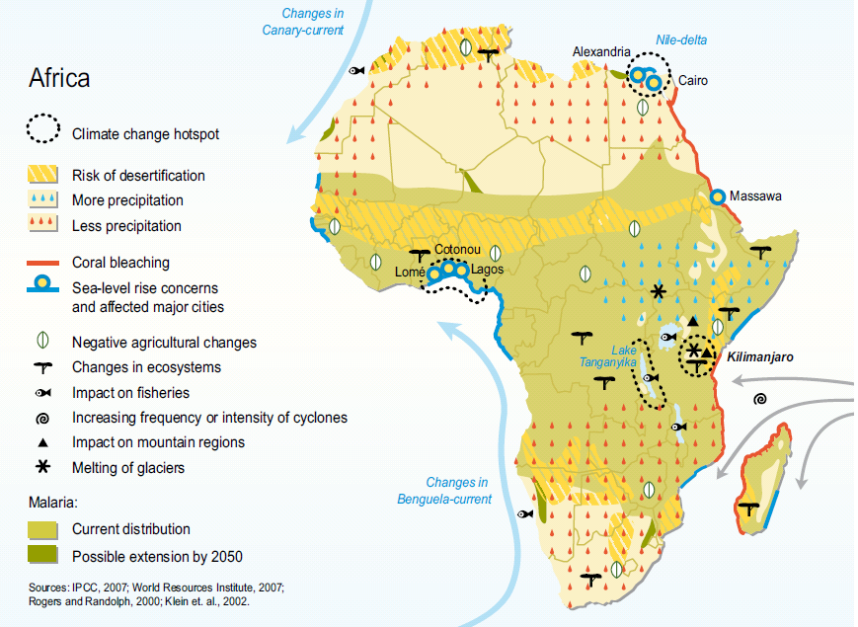
UNEP, 2009

Slide 80
Overview of major changes in climatic variables and their implications for selected sectors

Slide 81
Notes:
Overview of the changes in climatic variables and implication for selected sectors

Slide 83
Climatic variable | Observations | Projections | Identified consequences of these projections for the studied areas based on experiences and knowledge of involved stakeholders
Precipitation | Increased heavy precipitation by approx. 5% leading to local floods | Potential further increase in precipitation 3-10% | Destruction of infrastructure and assets and increase in erosion Losses of agricultural production Losses of productive agricultural areas Losses of livestock production Slow down of economic activities during heavy rainy seasons Destruction of infrastructure including damages in road infrastructure causing difficulty in market access Loss and injuries of people due to flooding, landslides and collapsing buildings

Slide 84
Phenomena | Likelihood of future trends | Agriculture, forestry and ecosystems | Water resources | Human health | Industry, settlements and society
-Warmer and fewer cold days and nights over most land areas, -Warmer and more frequent hot days and nights over most land areas | Confirmed hypothetically | -Increased yields in colder environments. -Decreased yields in warmer environments -Increased insect outbreaks | -Effects on water resources relying on snow melt -Effects on some water supplies | Reduced human mortality from decreased cold exposure -Increased mortality from diseases especially Malaria | -Reduced energy demand for heating and increased demand for cooling -Declining air quality in cities -Reduced disruption to transport due to snow, ice -Effects on winter tourism.
-Heat waves -Warm spells Frequency increases over most land areas | Very likely | -Reduced yields in warmer regions due to heat stress -Wildfire danger increases. | -Increased water demand -Water quality problems | Increased risk of heat-related mortality especially for the elderly, chronically sick, very young and socially isolated | -Reduction in quality of life for people in warm areas without appropriate housing . -Impacts on elderly, very young and poor

Slide 85
Phenomena | Likelihood of future trends | Agriculture, forestry and ecosystems | Water resources | Human health | Industry, settlements and society
Heavy precipitation events over most land areas | Very likely | -Damage to crops -Soil erosion -Inability to cultivate land due to water logging of soils | - Adverse effects on quality of surface and ground water -Contamination of water supply - Water stress may be relieved | -Increased risk of death from diseases and epidemics | -Disruption in social and economic systems due to loss of property, flooding and pressures on urban infrastructure
Drought-affected areas increase | Likely | -Land degradation - Crop damage - Increased livestock deaths -Increased risk of wildfire | -More widespread water stress | -Increased risk of food and water shortage -Increased risk of malnutrition -Increased risk of water and food- borne diseases | - Water shortages for settlements, industry and societies -Reduced hydropower generation -Migration of population
Seal level rise | Likely | - Increased salinity of irrigation water, estuaries and fresh water systems | -Decreased fresh water availability due to salt water intrusion in coastal areas | -Increased risk of death and injuries by drowning in floods -Migration-related health effects | - Economic costs of coastal protection and land-use relocations -Costs related to movements of population.

Slide 86
0 1 2 3 4 5 °C.
-------------- Increased water availability in most tropics and high latitudes Decreased water availability and increased drought in mid-latitudes and semi-arid low latitudes -----→ >---Millions of people with increased water stress --- | Water
About 30% of species ------------------- More extinction around the globe. -→--------------------------------at risk of extinction Increased coral bleaching --Most-corals bleached—widespread ----------------→------------- coral mortality Terrestrial biosphere trends towards a net carbon source → affected -------------- 15% to 40% of ecosystems Increasing species range shifts and wildfire risk Ecosystem changes due to the weakening of the meridional overturning circulation------→- | Ecosystems
→-----Adverse effects on land tenants and on the subsistence of farmers and fishermen → ----------Decreases for cereals in low latitudes---- - all cereals decrease in low latitudes ----------Potential increases for some cereals ------- Decreases in some regions In low latitudes | Food
→ ---------------------Increased damage from floods and storm surges. Loss of 30% of coastal wetlands------------------------------------------------→ . → ---------------------Additional people at risk of coastal flooding each year | Coasts
Increasing burden from malnutrition, diarrheal, cardio-respiratory and infectious diseases-→ . -→ ---------Increased mortality and morbidity from heat waves ,floods, and drought → -------------------------------------------Changed distribution of some disease vectors. -------------------------------------------------------Substantial burden on health services | Health
0 1 2 3 4 5 °C
Global temperature changes during the period from 1980 to 1990 (°C)

Slide 87
Case study
A vulnerability study of coastal areas and climate change in Senegal
Isabelle Niang
(University of Dakar/ENDA, Senegal)
Part of C3D Training Manual
Notes:
In this case study we show what approach was undertaken to address impacts of future ??

Slide 88
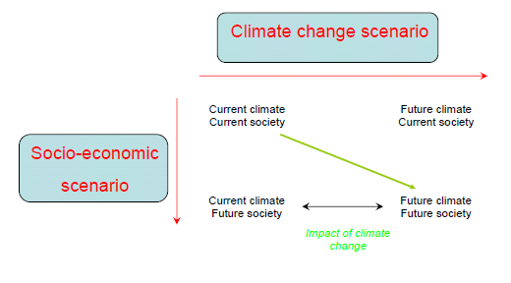
Impacts of Climate Change

Slide 89
Climate Change Scenarios
Temperature and rainfall anomaly maps compared to the climatic average (1961-1990)
Database of projected climate data
Estimations of sea-level rise
Flooding

Slide 90
Climate Change Projections
Projections in the coastal zone by 2050
Mean annual temperature increases from +1°C to +1.9°C
Decrease in annual rainfall from 1 to 10% for the Cap -Vert peninsula and from 5 to 15% in the Saloum estuary
Decrease in the intensity of upwellings

Slide 91
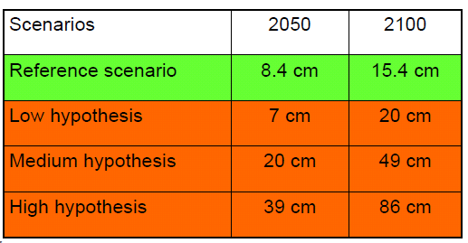
Sea Level Rise Scenarios

Slide 92
Flooding levels
Flooding levels: D = MHW + Sf+ Wf+ Pf
MHW: Mean high water level
Sf: Sea level rise
Wf: Height of storm surges for a given return period
Pf: Sea level rise caused by lower atmospheric pressure
Minimum values for a moderate high water level: 0.2 m for 2050 and 0.3 m for 2100
Moderate surge heights: from 0.8 - 1.6 m
Sea level rise: reference scenario and low hypothesis for acceleration of sea level rise
•

Slide 93
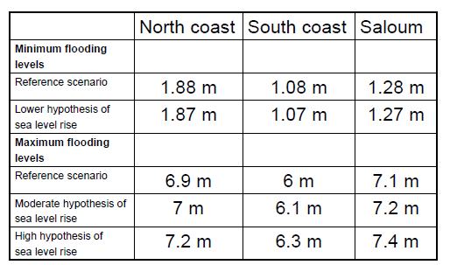
Flooding levels

Slide 94
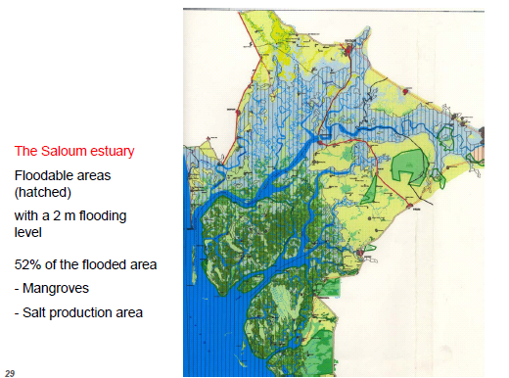
Notes:
Example of presentation of flooded areas

Slide 95
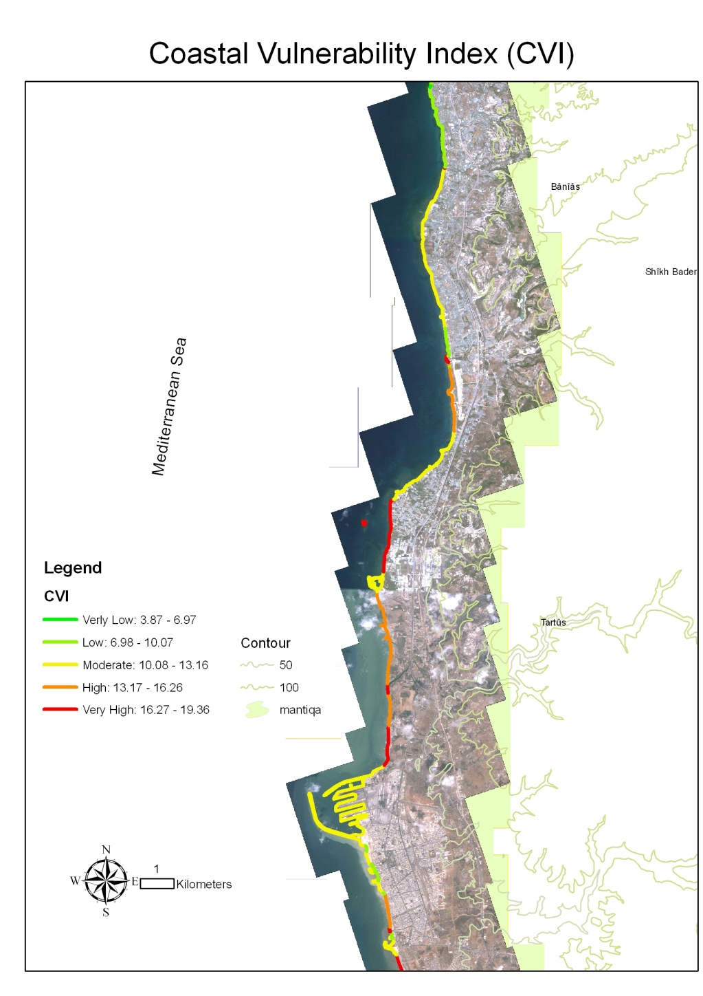
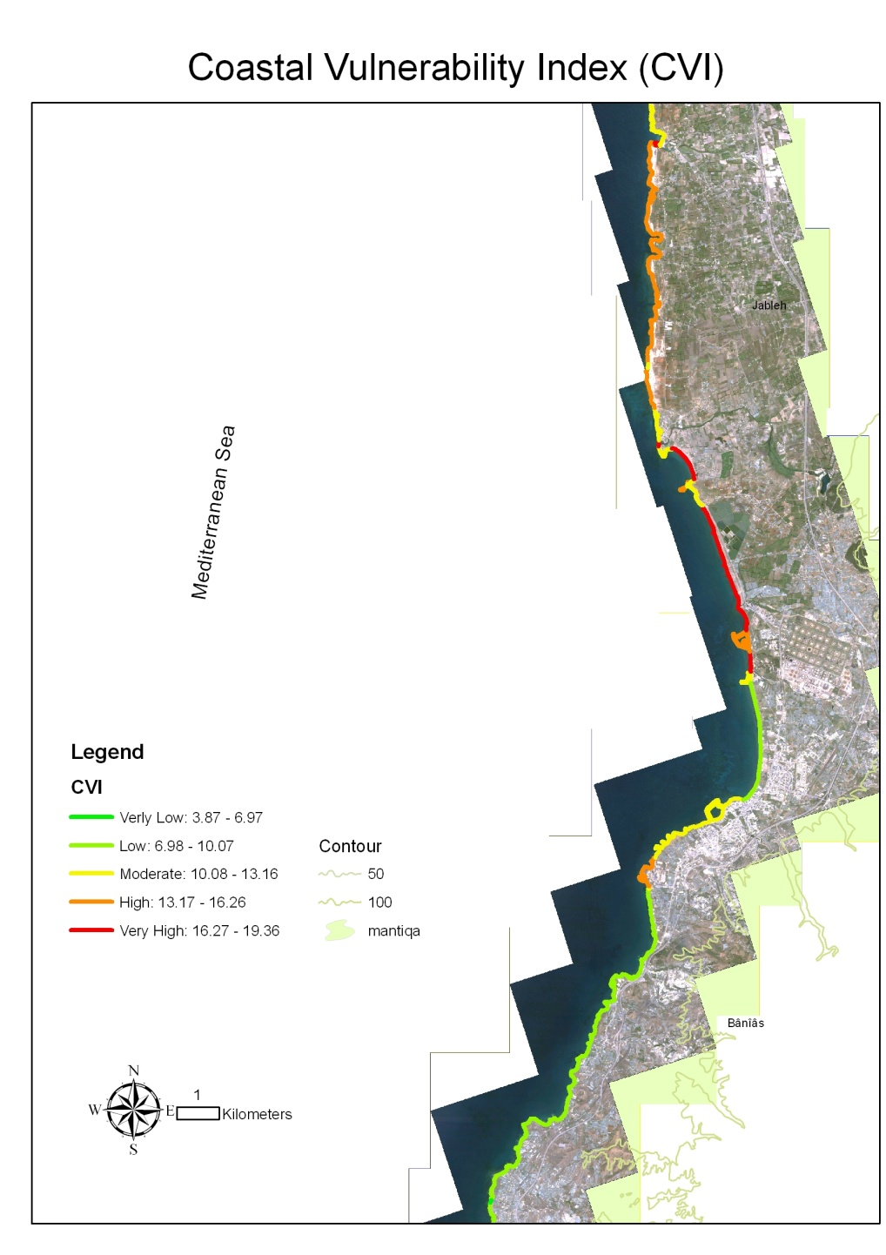
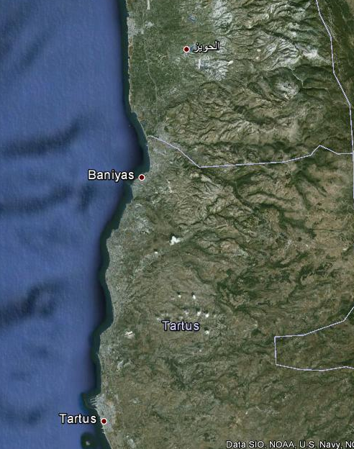
Coastal Vulnerability Index, Syria
1 South
2 North

Slide 96
Exercise 4
In your groups you can continue to work with the same selected ecosystem or select a different one and then identify major climate impacts.
Fill the table on the flipchart paper by listing a) the projected changes in the future climatic variables and b) impacts on ecosystems and c) human well-being (use also the tables in the Module)
On posted notes write down key drivers and pressures that also contribute to the identified impacts of climate change on environment and human well-being. Write these pressures and drivers and stick them next to the impacts written on the flipchart
Are the pressures and drivers different from those identified in exercise 2? Are some pressures and drivers exacerbated by climate change?
Notes:
Use the table in the previous slide to identify sectoral impacts .

Slide 97
Ecosystems/Area of focus
a) Projected changes in climatic variables - future state and trends
b) Impacts on ecosystems | c) Impacts on human well-being

Slide 98
1. Characteristics of vulnerability and scope of the assessment
2. Vulnerability assessment and the DPSIR framework
3. Monitoring vulnerability
4. Impacts of climate change and their assessment
5. Creating responses - determining the adaptation options
6. Prioritizing the adaptation options
7. Developing a basic implementation plan and a communication strategy

Slide 99
Basic Principles
Climate change causes and impacts could be addressed through a wide range of options or tools.
- Understanding climate change implications at the local level is necessary in order to develop an effective adaptation strategy.
- It is important to develop adaptation plans at the different local , national and regional levels (directorates- governorates) with a participatory approach adopted by various stakeholders.
Notes:
First point – examples: This will include important collective decisions on issues such as rural and urban development, land use, energy and water systems as well as cultural, social and psychological dimensions of values and lifestyle.

Slide 100
Responses to Climate Change
Adaptation: Adjustment in natural or human systems, in response to actual or expected climatic stimuli or their effects, that moderates harm or exploits beneficial opportunities.
Mitigation: The promotion of policy, regulatory and project-based measures that contribute to the stabilization or reduction of greenhouse gases’ concentration in the atmosphere. Renewable energy programs, energy efficiency frameworks and substitution of fossil fuels are examples of climate change mitigation measures.
Notes:
In this training manual we are focusing on adaptation, but we encourage indentifying adaptation options that have less contribution to climate change

Slide 101
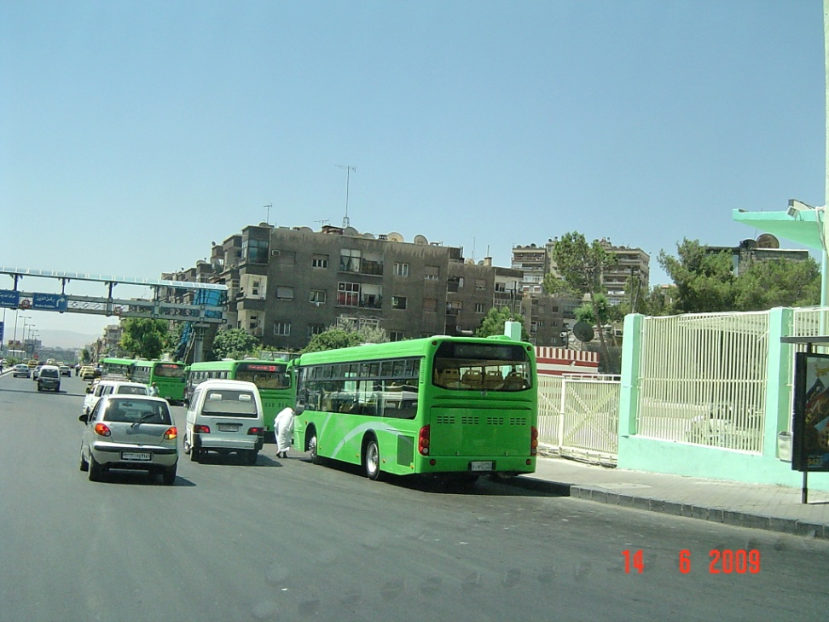
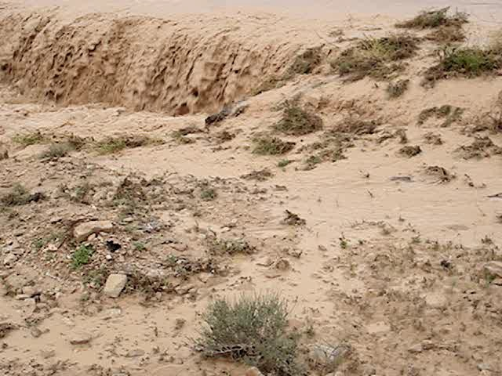
Response to Climate Change (Addressing climate change issues)
Mitigation
Adaptation

Slide 102
Adaptation
Adaptation refers to a group of policies, practices and projects that aim at effecting changes that could improve and raise the efficiency of social structures and economic activities to increase the resilience of these systems to the potential impacts of climate change and to make use of available opportunities. Adaptation to climate change includes averting risks through reducing vulnerability, enhancing adaptation and developing strategies based on accumulative assessment of risks.

Slide 103
Adaptation option - example
Climate variable | Impact | Adaptation options
High storm surge | Inundation – water becomes brackish Erosion – reduction of land area | Construct wood embankment Plant mangroves Limit removal of aggregates

Slide 104
Mainstreaming Adaptation
Climate change is not just an environmental issue – it is a development issue.
Mainstreaming includes compromises and tradeoffs among competing local, national and/or regional interests and priorities.
Finally, climate change adaptation mainstreaming process should contribute to sustainable development goals of the country at hand, talking into account all elements, including local/indigenous coping strategies.
Notes:
Mainstreaming climate change adaptation is not, however, an easy exercise.

Slide 105
Development and Adaptation
Communities need to understand the consequences of the climate change impacts and local development.
Depending on the character of the coast, the increase in sea level rise and heavy precipitation could lead to: coastal wetland loss; potentially negative impacts on ocean biodiversity and productivity; decreased food supply for sea birds and fishing communities. Meanwhile, an increase in extreme weather events could breach dykes, cause flooding and additional stress on the ecological integrity of coastal areas.
Depending on the population density, the impacts could also cause serious damages in human settlements, infrastructure and agricultural production.

Slide 106
Adaptation to climate change is an important future investment. It is the best available option.
During the first half of this century a number of objective factors underlined the inevitability of climate change and necessitated the adoption and prioritization of adaptation measures for the following reasons:
- GHGs emissions
-The limited effect of mitigation procedures
- Socio-economic and natural environmental conditions
-The effective role of adaptation measures in saving lives and reducing risks related to climate change and climate variability.

Slide 107
Adaptation Models
Supportive adaptation: It aims to improve infrastructure that enhances the adaptive capacity and leads to successful adaptation measures. These activities include raising awareness, strengthening institutions and improving capacity- building to identify vulnerabilities, and promote planning and technology transfer.
Direct /addressed adaptation: This concerns adaptation procedures directly addressed to help reduce or avoid damage.

Slide 108
Mitigation
Mitigation is an important measure that contributes to international efforts to reduce emissions and at the same time achieves a number of economic and social benefits that promote sustainable development. This is accomplished through the efficient use of energy and resources , reducing pollution through capacity- building and modernizing production systems, in addition to the expansion of vegetation development programs.

Slide 109
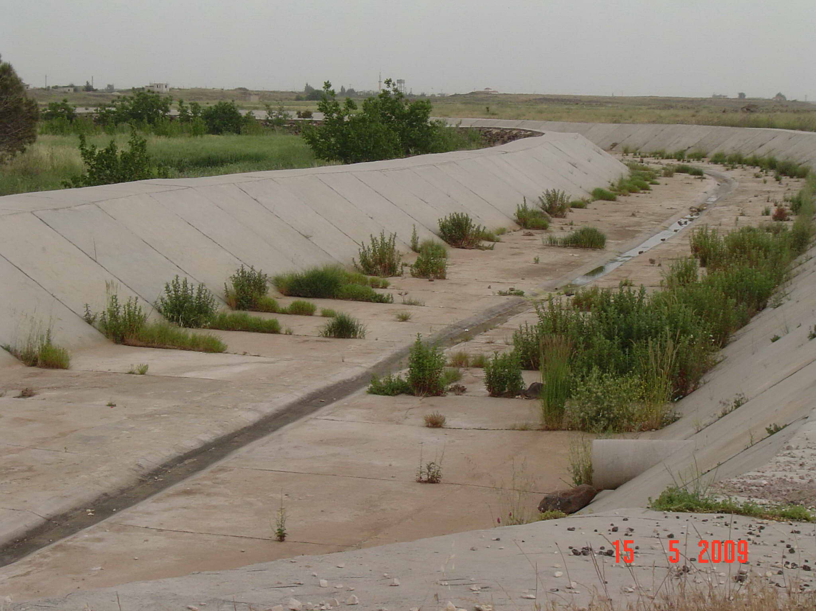

Slide 110
The General policy | Options/adaptation strategy | Sector
-Adoption of urban water policies and integrated management of water resources, water risk management, -Integrating climate change concerns into national policies - Controlling groundwater extraction operations. | -Development of water storage and maintenance technologies, water maintenance incentives, water reuse, water recycling, improving water efficiency - Raising public awareness, drawing flood hazards map, promoting public participation, developing floods adaptation and risk mitigation programs, -Promoting investment in water supply networks, controlled use of groundwater in urban and rural areas | Water supply/water risks
-Designing laws, regulations and criteria, integrating climate change concerns into the designing operations, -Developing land use policies, securing financial incentives, raising awareness about living in hazardous areas. | -Improving sanitary drainage, replacing the main sewage network, encouraging water filtration operations and storage, - Redesigning and moving structures, building water and storm barriers and regulators, developing sandy mountains and wetlands, promoting land tenure, -Building hard structures to cope with sea level rise and floods, protecting existing environmental barriers - Maintaining and safeguarding defensive areas around every building and district. | Infrastructure/settlements including cities in coastal zones
-Adoption of public health policies that acknowledge climate risks, -Promoting health services and increasing investments in this domain, -Boosting governmental, regional and international cooperation. | -Adoption of Public health national action plans, emergency medical services, opening of “cooling centres” in public places - Monitoring and controlling climatic problems, securing safe water and improving sanitation facilities, realizing better governmental and regional coordination. | Human health
- Integrating climate change concerns into the urban transport policy, promoting research and development investments, - Securing incentives for the car industry through the efficient use of energy | - Developing an environment-friendly transport system and energy-efficient vehicles - Vehicles’ assembly, effective system for public transport, -Developing new designs, criteria and schemes for roads and railways in urban areas, -Fuel substitution to address global warming. | Urban transport
-Adoption of sustainable energy policies in urban areas, management regulations, financial incentives to encourage the use of the green energy -Integrating the climate change phenomenon into design laws and criteria. | -Promoting general expenditures, transport and distribution lines, establishing land cables for public utilities, -Increasing energy efficiency and focusing on renewable resources | Energy

Slide 111
Adaptation in the Field of Public Health
- Securing minimum water requirements for household use
- Intensifying water pollution control/surveillance programs, and ensuring safety upon the re-use of wastewater.
- Enhancing medical services.
- Promoting health education and public awareness.
- Developing a national strategy for disaster control in addition to management plans to deal with anticipated hazards.
- Improving and controlling health records and ensuring their credibility through national information systems.
- Involving all parties working in the Health Services Field in a program aimed at developing strategies to cope with climate change infectious diseases.
-Promoting climate change diseases’ current prevention programs
-Enhancing capacity- building for Health Sector employees and institutions.

Slide 112
Adaptation in the Field of Energy
- Encouraging the renewable energies and the nuclear power option.
- Adoption of rationalization measures (behavioral and technical).
- Promoting the introduction of clean technologies in all energy transformation processes, especially electricity generation.
-The introduction of emissions’ mitigation techniques, including capture and storage of carbon dioxide.
- Cancelling subsidies for the energy sector.
- Imposing restrictions on CO2 emissions (taxes or fines)

Slide 113
Example 1 - Mainstreaming
Bangladesh - Agricultural policies in Bangladesh aim at food-grain self sufficiency. In drought-prone areas promotion of high yielding varieties and increasing cropping intensity have created a more vulnerable production system. New policies currently implemented are anticipating increased drought frequencies and move towards diversification of agriculture, including promotion of horticulture that will also help poverty alleviation.
Source: Kok et al., 2006

Slide 114
Example 2 - Mainstreaming
Senegal - For the vulnerability of forest and agricultural system in Senegal, climate change poses an additional stress. Restoring soil fertility is a key factor in increasing and stabilising agricultural production levels and carbon sequestration offers development opportunities. Currently biomass accounts for 43 % of total energy consumption; in rural areas this can go up to 80%. Agro-forestry for the local energy supply contributes to the rehabilitation of degraded lands and provides energy sources for the rural poor.
Source: Kok et al., 2006

Slide 115
Example: Climate impacts in Ghana
ClimSim, 2009

Slide 116
Example: Impacts and adaptations in selected regions of Ghana
Zone | Climate impacts | Adaptation options
Northern Savannah | Increased morbidity and disease prevalence Increased vulnerability of the poor Increased outmigration , loss of human capital | Strengthening traditional social security support systems Strengthening public healthcare delivery Targeted social transfers and safety nets Increased investment in urban social services
Transition | Increased demand - water, energy and basic services Decreased income for people in fish industry Increased out migration Increased food insecurity Threats to forest-based livelihood Potential conflicts and social tensions | Public private partnership in service provisions Develop early warning systems and awareness raising Promotion of conflict management mechanisms Provision of social safety nets for communities and migrants Develop alternative and additional livelihood
Bizikova and Bailey, 2009

Slide 117
Stocktaking and Mapping of Technical Capacities for the Adaptation Network in West Asia

Slide 119
Types of Adaptations
Infrastructure development for example building dykes, flood-resistant roads and dams.
Ecosystem- based adaptations help to preserve and restore natural ecosystems that can provide cost-effective protection against some of the threats that result from climate change (coastal ecosystems like wetlands and mangroves provide shoreline protection from storms and flooding and many other services)
Capacity-development to help communities learn new farming practices, use of technologies (processing), marketing and vocational skills, to assist extension agencies in using early warning systems and forecasts, government’s officials in integrating climate change into day-to-day planning.
Notes:
. Key characteristics of adaptation
Adaptation to climate change involves a very broad range of measures directed at reducing vulnerability to a range of climatic stimuli (changes in means, variability, and extremes). However, adaptation to climatic stresses needs to be inclusive of taking into account other non-climatic vulnerabilities so actions on climate change won’t create or exaggerate other vulnerabilities.
Adaptation planning shares many common features with risk management but involves unprecedented methodological challenges because of the uncertainty and complexity of the hazard.
Adaptation is a collaborative process; it brings together stakeholders from communities, researchers from various expertises, the private sector and many others.
Adaptation cannot avoid all impacts of climate change; therefore, no substitute for mitigation of climate change.
Adaptation options should be designed as proactive measure and in this way it helps communities to create responses that prepare them for future climatic, policy and development challenges

Slide 120
Adaptation type | Example | Implementation level
Anticipatory | Water harvesting | Individual- society
Reactive | Expanding water harvesting establishments to absorb great quantities thereof | Society
Top down | Changing the building code | National
Bottom up | Societal measures related to building | Societal and institutional
Autonomous | Farmers changing agricultural schedules | Society- individual
Planned | Changing sectors’ water allocations/provisions | Society- institutions

Slide 121
Complementary Adaptations
Infrastructure and changes in practices | Ecosystem-based measures | Governance, training and capacity development
Building grain silos Improved post harvest technologies Building small and medium dams Building flood-resistant roads to ensure market access | Promoting sustainable agriculture, organic farming and appropriate technology to reduce degradation Erosion control Restoring vegetation around river beds to limit flooding | Sustainable water management Farmers education – water harvesting and contour farming Training centers and microfinance for off-farming season activities Vocational training – especially for youth, in places with high in-migration; and creation of markets and training in other sector skills. Agricultural extension services, Education

Slide 122
Adaptations not only to Impacts
Elements of the DPSI |  | Responses – Adaptation
States, trends | Increased occurrence of droughts
Drivers and pressures | Population growth Migration from the affected areas Planting cash crops Reduced house-level food production |  | Local and community food storage, seed banks Training to obtain skills for work in other sectors Promote inter-cropping, natural fertilizer/pesticides Promote small-scale water storage, rainwater harvesting, mulching and composting
Impacts on environ-ment and human well-being | Reduced yields Lack of water for livestock Increasing poverty Malnutrition |  | Changes in cropping patterns, natural soil erosion control, create local ecosystems through planting indigenous trees and diversifying vegetation Social support networks, rotational credits, and indigenous medicinal plant knowledge

Slide 123
Adaptation Practices to Climatic Impacts
Drought | Sudan: Expanded use of traditional rainwater harvesting and water conserving techniques; building of shelter-belts and wind-breaks to improve resilience of rangelands; monitoring of the number of grazing animals and cut trees; set-up of revolving credit funds.
Sea-level rise; storm surges | Philippines: Capacity -building for shoreline defense system design; introduction of participatory risk assessment; provision of grants to strengthen coastal resilience and rehabilitation of infrastructures; construction of cyclone-resistant housing units; retrofit of buildings to improved hazard standards; review of building codes; reforestation of mangroves.
Landslide | China: Dense and deep‐rooted vegetation helps to bind soil together, resisting slippage of surface layers. China’s grain for green program bans logging and agriculture on steep slopes and prohibits forest clearing for shifting agriculture in the mountains of Southwest China. In exchange, the local communities get grain provisions and cash subsidies as well as resilience against flooding events.
Sources: Schneider et al., 2007 and World Bank, 2009

Slide 124
Coping and Adaptation
Coping: using only food storage to overcome droughts (if frequency changes, other impacts occur). Community resources are undermined
Adapting: rainwater storage, planting, different crops, insurance, food storage, off farm income
The ultimate goal of the adaptation actions is not only to respond to changes in climatic variables, but also to move towards a resilient community. Using principles of sustainable development could help in identifying those adaptation responses, creating ancillary benefits or co-benefits between climate and development goals.

Slide 125
1. Characteristics of vulnerability and scope of the assessment
2. Vulnerability assessment and the DPSIR framework
3. Monitoring vulnerability
4. Impacts of climate change and their assessment
5. Creating responses - determining the adaptation options
6. Prioritizing the adaptation options
7. Developing a basic implementation plan and a communication strategy

Slide 126
Adaptation Prioritization
There are number of options available to adapt to expected climate impacts and depending on for example available capacities, cultural, social and economic preferences, urgency for actions, adaptation options need to be evaluated and prioritized.
Prioritizing between adaptation options based on criteria that recognizes the importance of sustainable development also helps to realize synergies and create long-term adaptation options

Slide 127
Work methodology as cited in the Intergovernmental Panel for Climate Change Technical Guide for Adaptation and Assessment of Climate Change Impacts
1- Identification of the problem
2- Selection of the approach of action
3- Assessment of approach vulnerability
4- Selection of scenarios
5- Impact assessment
6-Assessment of the adaptive capacity
7- Assessment of adaptation options

Slide 128
Examples of criteria
Category | Criteria
Sustainability | Mitigation co-benefits
 | Environmental impacts
 | Equity
 | Implementation Cost
 | Operating and Maintenance Cost
Effectiveness | Robustness
 | Reliability
Risk and Uncertainty | Urgency
 | Degree of risk or impact
 | Precautionary
Opportunity | Ancillary benefits
 | No-regret option
 | Window of Opportunity
Implementation | Public acceptability
 | Funding sources
 | Capacity (information, technical, staff, resources)
 | Institutional

Slide 129
Scoring the criteria
Technology required | Is the technology for the intervention readily available? 1 = Not available, 2 = must be imported, 3 = available in the country, 4 = locally available, 5 = already installed
Additional running costs | Will the intervention incur additional running costs? 1 = High costs, 2 = Medium, 3 = Low, 4 = No O&M costs
Local employment | To what extent will the intervention impact on job creation? 1 = Loss of jobs , 2 = Neutral, 3 = Few jobs (<10), 4 = Many jobs (10-30)
Local capacity to implement | What level is the institutional capacity currently at with respect to the intervention? 1 = Very low, 2 = Low, 3 = Adequate, 4 = High
Acceptability to local community | What is the consumer acceptability of this intervention in terms of additional cost to them and convenience? 1 = None (high additional costs) , 2 = Low (some additional costs or inconvenient), 3 = Neutral, 4 = High (no additional costs)
9. Long -term applicability | What is the period of impact of the intervention? (short - long term) 1 = <2 years, 2 = 2-5 years, 3 = 5-15 years, 4 = 15-25 years, 5 = >25 years

Slide 130
Adaptation Prioritization
Using multi-criteria assessment ,options will be classified in categories such as :
A = Urgent adaptation options which can be done by communities themselves
B = Urgent adaptation options for which communities needed assistance from the Government; options will be then allocated to the responsible ministries
C = “No-regrets” options that help to address problems that need to be dealt with anyway
D = Adaptation options that were less important/urgent
E = Adaptation options for which there was no need or willingness to implement

Slide 131
Example
Municipal water management in the context of changing climate in arid regions of South Africa
The most severe impacts of climate change in the form of reduced rainfall are likely to occur along the western part of South Africa, where small towns and subsistence farmers are most vulnerable.
Adaptation responses obtained from the stakeholder group were evaluated to create a portfolio of strategies relevant for a future water resource management strategy
Notes:
The analysis of the strategies was done using a simple multi-criteria analysis tool developed for this project. A set of criteria against which to rate the strategies was developed. These were weighted with input from the stakeholders. A table was developed with the criteria across the top and the strategies down the side. The stakeholders were requested to score each strategy against the each criteria using a prescribed scoring system. The results were standardised and the average scores were used for comparison purposes.

Slide 132
Mukheibir, 2005.
Notes:
Case Study 4: Water resource management strategies in response to climate change in South Africa: Specific focus on municipal water in arid regions

Slide 133
Exercise 5
Continue in your groups with the created flipchart that outlines climate impacts on human well-being , ecosystems and drivers and pressures. In this exercise, focus on identifying potential adaptation responses
Consider both the listed impacts on human well-being and ecosystems and also the listed drivers and pressures that contribute to these impacts.
Use the provided sticky notes or index cards to write down the responses and post them next to the relevant impacts, drivers and pressures.

Slide 134
Exercise 5 cont.
Identify the most urgent adaptation options from the responses that the group come up with
Select key criteria (up to 3) that the group would suggest to use to prioritize selected adaptation responses.
If time permits evaluate the chosen adaptation actions according to the selected criteria (use a simple ranking system)

Slide 135
1. Characteristics of vulnerability and scope of the assessment
2. Vulnerability assessment and the DPSIR framework
3. Monitoring vulnerability
4. Impacts of climate change and their assessment
5. Creating responses - determining the adaptation options
6. Prioritizing the adaptation options
7. Developing a basic implementation plan and a communication strategy

Slide 136
Implementation of Responses
Adaptation options include activities that are new and untested, but most of the activities are well-known to communities.
Local communities should be seen as a valuable knowledge about climate change impacts and adaptation, even if the options are not explicitly recognized as helping to reduce vulnerability to climate change.
Building on this familiarity helps to empower local communities and decision-makers to engage in developing relevant responses to climate change.

Slide 137
Some Issues in Short and Medium term
A preferred option (often a win – win solution) that it is supported by consensus
A ‘low-hanging fruits’ option: It includes responses that require minimal recourses and is easy to implement
An area of the highest urgency (if it is applicable) to minimize major sources of vulnerability
An area that provides a “no-regret option” that addresses problems that need to be dealt with anyway

Slide 138
Copenhagen Accord --key points
Recognises the need to limit global temperatures rising no more than 2°C above pre-industrial levels.
No reference to a legally binding agreement
US$ 30 billion short-term funding for immediate action till 2012 and US$ 100 billion annually by 2020 in long-term financing, as well as mechanisms to support technology transfer and forestry.
On transparency: Emerging nations monitor their own efforts and report to UN every two years. Some international checks?
No detailed framework on carbon markets - "various approaches" will be pursued
The commitment to list developed countries’ emission reduction targets and mitigation action by developing countries for 2020

Slide 139
Levels of Governance and Adaptation
Two types: decision-making at and for local levels as both cases involve different scales and actors.
Local level adaptation is strongly related to the other levels of decision-making.
Local actors should both benefit from and shape adaptation decision-making at other levels in order to ensure successful adaptation responses.
Lessons and experiences with adaptation at the local level must feed into higher levels of decision-making to make sure that local strategies remain relevant and appropriate, and provide a basis for transferring knowledge to other sectors and communities.
(OECD, 2009)

Slide 140
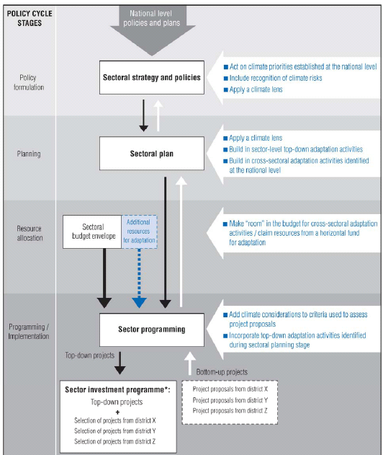

Slide 141
National Priorities
Improving the coverage and quality control of climate monitoring data. Commissioning national-level assessments of climate change impacts, vulnerabilities and adaptation options;
Moving the co-ordination for adaptation into powerful central bodies (Office of the President or Prime Minister or planning agencies);
Including considerations of climate change risks within long-term visions, PRSPs and SD plans;
Making an economic case for adaptation through horizontal funds for the incorporation of adaptations in policies, plans and programs (OECD, 2009)

Slide 142
Sectoral Priorities I.
Carrying out an assessment on sector-specific impacts and vulnerabilities;
Raising awareness among both sectoral planners and donor agencies of the implications of climate change in specific areas;
Boosting in-house capacity within sectoral ministries and donor agencies to better evaluate the implications of climate change;
(OECD, 2009)

Slide 143
Sectoral Priorities II.
Reviewing sectoral regulations based entirely on historical climate information– such as more frequent updating of the climatic baseline (e.g. in water resource management);
Collecting better information on the costs and benefits of adaptations so that decision makers can factor such information into their decision- making;
Making ”room” in the budget for adaptation responses identified in the context of cross-sectoral plans, or claiming resources from a horizontal fund for adaptation.
(OECD, 2009)

Slide 144
Integrating the Adaptation Strategy into National Plans
Proper scientific assessment and a better understanding of climate change impacts and risks represent the first step towards developing an adaptation policy to tackle potential effects of climate change.
This requires capacity- building in the field of scientific assessment of the vulnerable sectors and fragile ecosystems, and the provision of the necessary financial resources to carry out this mission.
According to various social circumstances as well as the economic and political environment in the country, appropriate measures and mechanisms are developed to integrate these policies into national plans.
Notes:
Mainstreaming climate change adaptation is not, however, an easy exercise.

Slide 145
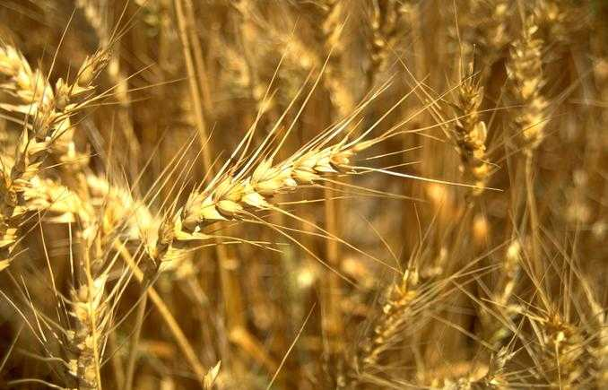
Example: Integrating adaptation into agricultural policies in Syria
Agricultural policies in Syria concentrate on achieving self-sufficiency in wheat and considering it a strategic crop. To achieve this, the following has been accomplished:
Wheat irrigated and rain-fed areas have been expanded,
Wheat is being marketed exclusively by the state,
Modern irrigation techniques have been adopted to save water,
A fund has been established to help farmers cope with crop failure due to drought,
New drought-tolerant varieties are developed and the cultivation of local breeds is encouraged.

Slide 146
Communicating Adaptation Options
Priority adaptation options must be delivered to the masses and target groups including decision-makers.
Learned lessons and knowledge, especially local (inherited practices and information) must be disseminated and technology transfer should be encouraged.
Focal points have to be expanded and appropriate messages have to be transmitted.

Slide 147
Communicating Adaptation Options
The options identified need to be communicated in a language that speaks to the target audience.
Communication also helps in collecting knowledge from the experiences and practices of at-risk groups, including traditional knowledge.
Communication could also be used to motivate, support and ensure that skills of policy-makers and leaders at the local level are improving on these issues.

Slide 148
Dissemination of Information
Ensure you have a good distribution network
Ensure your distribution list matches your target audience and update it if needed.
Consider different ways of distributing your strategy
Keep thinking about distribution long after your product has been produced (even if it is hard to do so)

Slide 149
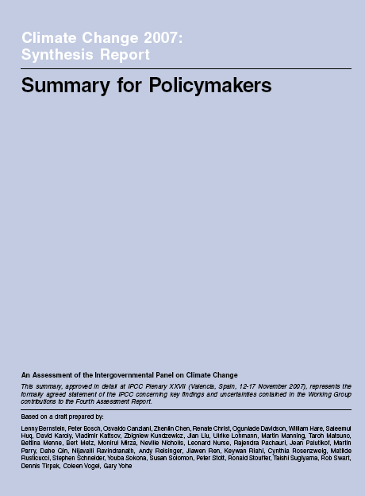
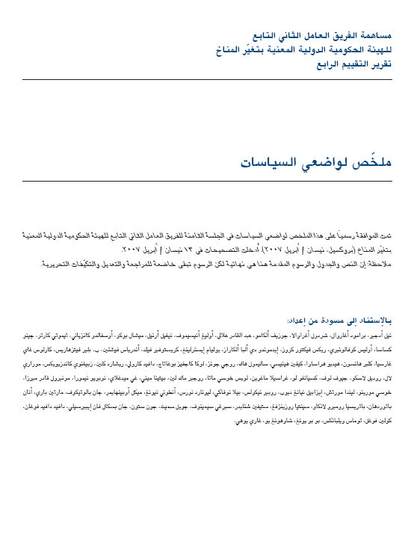
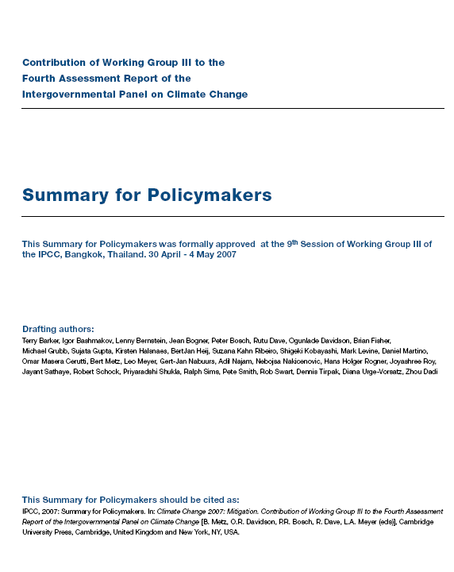
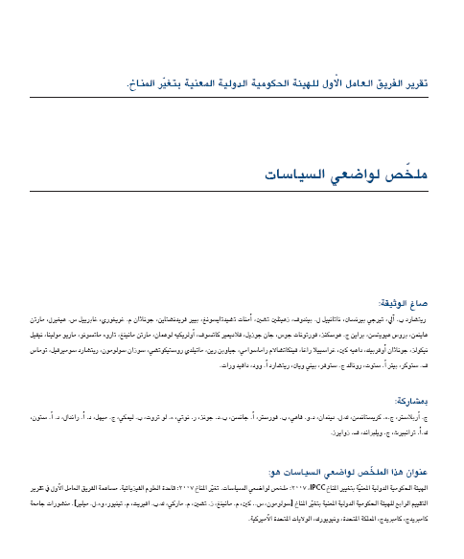

Slide 150
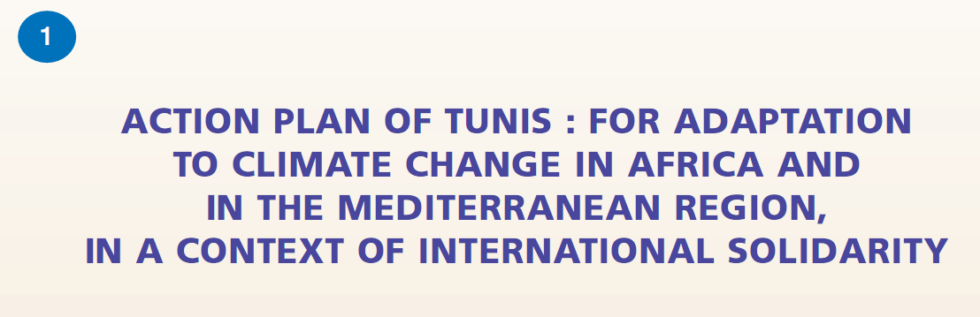
The 2007 Arab Declaration on Climate Change
The 2008 draft Arab Framework Action Plan on Climate Change
A STRATEGY OF CLIMATE CHANGE ADAPTATION NETWORK
FOR WEST ASIA 2009

Slide 151

Human Development Report
2007/2008
Combating Climate Change
Human Solidarity in a divided world

Slide 152
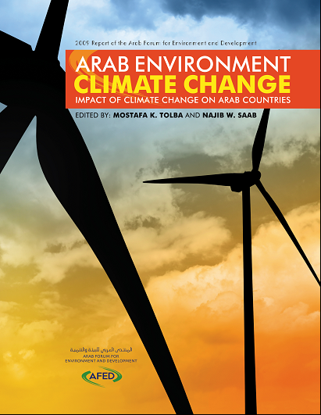
http://www.afedonline.org/afedreport09/Full%20English%20Report.pdf

Slide 153
Exercise 6: Developing an implementation plan
Build on the priority adaptation options from the previous exercise and outline them in a policy relevant manner
Use a simple scale to estimate costs of adaptation options compared to cost of inactions to help justify the need for actions. (For example investing into restoring coastal ecosystems and building a dyke will cost less than the last two flood damages)
Create an overview of key priorities on a road map that you would need to undertake to implement the identified adaptation options
Identify capacity gaps that are needed to be developed for the successful implementation of the identified adaptation policies

